Slide 1
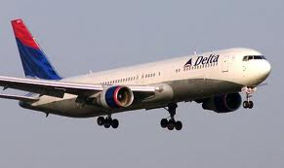
Fly America Act

Slide 2
Basics
All foreign air travel that is paid on federal funds must be accomplished through U.S. flag carriers.
Alaska Airlines (AS)
American Airlines (AA)
Continental Airlines (CO) *merged with United 2012
Southwest Airlines (WN)
United Airlines (UA)
USAirways (US)
Delta Airlines (DL)
Frontier Airlines (F9)
Hawaiian Airlines (HA)
JetBlue Airways (B6)
Midwest Express (YX)
Spirit Airlines (NK)
Virgin America (VX)
Airtran Airways (FL)

Slide 3
There are very limited exceptions to this.
U.S. flag air carrier cannot provide the air transportation needed
An Open Skies Agreement Exception applies, and traveler has confirmed the Open Skies Agreement has not been nullified by the existence of a City-Pair Agreement.
No U.S. flag air carrier provides service on a particular leg of your route (Travelers can only use foreign air carrier to or from nearest interchange point to connect with a U.S. carrier.)
A U.S. flag air carrier involuntarily reroutes traveler on a foreign air carrier.
Service on a foreign air carrier is three hours or less, and use of U.S. flag air carrier doubles en route travel time.
Air travel is between the U.S. and another country and use of a U.S. carrier on a nonstop flight extends travel time by 24 hours or more.
Use of a U.S. carrier increases the number of aircraft changes outside the U.S. by two (2) or more.
Use of a U.S. carrier extends travel time by six (6) hours or more.
Use of a U.S. carrier requires a connecting time of four hours or more at an overseas interchange point.

Slide 4
Example of an allowable flight:

Slide 5
Example of an unallowable flight:

Slide 6
This is okay:
DL Delta
Flight 9447
Operated by KLM
This is not okay:
AF Air France
Flight: 9693
Operated by: Alaska Airlines or
AF Air France
Flight: 309

Slide 7
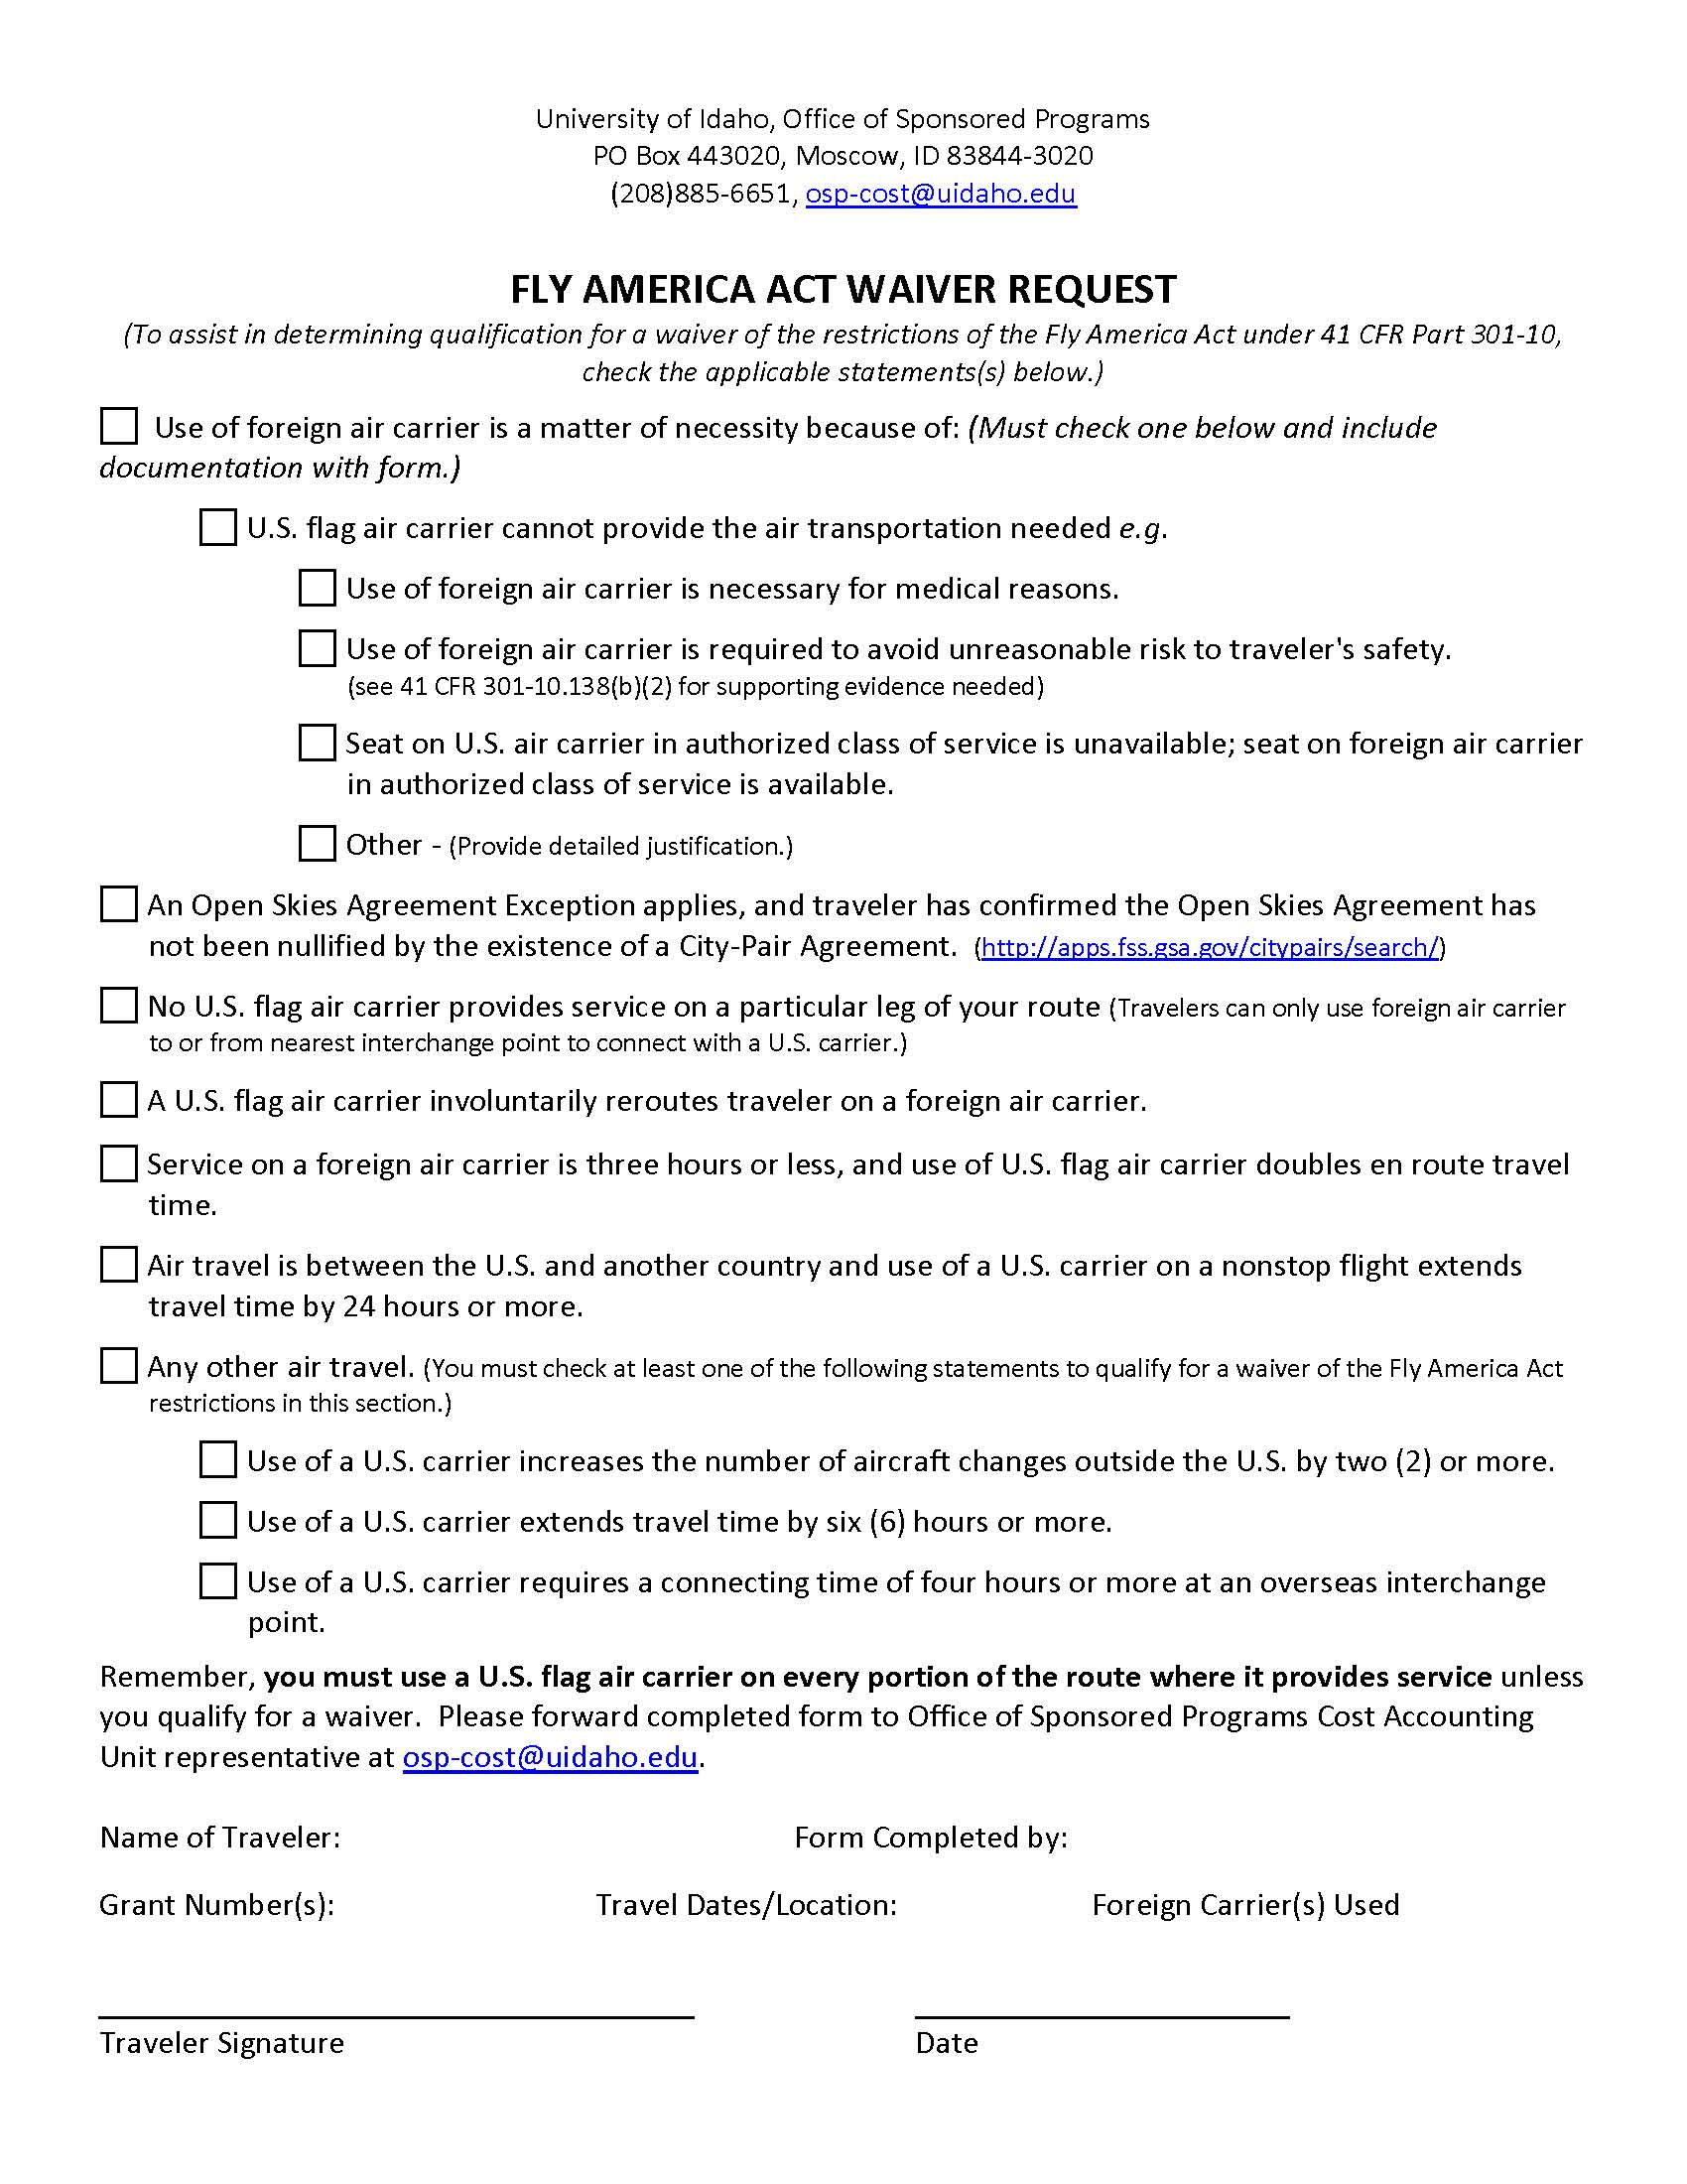
Fly America Act Waivers found at http://www.uidaho.edu/osp/award/Copy%20of%20flyamericaact

Slide 8
When to use a waiver
When booking the flight it is found that a U.S. flag carrier is not available for some part of the trip .
Before the trip is actually booked.
If during the trip an extenuating circumstance takes place.
OSP will only accept waivers that conform to the above.
All waivers must have back-up documentation attached.

Slide 9
Open Skies Agreement exception
A new wrinkle to Fly America Act.
U.S. and European Union
U.S. and Australia
U.S. and Switzerland
U.S. and Japan
City-Pair agreements (if one exists cannot use this exception) http://apps.fss.gsa.gov/citypairs/search/
For more details http://www.gsa.gov/portal/content/103191

