Slide 1
How to be considered as a Peer Reviewer for programs administered by The Department
U.S. Department of Education (Department)

Slide 2
Benefits of Being a Peer Reviewer
An excellent professional development opportunity
Serve the education community
Exposure to innovative ideas in education
Make recommendations to the Department of which projects to fund

Slide 3
Peer Reviewer Selection and Requirements
Selection
Each Department program selects its own reviewers based on the expertise needed specific to a grant competition
  Example programs: (1) Education Innovation and Research and (2) Magnet Schools Assistance
If a reviewer is interested in a specific program, then he or she should look for that specific program’s call for reviewers
  The Department put a notice in the Federal Register in March 2020 entitled: “Peer Review Opportunities with the U.S. Department of Education’s Office of Elementary and Secondary Education, Office of Postsecondary Education, and Office of Special Education and Rehabilitative Services”
Requirements
Department program specific expertise
Possess (1) high-standards of analysis and evaluative writing as well as (2) objectivity when assessing grant applications
Must be able to put in the necessary time for (1) reviewer training and (2) review period
Ability to work independently and as a member of a team
Access to a phone, email, computer, the Internet, and the G5 grants management system

Slide 4
WORKING with THE G5 –
Grants management SYSTEM
4 Step Registration process to be considered as a potential Department peer reviewer

Slide 5
4-Step Registration Process
Registering With G5
Activating Your Account
Logging into G5 - Two Factor Authentication
Editing Your Reviewer Profile

Slide 6
Step 1: Registering with G5
Go to www.g5.gov
  Click the Sign-up link
  You will then be moved to the registration screen
Registration* screen
  Enter the fields marked by a red asterisk (do not include dashes in phone numbers, do include your area code)
  Enter a valid email address
  Click the Continue button
Terms and Conditions Screen
  If you agree to the terms listed, select the Agree radio button and click the Submit button.
Activation Link
  An account activation email will be sent to the email address you provided
  Click on the link provided. You will then be taken to G5 to activate your account.
*If you have previously registered in G5 you do not need to register again. Once you register, G5 retains your information for consideration in future years, and you may go into and update your reviewer profile.
Internet Explorer is the optimal browser for G5.
Should you need assistance, contact the G5 Helpdesk at (888) 336-8930.

Slide 7
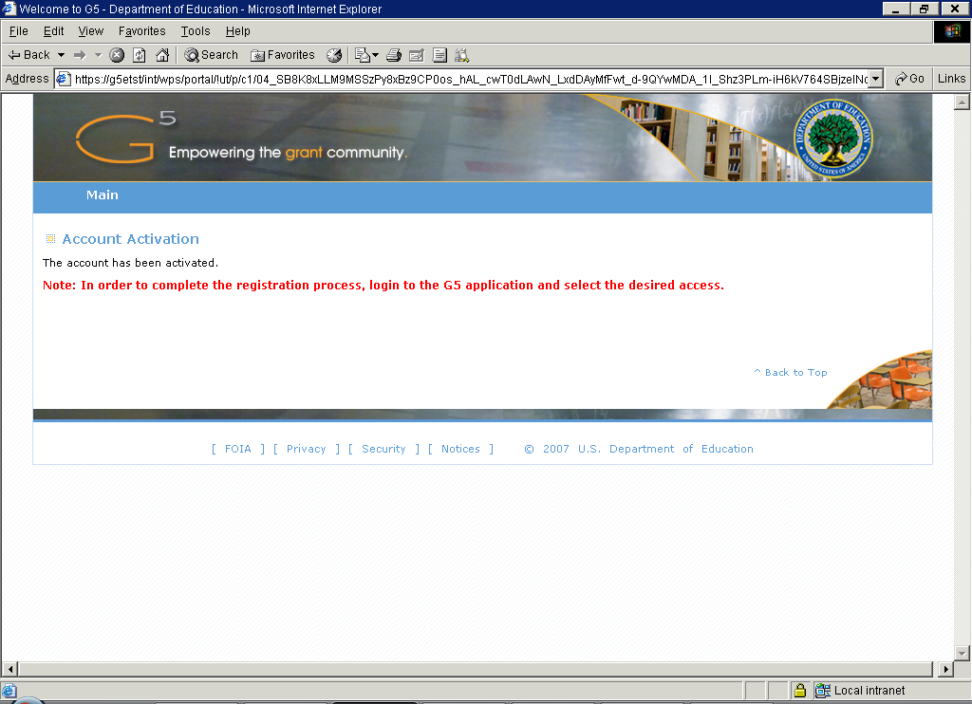
Step 2: Activating Your Account
Please read the user agreement, click the Agree radio button to acknowledge your compliance, and click the Submit button
Read the G5 User ID and Password Memorandum and click the Continue button
Enter the required fields and click the Continue button to finalize your activation
Click the Activate button to confirm the information you have entered and activate your account

Slide 8
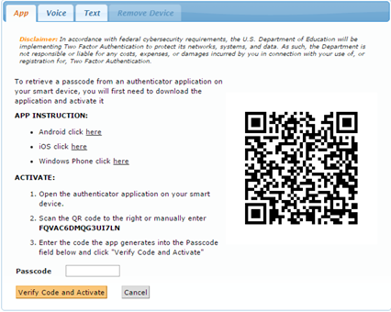
Step 3: Logging into G5
Go to www.g5.gov
  After entering your Email ID and Password, you must check the box indicating that you accept the Department’s terms for using G5
  Then click the Login to G5 button
    You will have to check the Yes, I Accept the Terms checkbox each time you log into G5
Two Factor Authorization
  You will have one of three ways to retrieve the unique code needed to complete the G5 log-in process:
    App: Use an authenticator application on your smart device (click on the hyperlink for your specific mobile device to get instructions)
    Voice: Receive Voice Call-Back
    Text: Receive SMS Text
  Use only one of the three options to retrieve the unique code necessary to log into G5
  You will need to enter the 6-digit code generated into the Passcode field in G5
    The authentication code is only valid for 30 – 60 seconds. If you do not enter the code in time, you will need to enter the next code that appears

Slide 9
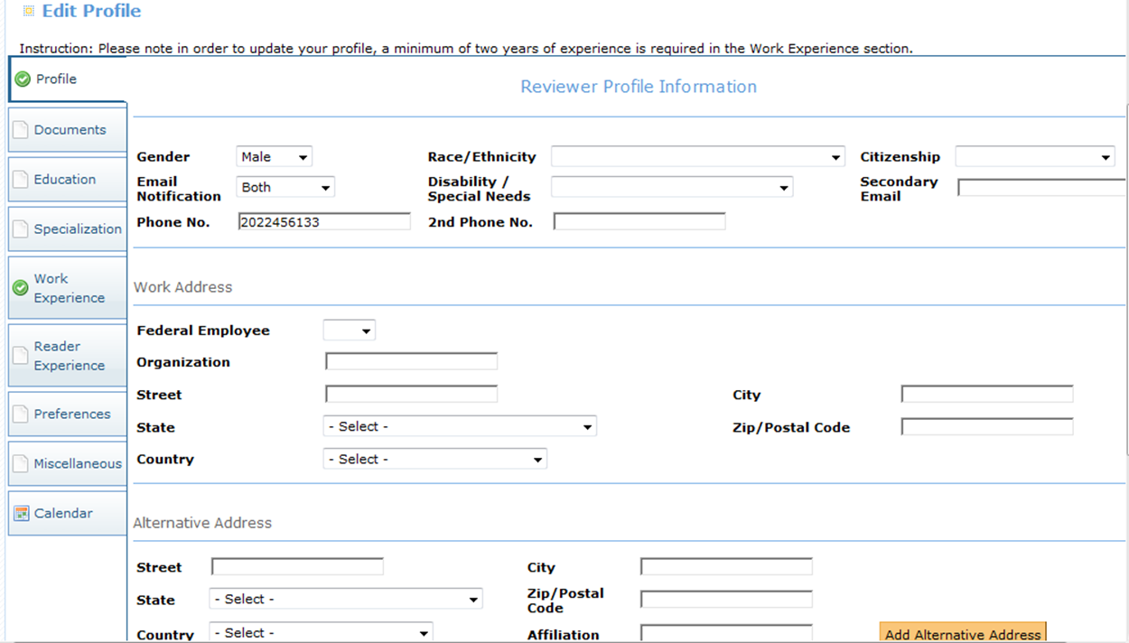
Step 4: Editing Your Reviewer Profile (part 1)
Once you have completed the Two Factor Authorization Log-in process, you will be directed to My Profile where you will need to select an available type of access
  In this case you will select Reviewer and click the Continue button

Slide 10
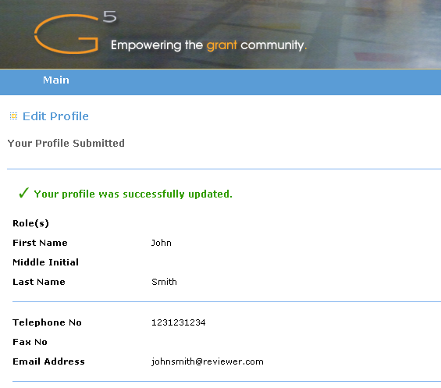
Step 4: Editing Your Reviewer Profile (part 2)
You must upload a resume on the Documents tab
  All uploaded documents must be in a PDF format
You must also enter a minimum of two years of experience on the Work Experience tab
All other fields are optional
  However, it is encouraged that you include the following in your profile: Specialization, Reader Experience, and Preferences*
After review, click the Submit button to request reviewer access
You will receive a confirmation message, like the one below, indicating your profile was successfully updated
  The resume is now available to ED program staff to consider for a competition
You will need to log out and allow some time for your request to be processed
*For what Department grant competitions the reviewer wants to serve.

Slide 11
Other Helpful Resume Hints
Cite prior grant experience, i.e. writing, administering, evaluating, or reviewing
Be sure resume is complete, spell out abbreviations, and include dates
Keep it concise – suggest 2 pages, no longer than 5 pages
Highlight professional accomplishments and specific experiences

Slide 12
Final Points
Each Department program selects its own peer reviewers based on expertise needed specific to a grant competition
Individuals selected to be a peer reviewer will be contacted by the program office
Neither submission of your resume or registering in G5 guarantees that you will be selected to be a peer reviewer
If you have peers you would like to recommend that may be interested in being Department reviewers, please provide them this resource toolkit
Relevant pages where new potential reviewers should go are below:
  www.g5.gov
  ED.gov
  https://www.federalregister.gov/documents/2020/03/02/2020-04148/peer-review-opportunities-with-the-us-department-of-educations-office-of-elementary-and-secondary
  https://www2.ed.gov/documents/peer-review/peer-reviewer-toolkit.pptx
  Grants.gov

