Slide 1


Fall 2023
Student Organization Funding for Clubs and How to Use it

Slide 2
Club Funding Sources
SBA Funds
Donations
Fundraising
Each semester the president of each student org will submit the Org Registration and Allocation Request Form
SBA leaders considers the club’s past events and the proposed events; makes recommendation to the Associate Deans of Students
ADSAs will make allocations considering the request form, SBA recommendation, and available funding.
Not on EAF (specific use or club)
Must go through Foundation
10% charge upon deposit

Slide 3
Other Considerations (Bank Accounts)
Per the University of Idaho College of Law uniform budget system section 4(f):
  Any student organization that holds money outside of the University of Idaho after June 30, 2015, will not be recognized or eligible to receive funds from the student bar association.
Please see the Fiscal Officer or the Student Services Manager if your club currently has an outside bank account.

Slide 4
SBA Funds
Each club must submit the Student Organization Registration & Allocation Request Form
  Fall 2023 forms due to Student Services Manager by Tuesday, Sept. 5.
  This will be sent out following completion of Money Matters training
If you run out of money allocated to your organization for the semester but have another expense, the club treasurer may submit a Supplemental Request for events.
  Each club will receive a copy of this request form in their allocation email from the ADSAs.
If you do not have funds in your SBA Account, the club treasurer must go through the Supplemental Request process.
It is the required job of the club treasurer to account for expenditures that have occurred.
Staff can provide you with number accurate to 1st of the previous month.

Slide 5
Other Considerations (Cash Box)
Coordinate with the Student Services Manager.
Cash box is available upon request including $50 in cash box funds to assist in cash payments for events or fundraisers. You may have to make your change.
The request must be made 5 business days prior to the event (hard deadline) and the designated cash must returned the next business day.
A cash box without designated cash box funds can be provided within one business day of the event.
The designated cash box funds will be required to be signed out by the club Treasurer and the club Treasurer will be personally responsible for its return.

Slide 6
Funding Approval Process (EAFs)
Funding Approval Requests are submitted via Qualtrics Survey
  Group Treasurers will be given access to the survey
The survey must be filled out & submitted by the Club Treasurer 10 days before event/spending.
We will review and get back to you as quickly as possible however same day approval is unlikely. We work to review things in a timely manner but know approval can take a few days.
You will receive a copy of the survey to your email. A separate email confirmation from the Finance Team will be sent once your request has been reviewed and approved.
The form is required to be completed and fully approved prior to any funds being used, through reimbursement, invoice/billing, etc. to ensure funding.
  Funding Approval Requests submitted after the event or meeting are subject to College of Law Dean direct review/approval.
Must be a program that has a valid educational and/or business purpose.
Notes:
NO EAFS should be provided directly to the Administration Office staff. All EAFS should be routed through the SBA Treasurer and/or Sande Schlueter.
SBA allocated funds – directly to SBA Treasurer
Group fundraising/gift funds – directly to Sande Schlueter

Slide 7
Available Payment Types
Reimbursement
Invoice
This is where personal funds are used and reimbursed after the purchase has been made
An approved Funding Approval Request must be on file before the purchases are made.
WARNING- Not all items are reimbursable, so you use this option at your own risk
The Funding Approval Request must have CoL Asst. Fiscal Officer approval before any personal funds are used. She will hold the EAF until the reimbursement forms and receipts have been received from the Club Treasurer.
Funding Approval Requests submitted after the event or meeting are subject to College of Law Dean direct review/approval.
This is reserved for when an invoice is specifically requested by the business providing the goods or services.
The Invoice process can take up to 30 days to process
You must provide a W-9 from the organization or entity to be eligible for invoicing
You may request the W-9 process by sending the vendor name and email contact information to the Student Services Manager at law-eaf@uidaho.edu.
Notes:
University has restrictions on what can and cannot be purchased with a university pcard. Contact Sande with questions.
Online purchases can be made with a pcard (depending on what is being purchased); but will not be tax exempt.

Slide 8
Purchasing Cards are no longer allowed to be
‘checked out’
Beginning Summer of 2023, Purchasing Cards are no longer an option for any purchase that requires “check out” of the physical card.
Fiscal staff are not allowed to check out their purchasing cards to anyone.
This applies to all departments on campus (not just student based).
If you think your purchase could be made with a P-Card remotely (such as online or over the phone), please include those details on the additional information part of the Funding Approval Request. We will do our best to work with your group while we navigate this limitation.
  This is limited – most places can’t/won’t do tax-exempt online and we cannot have tax on our P-Cards.

Slide 9
Other Considerations (University Resources)
If you need to use the services of a University of Idaho entity, funds can be transferred under the INVOICE payment option.
    This will require accounting index information. Include as much detail as possible on your Funding Approval Request and we will work with you if this is an option.
    Indexes are not provided directly to Student Orgs rather we will complete the process with the department needing that information
    This option works fabulous for the VandalStore!
Example- There is a setup fee to use rooms in other buildings on campus. The EAF would be submitted for the event and a transfer of funds can be coordinated.

Slide 10
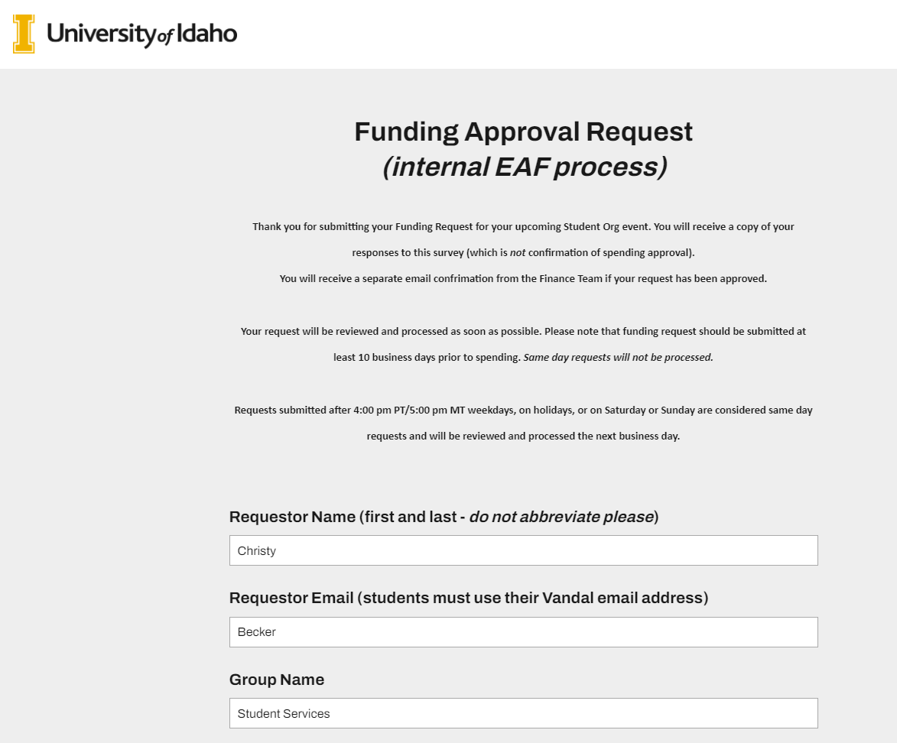
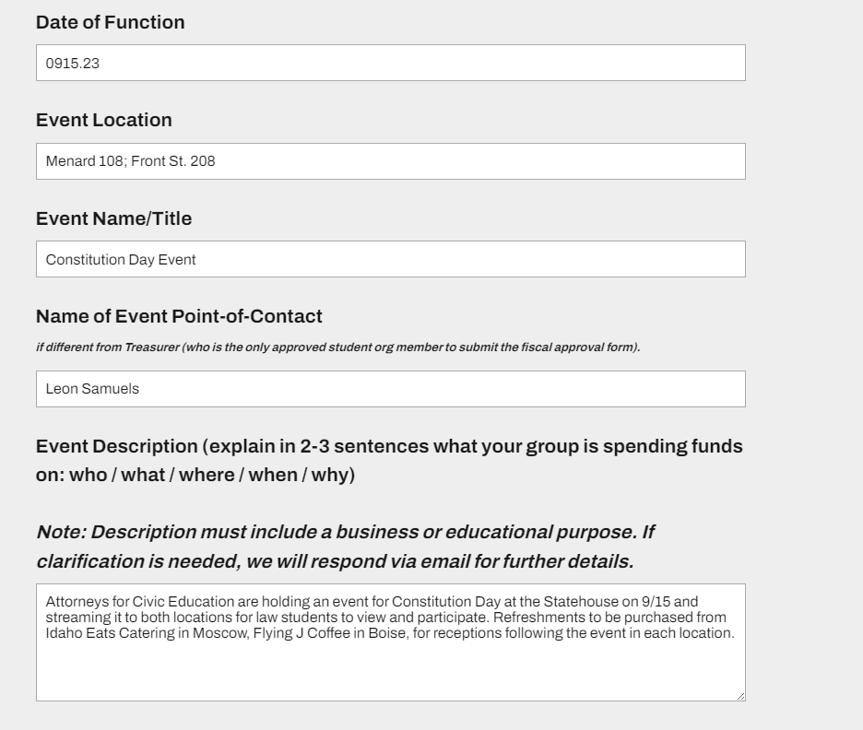

Slide 11
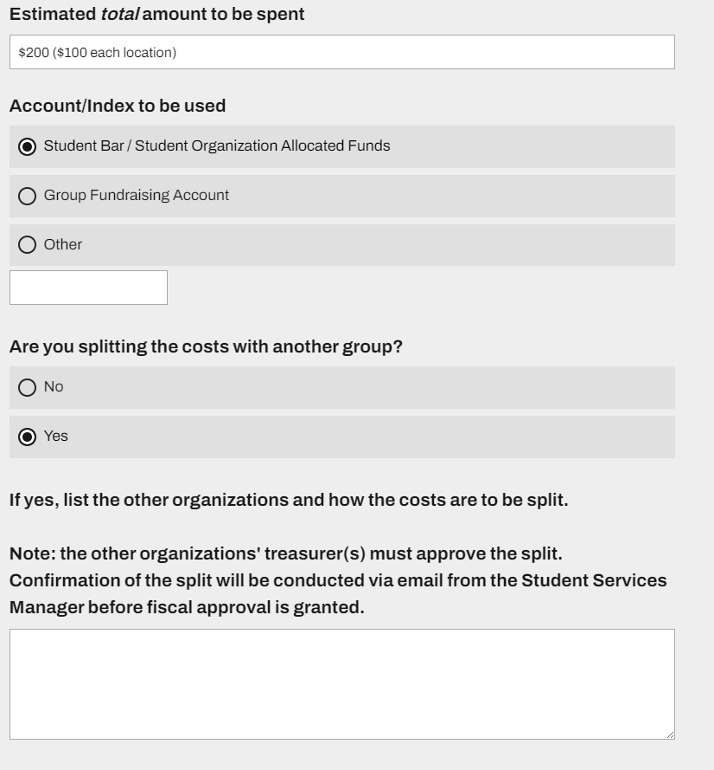
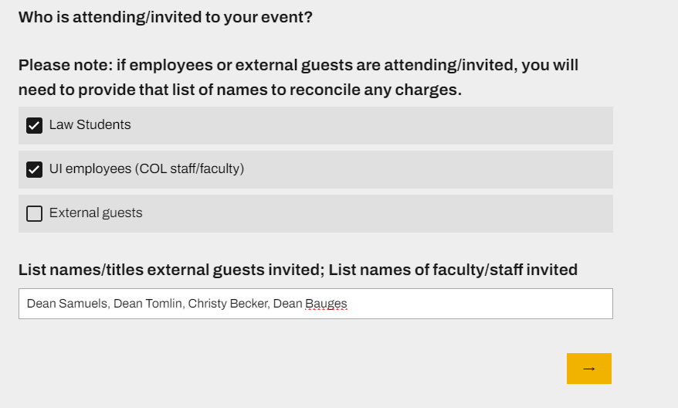

Slide 12
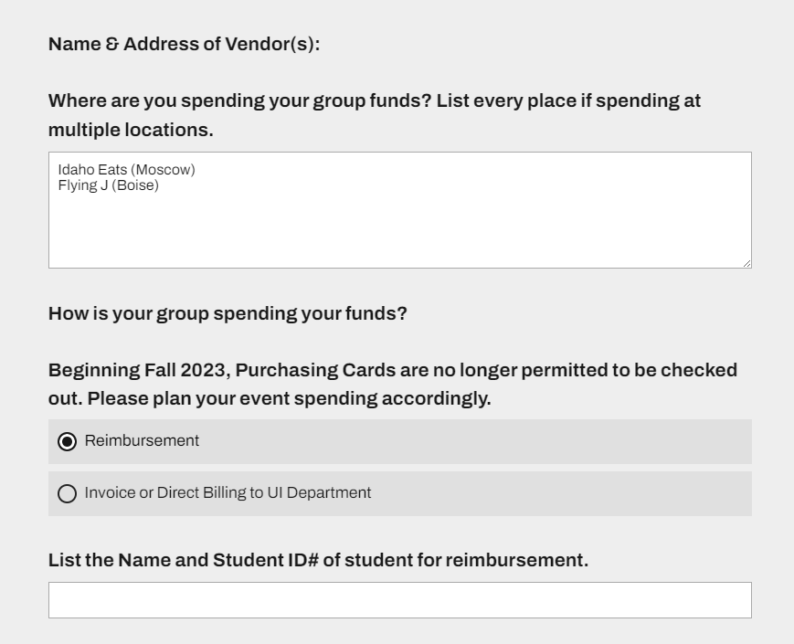
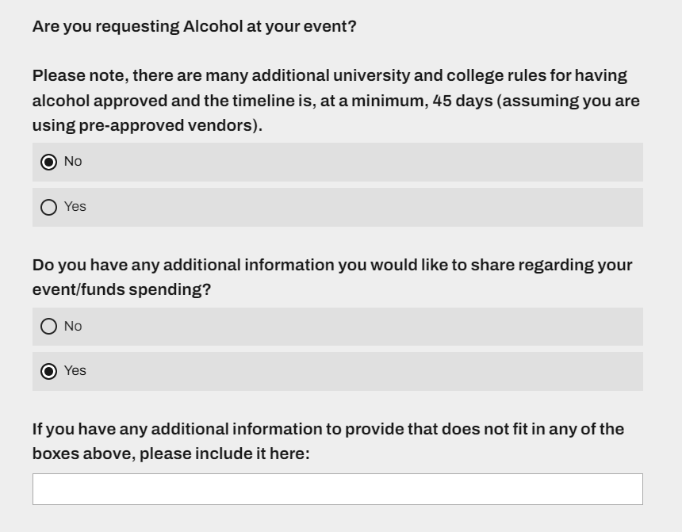
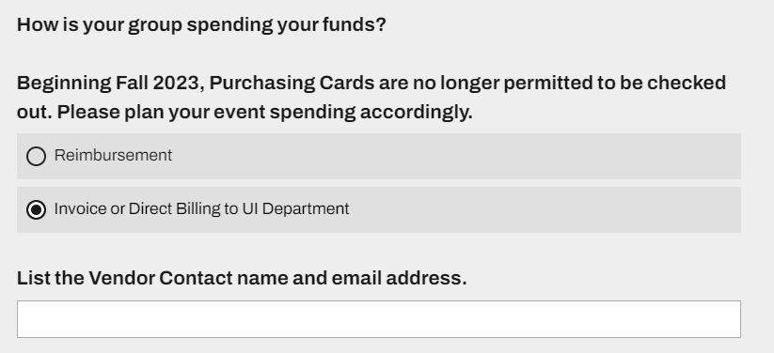

Slide 13
EAF and Special Circumstances
TRAVEL- If you are using funds for travel (student, faculty or staff event participants, or non-employee guest speakers), please contact the Student Services Manger before submitting the Funding Approval Request (EAF). There are special requirements/policies/procedures for travel.
JOINT CLUB EVENTS- If you are doing an event with multiple clubs, the participating clubs can either split the funding or transfer funds from club to club. This should be included on the Funding Approval Request – approval must be confirmed by each group treasurer via email to law-eaf@uidaho.edu before event spending will be approved.
GIFTS- If your club is planning on buying any gifted items, discuss with the Student Services Manger before moving forward. There are many policies concerning gifted items that must be followed.
  GIFT CARDS may not be purchased with university funds.
Notes:
No groups have access to funds that can be used to purchase or reimburse for alcohol without obtaining prior permissions. Contact Law Events with questions.
All alcohol permits for student organizations require Associate Dean for Students approval. Be sure to meet with and discuss plans for the event. They are signing off on the permit on behalf of the College, who will be the sponsor of the event – not the club.
Alcohol permits take time to process and require paperwork from the vendor to be completed. Be sure to contact Law Events as early as possible to get this process started. Anything within 30 days of the event is difficult to get done and there are no guarantees the UI will approve.

Slide 14
Funding Approval Dos and Don’ts
Do
Don’t
Have the club treasurer fill out the Funding Approval Request survey
Ask questions if you’re confused
Submit at least 10 business days prior to the event for non-alcohol related events and 45 business days prior for alcohol related events
Answer the questions in as much depth and detail as possible
Send the old EAF to anyone
Seek funding approval from anyone other than the Student Services Manager
Leave fields empty on the form
Be vague
Request the use of SBA Funds for Alcohol, any gift items, or other cash equivalent items.
  UI Bookstore items are a special circumstance.

Slide 15
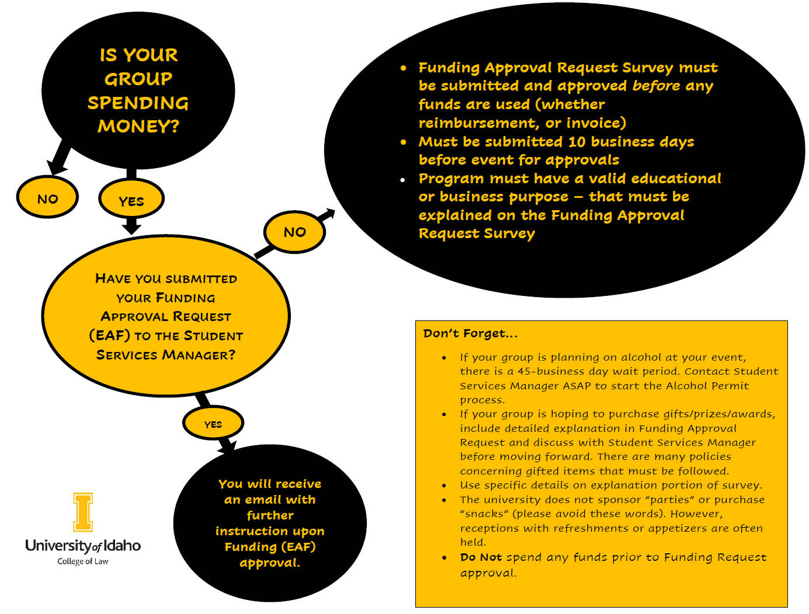

Slide 16
Alcohol Permits
Alcohol Permits must be submitted 45 business days ahead of your event. This is a firm timeframe. If you have any questions about this, please address them will the Student Services Manager.
When you submit an Alcohol Application, you must have an Approved EAF at that time.
There are many university rules and regulations when it comes to alcohol permits. These are approved only on a case-by-case basis and are required to be discussed with the Student Services Manager before going forward.

Slide 17
Contracts
You CANNOT sign a contract
All contracts must be sent to the Student Services Manager at law-eaf@uidaho.edu for processing
  Note: Contracts can take 2-3 weeks for processing through the purchasing office.
  Until the contract is signed, no payments will be made to a vendor. Keep this in mind if the contract outlines payment dates.
Please read through the contract. If there are payment dates, deadlines, etc. be sure to note that in the body of the email.

Slide 18
Finance Rules
All finance rules explained regarding funding, donations, bank accounts, etc. are based upon UI policies.
This also applies to Entertainment Approval Forms (EAF), Funding Approval Requests, and Alcohol Permits.
Every policy that the Student Organizations must adhere to, are policies all UI employees must follow as well.

Slide 19
Room Requests
Requests should be submitted at least 24 business hours in advance of the date needed. Same day requests will not be processed.
Cannot release designated make-up space to student groups until 7 business days prior to the requested/needed date. If requested, the request will be held or you will be notified as to why it cannot be processed.
All meetings should be included on the Room Calendars, including Zoom only meetings. This is to help ensure conflicting meetings or events are not scheduled.
Not all rooms are capable of connecting between locations. PLEASE check out the Law Technology page on what the rooms in each location can and cannot do.
For more information, Request a Room - College of Law - University of Idaho (uidaho.edu)
Notes:
Contact Sande Schlueter directly with questions about room reservations.

Slide 20
Common Issues
Asking Questions of someone other than the Student Services Manager or turning your Funding Approval Request into someone else
  The most likely outcome of this will be that you may receive incorrect information or the EAF may not be submitted properly and thus not approved.
Funding Approval Requests not being properly filled out
  Please pay attention to detail and ensure it is signed.
  Specific items need to be listed in the summary section. Descriptions like “Supplies” or “Gift For the Speaker” will be rejected for being too broad.
  A list of attendees for meetings or events must specify the names of any UI employee attending. The list is a University requirement.

Slide 21
Common Issues
If my club is doing a fundraiser, how can we deposit the funds in our account?
  A check can be issued to the University of Idaho College of Law with “SBA- (enter club name here)” in the memo line.
  All checks and cash can be provided to the Student Services Manger or the Fiscal Officer.
Timeline issues: follow the 10-day rule for EAFs and 45-day rule for Alcohol Permits. This allows time for the processing of these requests, and we cannot guarantee approval outside of these timelines.
Contracts. DO NOT sign a contract – no student or UI employee is allowed to sign a contract. There is an approval process for getting contracts signed and you must speak with the Student Services Manager if a contract is mentioned.

Slide 22
