Slide 1
Web Time Entry
Web Time Entry Summary Report
- Payroll

Slide 2
PWRWTES
Web Time Entry Summary Report

Slide 3
Purpose
Reduce the number of RPRs and Special Checks
Give better control to supervisors and time sheet keepers
Get time sheets through the system more…
  Quickly
  Efficiently
  Correctly
Benefits the employee, the department and payroll staff

Slide 4
To Get Access
If you don’t have access to PWRWTES in Banner
Email finacess@uidaho.edu

Slide 5
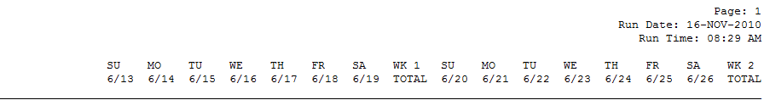
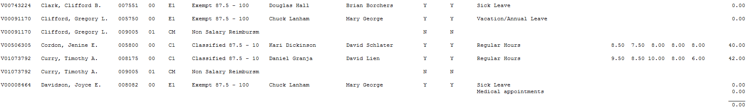
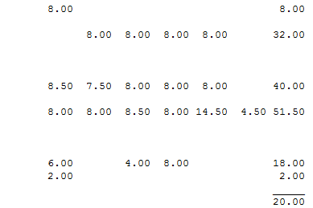


Slide 6
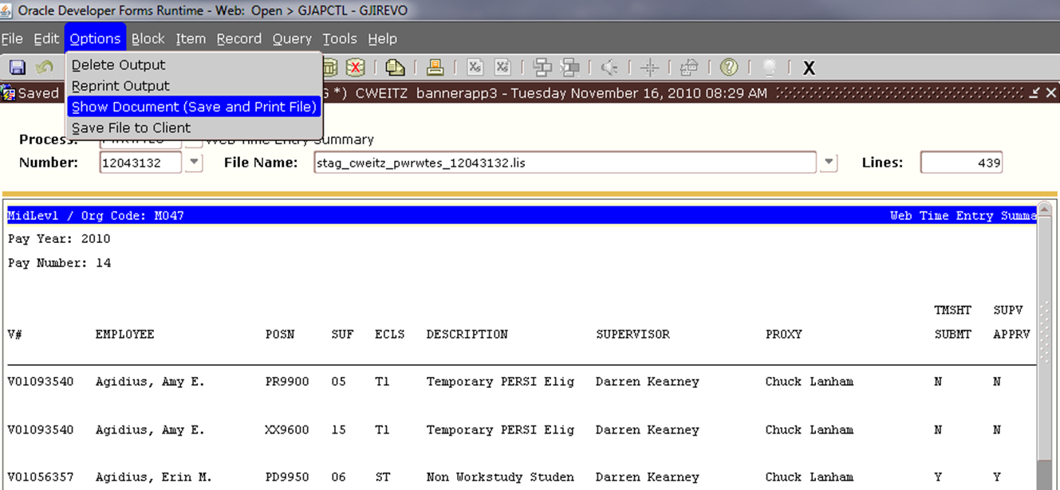
Using the .lis or Printing
How the report was intended to look
Prints on legal size paper

Slide 7
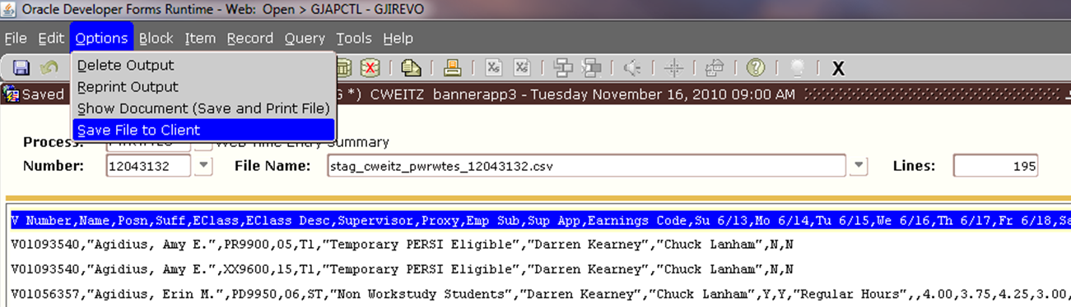
Using the .csv
Total columns may look different
Gives the ability to change the look by removing columns, etc.

Slide 8
How to make it work for you
Pull by Mid Level or Time Sheet Org
Pull/print everyday if needed
Track/monitor employees that need assistance and reminders to submit
Track/monitor supervisors or their proxy for approvals
Look for…
  Anyone who works or is using leave that totals more than 40 hours in one week
  Confirm holiday time is correct
  Confirm vacation, sick leave, etc. is correct

Slide 9
Questions?

