Slide 1



Slide 2
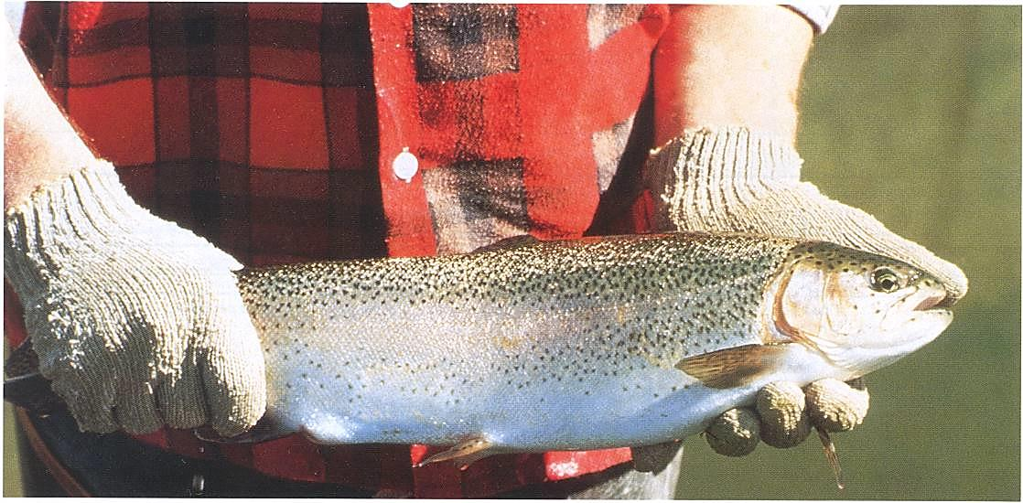
Seafood at Its Best
Lesson 1
What Is Seafood?
Notes:
Lesson 1: What Is seafood? (slide 2)

Slide 3
Lesson 1
Goals
Provide a brief introduction to the U.S. seafood industry
Participants will gain a better understanding of the large variety of seafood products available.
Notes:
Lesson 1 Goals (slide 3)
The goals of this lesson are to provide a brief introduction to the U.S. seafood industry and to increase participants’ knowledge about seafood. We hope this will lead to better informed consumers.

Slide 4
Lesson 1
Objectives
Increase knowledge of the following:
        What is seafood?
        Where does our seafood come from?
        Consumer preferences
        Future seafood supply and demand
Notes:
Lesson 1 Objectives (slide 4)
Lesson 1 will define seafood and provide an overview of the sources of our seafood supply. Consumption patterns and future seafood demand will also be discussed. Before we begin, I would like you to take a few minutes to complete the pretest.
Instructor: Pass out lesson 1 pretest.

Slide 5
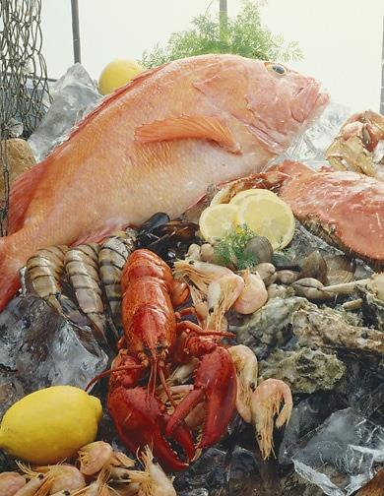
Definition of Seafood
Seafood includes freshwater and saltwater:
  Fish
  Molluscan shellfish
  Crustaceans
Commercially caught or
farm raised
Notes:
Definition of Seafood (slide 5)
Typically, when we think of seafood we think of fish from the oceans. However, seafood is much more than that. According to the Food and Drug Administration (FDA), seafood encompasses all commercially obtained freshwater and saltwater fish, molluscan shellfish, and crustaceans. Molluscan shellfish (or mollusks) and crustaceans are both commonly referred to as shellfish.

Slide 6
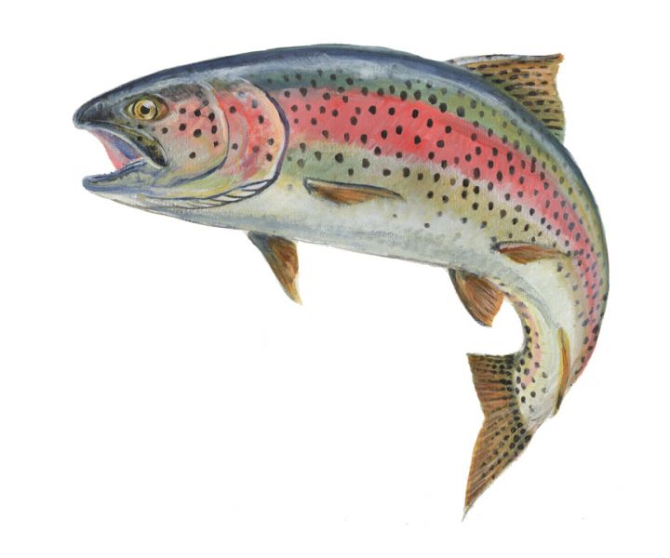
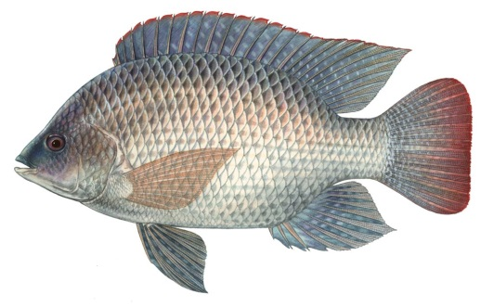
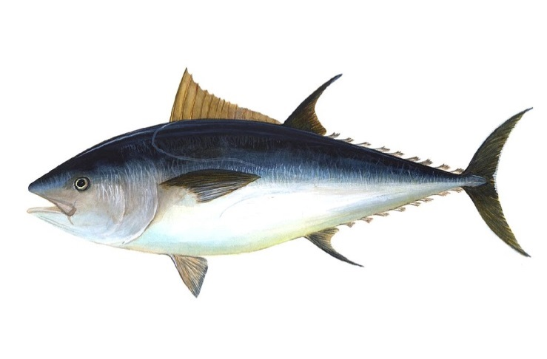
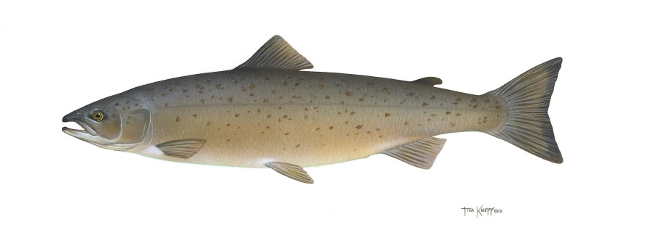
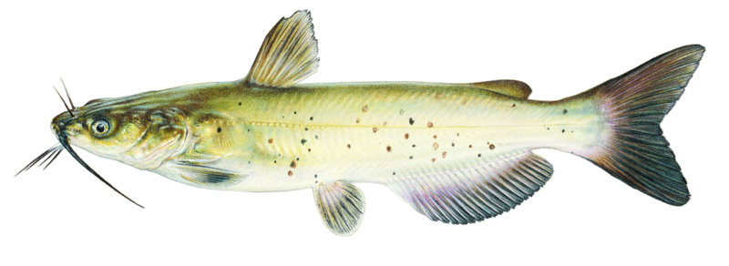
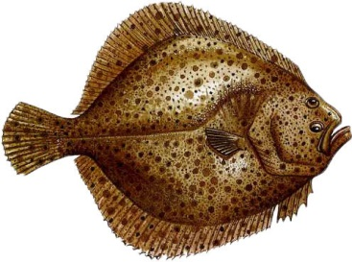
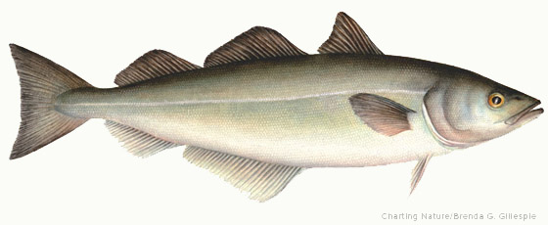
Fish
Aquatic vertebrates that have gills, fins, and usually an elongated body covered with scales
Rainbow trout, catfish, tilapia, flatfish, pollock, salmon, tuna
Notes:
Fish (slide 6)
Fish are aquatic vertebrates (animals with a backbone) having gills, fins, and usually an elongated body covered with scales. Rainbow trout, catfish, tilapia, salmon, flatfish, tuna, and pollock are fish commonly available for consumption. Catfish are one species of fish that do not have scales.

Slide 7
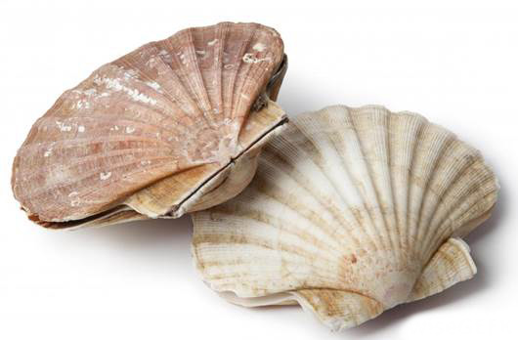
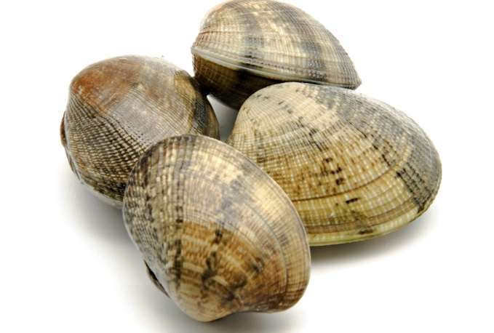
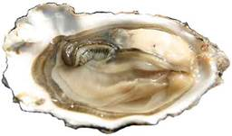
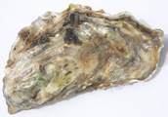
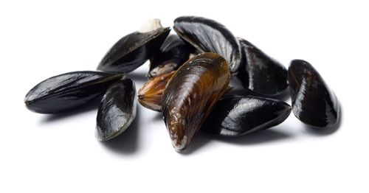
Molluscan Shellfish
Aquatic invertebrates characterized by a shell (sometimes lacking) of one or more pieces that wholly or partly enclose the soft, unsegmented body
Oysters, clams, mussels, scallops
Notes:
Molluscan Shellfish (slide 7)
Molluscan shellfish or mollusks are aquatic invertebrates characterized by a shell (sometimes lacking) of one, two, or more pieces that wholly or partly enclose the soft unsegmented body. Examples include oysters, clams, mussels, squid, and scallops.

Slide 8
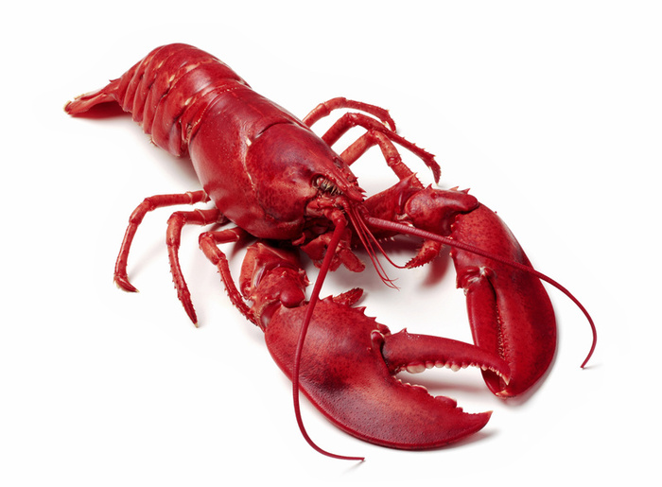
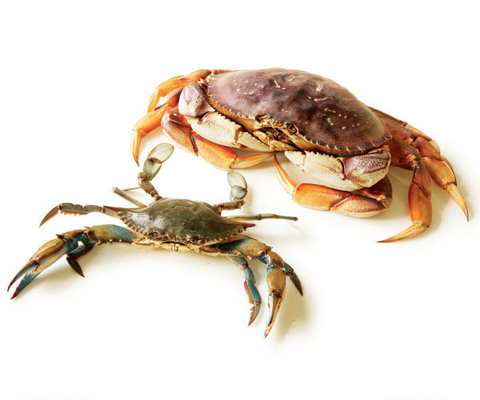
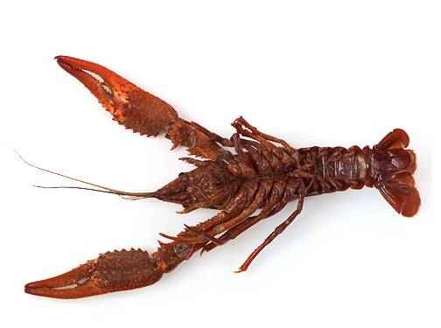
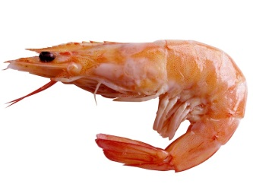
Crustaceans
Arthropod animals characterized by a hard, close-fitting shell that is shed periodically
Crabs, lobsters, shrimp, crayfish
Notes:
Crustaceans (slide 8)
Crustaceans, or shellfish, are arthropods (a group of animals that includes insects and spiders) characterized by a hard, close-fitting shell that is shed periodically. Popular crustaceans sold as seafood include shrimp, lobsters, crabs, and crayfish (also known as crawfish).

Slide 9
Imported Seafood
About 5.3 billion pounds of edible seafood is imported annually, which results in a $10.4 billion trade deficit
About 90% of seafood is imported
Imports are mostly from China, Thailand, Canada, Indonesia, and Vietnam
Leading seafood imports by value:
shrimp, lobster, salmon, canned tuna
Notes:
Imported Seafood (slide 9)
The U.S. is the world’s second-largest importer of seafood. According to the National Marine Fisheries Service, the U.S. imports about 5.3 billion pounds of edible product (average for years 2008-2012). Recently, imports accounted for about 90% of all seafood consumed in the country. U.S. seafood imports result in a trade deficit of about $10.4 billion annually (average for years 2008-2012). In 2012 the U.S. imported 5.38 billion pounds of edible seafood valued at $16,686,785,000 and exported 3.2 billion pounds of edible product valued at $5,464,394,000.
In 2011, the countries with the highest volume of seafood exported to the U.S. were China, Thailand, Canada, Indonesia, Ecuador, and Vietnam. Of all U.S. seafood imports, those with the highest value are shrimp, lobster, salmon, and canned tuna. China dominates the export of frozen tilapia fillets, whereas the majority of fresh tilapia fillets originate from Central and South America. The U.S. shrimp market is largely supplied by Asia and Central and South America. Chile, Norway, and Canada export salmon to the U.S. Pangasius*, a recent addition to the top ten seafood list, comes from Vietnam. Thailand supplies the majority of canned tuna and Canada is a major supplier of lobster.
*Pangasius is the scientific family name for certain types of freshwater catfish primarily found in Vietnam, Cambodia and neighboring nations. Market names include Basa, Tra, Swai and Sutchi. Pangasius is farm raised.

Slide 10
Aquaculture
Aquaculture (fish farming) – production of aquatic animals and plants under controlled conditions for all or part of the life cycle
Approximately 48% of world seafood supply comes from aquaculture
Common aquaculture species include:
rainbow trout, catfish, salmon, shrimp, clams and oysters
Notes:
Aquaculture (slide 10)
Aquaculture has become an increasingly important source of seafood. Aquaculture, or fish farming, is the production of aquatic animals and plants under controlled conditions for all or part of the life cycle. The propagation and rearing of aquatic species goes back several thousand years, but modern commercial aquaculture is a relatively recent phenomenon.
About 48% of the world’s seafood supply is now farm raised. Since 2000 aquaculture has accounted for worldwide growth in per capita supply as capture fisheries have declined. Between 1996 and 2011, world aquaculture production increased from 26.7 million metric tons to 63.6 million metric tons (58.9 to 140.2 billion pounds).
Aquaculture continues to be one of the fastest growing animal-food producing sectors in the world. Aquaculture will soon overtake capture fisheries as the primary source of seafood.
Common farm raised species available at restaurants and seafood markets include rainbow trout, catfish, salmon, shrimp, tilapia, clams, and oysters.

Slide 11
Notes:
World Seafood Production (slide 11)
The majority of the world’s seafood supply still comes from capture fisheries; however, it is predicted that aquaculture production will surpass capture fisheries in volume sometime during 2013. Total world capture fisheries production decreased from 93.5 million metric tons (mmt) in 1996 and to 90.4 mmt in 2011. Not all of this was used for human consumption. About 30% of capture fisheries production serves non-food uses (green bars on graph), such as fish meal and fish oil for animal feeds and industrial uses. The amount of capture fisheries used for human food consumption has averaged around 63.9 mmt during the same period (red bars). The total supply for human consumption is represented by the purple bars (aquaculture + capture; does not include non-food fish).
The largest capture fishery of edible product in the U.S. (and the world) is Alaska pollock. Alaska pollock is marketed as fillets, minced blocks, and surimi, a starting material for imitation crab meat.
World capture fisheries production, including food and non-food use, has stayed relatively flat over this period, strongly suggesting we have reached the limit of what can be harvested from the oceans and inland waters of the world. Since 1996, capture fisheries landings have ranged from 87.7 to 95.6 million metric tons per year (193 to 210 billion pounds). Fluctuations are mostly due to the anchovy fishery, which is used for fish meal and fish oil production, and not to any increases in overall edible seafood supply. As the world population continues to grow, expansion of the global seafood supply will not likely come from capture fisheries.
Overall, the trend for the world’s seafood supply shows a stagnation or decline in capture fisheries, accompanied by an increase in aquaculture production. Since 1996, world aquaculture production has more than doubled (dark blue bars). Increased aquaculture production will be necessary to supply the world’s increasing demand for seafood. The light blue line represents the percent of the world’s seafood for consumption due to aquaculture.
FAO – Food and Agriculture Organization of the United Nations

Slide 12
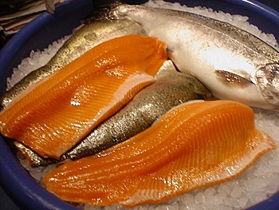
Advantages of Aquaculture
Steady supply
Consistent quality
Moderating prices
Uniform product size
Notes:
Advantages of Aquaculture (slide 12)
Aquaculture offers many advantages over capture fisheries. Unlike capture fisheries, which are typically seasonal, aquaculture production generally can offer a steady supply of product year round. A steady supply tends to moderate prices.
Due to greater control over feed and the culture environment, product quality is more consistent. Aquacultured animals are harvested when they reach market size and usually are size-graded to meet consumer demands. This ensures a more uniform product size.

Slide 13
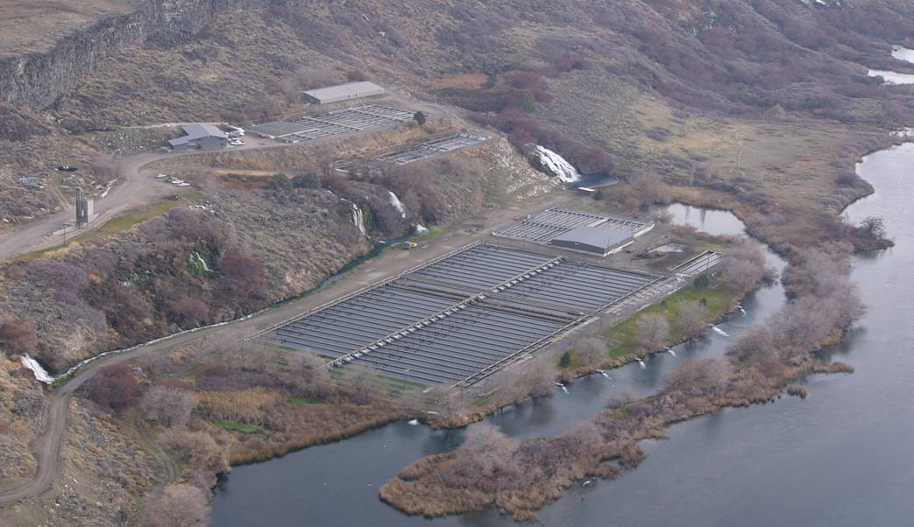
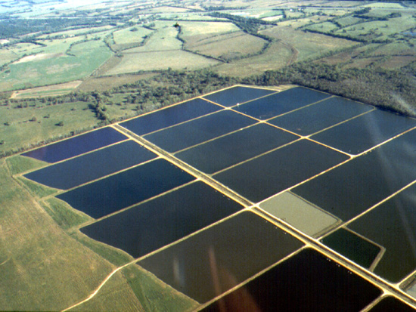
U.S. Aquaculture
High-quality, safe, wholesome, and affordable seafood
Farm-gate value of over $1 billion
Provides employment in rural areas
Notes:
U.S. Aquaculture (slide 13)
U.S. aquaculture supplies the American consumer with high-quality, safe, wholesome, and affordable seafood. Domestic aquaculture production supplied about 753 million pounds round weight of product in 2010, with a farm-gate value* of more than $1 billion. The majority of aquaculture production occurs in rural areas, where it is a key source of employment.
*Farm-gate value: ex-farm value; price the grower receives.

Slide 14
U.S. Aquaculture
Catfish
Catfish represents the largest domestic aquaculture industry in the U.S.
Approximately 300 million pounds produced in 2012
Leading catfish-producing states include Mississippi, Alabama, Arkansas, and Louisiana
Catfish are grown in earthen ponds and fed
grain-based feeds
Notes:
U.S. Aquaculture: Catfish (slide 14)
Catfish production dominates the domestic aquaculture industry by volume and value. The major catfish-producing states are in the South and include Mississippi, Alabama, Arkansas, and Louisiana. Catfish are grown in earthen ponds (typically 10 to 20 acres in size) and are fed grain-based feeds.

Slide 15
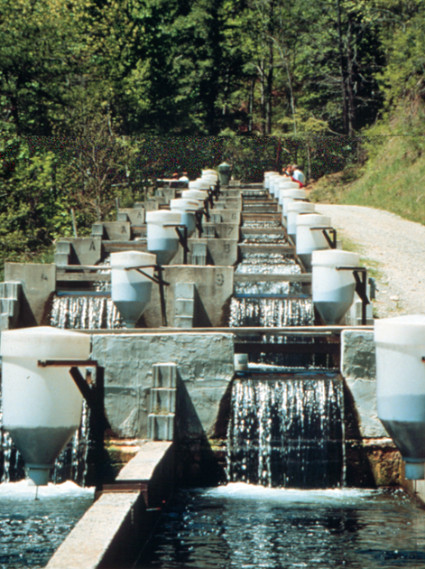
U.S. Aquaculture rainbow trout
Rainbow trout are grown both for the table and for stocking ponds
Produced in flow-through raceways
Rainbow trout are grown in numerous states
In 2012, 47.7 million ponds of market-size trout produced
Notes:
U.S. Aquaculture: Rainbow Trout (slide 15)
Rainbow trout are grown both for the table and for stocking recreational ponds. Rainbow trout usually are reared in flow-through raceways. Raceways are linear rearing units constructed from soil or concrete. Rainbow trout require cold, highly oxygenated water for optimal rearing conditions. Raceways receive a continuous flow of such water, usually from springs or streams.
Rainbow trout are produced in numerous states; however, most of the production occurs in Idaho.

Slide 16
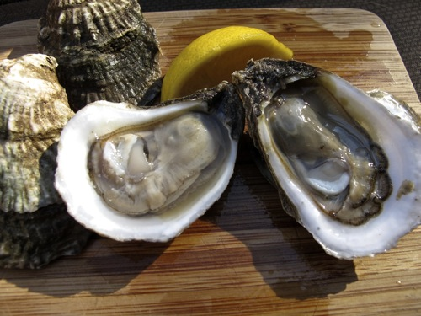
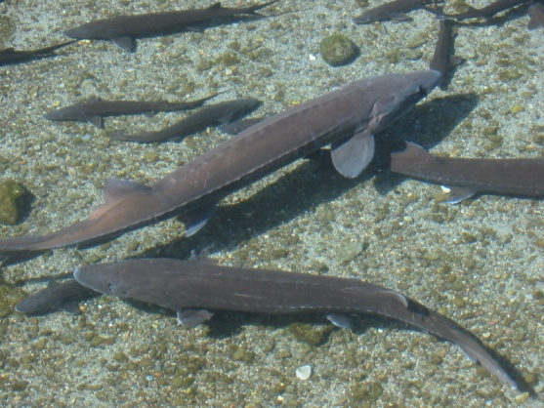
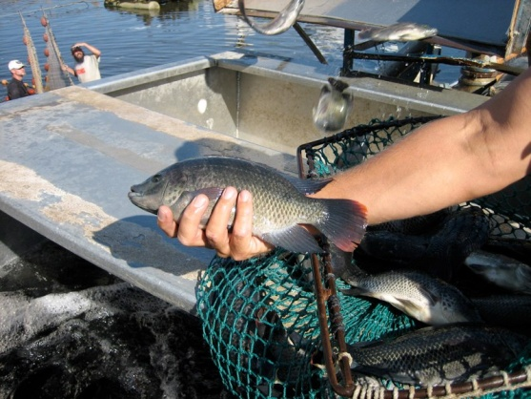
U.S. Aquaculture
Other Species
Other species grown for food include salmon, hybrid striped bass, tilapia, sturgeon, crayfish, shrimp, oysters, clams and mussels
Notes:
U.S. Aquaculture: Other Species (slide 16)
Several other species of aquatic animals are grown for food in the U.S. These include salmon, hybrid striped bass, tilapia, sturgeon, crayfish, shrimp, oysters, clams, and mussels.
Photograph left to right: oysters, sturgeon, tilapia

Slide 17
Notes:
U.S. Seafood Consumption (slide 17)
Americans ate a record 16.6 pounds per capita of seafood (edible weight) in 2004. This amount is still less than the recommended intake by the Dietary Guidelines for Americans 2010, which at a minimum would be 26 pounds per year. From 1990 to 2011 per capita consumption has averaged about 15.5 pounds per year (red line on the graph).

Slide 18
Top 10 Species Consumed
U.S. Per Capita (lbs.)
2001 |  | 2011
Species | Pounds | Species | Pounds
Shrimp | 3.40 | Shrimp | 4.20
Canned Tuna | 2.90 | Canned Tuna | 2.60
Salmon | 2.02 | Salmon | 1.95
Alaska Pollock | 1.21 | Alaska Pollock | 1.31
Catfish | 1.15 | Tilapia | 1.29
Cod | 0.56 | Pangasius | 0.63
Clams | 0.47 | Catfish | 0.56
Crab | 0.44 | Crab | 0.52
Flatfish | 0.39 | Cod | 0.50
Scallops | 0.35 | Clams | 0.33
Notes:
Top 10 Species Consumed in the U.S. (slide 18)
Because the seafood supply is still sourced from the wild the seafood industry changes from year to year as supplies of wild-caught seafood fluctuate. And consumer preferences can change too. Freshness/quality, taste, price and availability are typically the most important factors influencing consumers’ purchases of seafood. There are substantial differences between the 2001 and 2011 top ten species. Of particular note two new species, tilapia and pangasius, are in the top ten in 2011 that were not present in 2001. Both of these species are farm-raised. During this period tilapia consumption in the U.S. increased over 300%. Flatfish and scallops were not in the top ten in 2011. Between 2006 and 2011 shrimp, canned tuna, salmon, tilapia, and Alaska pollock were consistently in the top six. Catfish dropped to 7th in 2011. It is interesting to note how per capita consumption of these individual species fluctuated from year to year (graph below). Several factors can contribute to the variability observed, including changes in supply, contraction of an industry due to increased production costs and competition from imports, state of the economy, foreign exchange rates, and price.

Slide 19
Preferred Product Type
2011
Notes:
Preferred Product Types of Seafood Consumed in the U.S., 2011 (slide 19)
Per capita consumption of fresh and frozen product was 11.6 pounds in 2011. Fresh and frozen fish accounted for 6.3 pounds and shellfish accounted for 5.3 pounds. Consumption of canned seafood products was 3.9 pounds per capita. Consumption of cured (smoked fish for example) seafood products was 0.3 pounds per capita, the same amount per year since 1980.

Slide 20
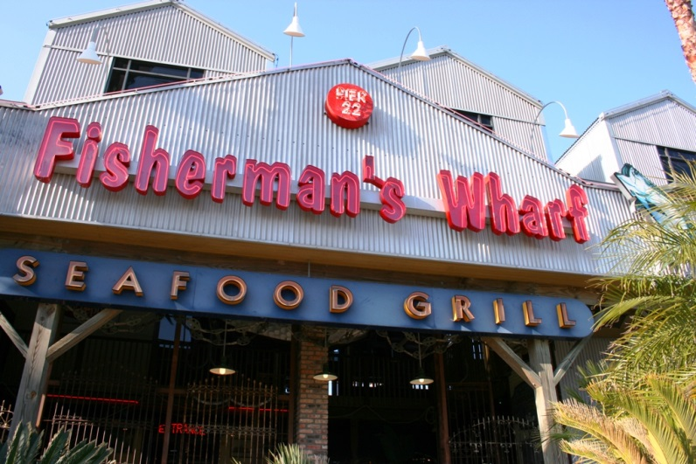
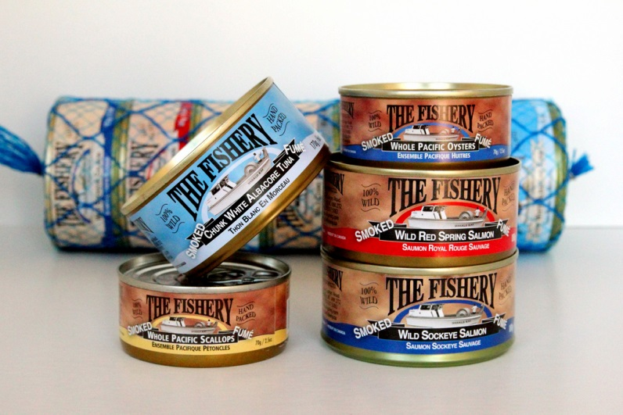
Where Do We Eat Seafood?
Americans eat most seafood away from home at food service establishments such as restaurants
Significant amounts of low-cost, familiar, or easily prepared items such as canned tuna, salmon, tilapia, and shrimp are consumed at home
“Fisherman’s Wharf” by Katharine Shilcutt
”Smoked Wild Canned Fish (The Fishery) by Renee S. Suen
Notes:
Where Do We Eat Seafood? (slide 20)
Americans consume most seafood outside the home, with out-of-home expenditures accounting for two-thirds of total seafood expenditures. When the economy is doing poorly seafood consumption decreases, because people eat out less often. Although significant amounts of low-cost, familiar or easily prepared seafood, such as canned tuna, salmon, tilapia and shrimp, are eaten in the home.

Slide 21
How Much Money Do We
Spend on Seafood?
In 2011 – $57.7 billion at food service establishments (restaurants, carry-outs, caterers, etc.)
In 2011 – $27.6 billion in retail sales for home consumption
Average household spending for in-home seafood purchases in 2011 was $117
Asian, African & Hispanic Americans; higher income; and older households spend more on seafood
Notes:
How Much Money Do We Spend on Seafood? (slide 21)
More than two-thirds of the money Americans spend on seafood was spent away from home at food service establishments such as restaurants, carry-outs, cafeterias/institutions, and caterers.
Average household* spending for in-home seafood consumption was $121 for 2011. Total retail sales were $27.6 billion in 2011, about 32% of total dollars spent on seafood. The market share between food service and retail has remained relatively the same over the past several years at a 67-70% to 30-33% split.
According to the U.S. Department of Labor, Bureau of Labor Statistics Asian, African and Hispanic Americans spend more money for in-home seafood purchases. In addition, those with higher incomes (generally more than $70,000 per year before taxes) and older households (35-64 years of age) spend more for in-home seafood purchases. Consumers in the northeast and west spend more for in-home seafood than those in the midwest and south.
U.S. Department of Labor, Bureau of Labor Statistics: http://www.bls.gov/
* The Bureau of Labor Statistics uses the term consumer unit. A consumer unit consists of any of the following: (1) All members of a particular household who are related by blood, marriage, adoption, or other legal arrangements; (2) a person living alone or sharing a household with others or living as a roomer in a private home or lodging house or in permanent living quarters in a hotel or motel, but who is financially independent; or (3) two or more persons living together who use their incomes to make joint expenditure decisions. Financial independence is determined by spending behavior with regard to the three major expense categories: Housing, food, and other living expenses. To be considered financially independent, the respondent must provide at least two of the three major expenditure categories, either entirely or in part.

Slide 22

Future U.S. Seafood Demand
USDA predicted per capita consumption would be 16 pounds by 2020
There is a potential need by 2020 of an additional
4 to 5 billion pounds
(round weight) to satisfy
demand
Notes:
Future U.S. Seafood Demand (slide 22)
Predicting future seafood demand is not an exact science. In the early 1990s, the USDA predicted that by 2020 per capita seafood consumption would be 16 pounds. Yet in 2003, per capita consumption already exceeded 16 pounds. It now is estimated, given projected population growth, that by 2020 an additional 4 to 5 billion pounds round or live weight of seafood will be needed to satisfy demand in the U.S.

Slide 23
Population Demographics Will Influence Seafood Demand
By 2020, 84 million Americans will be over
the age of 60
They will eat more seafood, dine out more often, and prefer prepared meals for in-home consumption
Continued growth of minority population
Minorities eat more seafood than the national average
Notes:
Population Demographics Will Influence Seafood Demand (slide 23)
Population demographics will become the driving force behind increased seafood consumption in the U.S. The American population is aging. By 2020, 84 million Americans will be over the age of 60 (2010 U.S. population is 308.7 million—http://www.census.gov/). Older, more health-conscious Americans eat more seafood. That trend will continue. Older Americans also dine out more often and prefer more prepared meals for in-home consumption, which also will increase seafood consumption.
The projected U.S. population for 2020 is over 341 million, of which 45% will be between the ages of 35 to 64. This age group spends more money for retail seafood and in general, eats more seafood.
The continued growth of minorities, which consume more seafood than the national average, also will contribute to increased seafood demand.

Slide 24

Future Seafood Markets
Organic seafood: small volume, high value
“Functional” seafood with FDA-approved health claims and/or added nutrients
Greater convenience:
heat-and-eat entrees,
“ready to cook” meals
Notes:
Future Seafood Markets (slide 24)
Potential future seafood markets will probably include organic seafood, “functional” seafood, and products that are more convenient. Organic seafood, currently available from other countries, includes such items as salmon, trout, shrimp, and mussels. Efforts are underway to develop USDA-approved organic standards for U.S. aquaculture products.
“Functional*” seafood having FDA-approved health claims or added nutrients will probably become more common as scientific research continues to establish the health benefits of seafood.
More and more consumers demand greater convenience when it comes to their food purchases. Seafood will be no exception. Heat-and-eat entrees and “ready to cook” seafood meals will be quite common in the near future.
*”Functional foods” – in 2009 the International Food Information Council Foundation (http://www.foodinsight.org/) conducted a consumer survey asking consumers to identify the top “functional foods.” Fish, fish oil and seafood were ranked second by consumers after fruits and vegetables. Accordingly, the research showed that consumers are increasingly associating certain foods with specific health benefits.
FDA – Food and Drug Administration

Slide 25
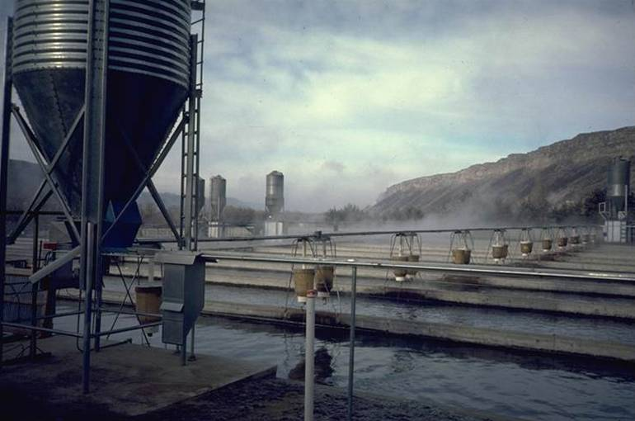
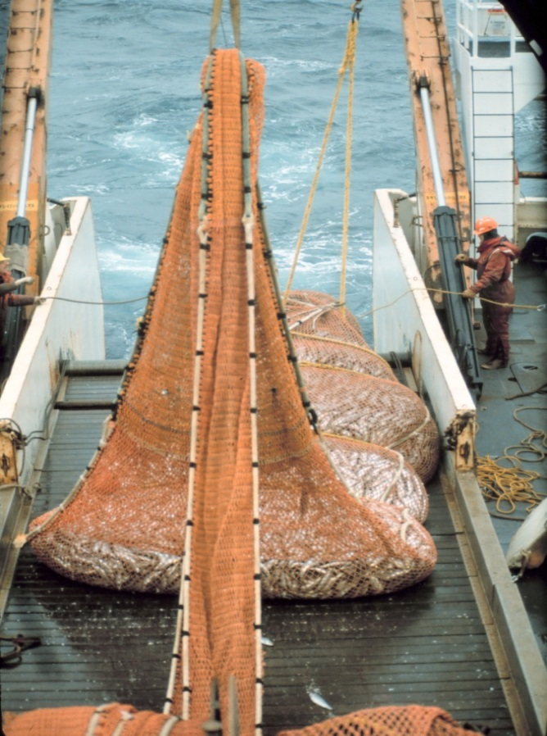
Where Will Our
Seafood Come From?
?
Notes:
Where Will Our Seafood Come From? (slide 25)
But where will the seafood come from to satisfy future demand?

Slide 26
Future Seafood Supply
Production from capture fisheries has leveled off, and most fishing areas have reached maximum potential
Estimate: at current consumption levels, global seafood supplies will need to increase by ~ 30 million tons
by 2030
Aquaculture will continue to be an important source of seafood
Notes:
Future Seafood Supply (slide 26)
According to the UN Food and Agriculture Organization (FAO), as the global population increases, demand for seafood products will increase too. Production from capture fisheries has leveled off, and many fishing areas have reached their maximum potential.
The FAO estimates global seafood supplies will have to increase by an additional 30 million tons (that’s 60 billion pounds) by 2030 to maintain current global consumption levels. Even now, if the U.S. population increased current consumption to the minimum level recommended by the Dietary Guidelines for American 2010, the current supply of seafood is insufficient to meet the demand. The 2010 edible seafood supply of 5.3 billion pounds would need to increase by about 65%.
Aquaculture has the potential to continue to meet a significant portion of the world’s increasing demand for seafood, but faces significant challenges, such as land and water availability, capital, social and policy issues.

Slide 27
Summary
Seafood includes freshwater & saltwater fish, molluscan shellfish, and crustaceans
Almost all of our seafood is imported
Aquaculture supplies about 48% of all seafood worldwide
Americans consume around 15 ¹/₂ pounds of seafood each per year
Notes:
Summary (slide 27)
Seafood includes all commercially captured or farmed freshwater and saltwater fish, molluscan shellfish, and crustaceans. Molluscan shellfish (or mollusks) and crustaceans (shrimp, lobster, and crayfish) are both commonly referred to as shellfish. The majority of our seafood is imported, which contributes significantly to our national trade deficit.
Worldwide, aquaculture supplies about 48% of the total seafood supply. Aquaculture products are changing the nation’s seafood supply through increased supply, lower prices, and greater seafood choices.
Americans eat around 15.5 pounds of seafood each per year, 10.5 pounds less per year than the Dietary Guidelines minimum recommendation of at least 8 ounces per week of a variety of seafood (26 pounds per year total).

Slide 28
Summary
The three most popular sea foods are:
  Shrimp, canned tuna, and salmon
  They comprised 58% by weight of the seafood we consumed in 2011
  Aquaculture supplies a significant amount of shrimp and salmon
Majority of seafood products (72%) are fresh and frozen and the balance canned or cured
Notes:
Summary (slide 28)
The three most popular seafoods consumed in the U.S. are shrimp, canned tuna, and salmon. Rounding out the top five seafood choices are tilapia and Alaska pollock. Shrimp, canned tuna, and salmon comprised 58%, by weight, of all seafood consumed in 2011. Aquaculture supplies a significant amount of the shrimp and salmon eaten in the U.S.
The majority of seafood products (72%) are fresh and frozen, followed by canned and cured products at 26% and 2%, respectively.

Slide 29
Summary
Most seafood is consumed away from home, where
two-thirds of our seafood dollars are spent
Population demographics will impact seafood demand
Aquaculture will be a major supplier of seafood in the future
Notes:
Summary (slide 29)
Americans eat most seafood away from home, where two-thirds of our seafood dollars are spent. The growth and aging of the American population will have a significant impact on seafood demand. Older Americans, those with higher incomes and minorities tend to eat more seafood than the average American. Aquaculture will continue to grow worldwide and contribute significantly to our seafood supply.
Now, let’s take a few minutes to complete the posttest.
Instructor: Pass out lesson 1 posttest

Slide 30
Photo credits | licensed under Creative Commons
“Fisherman’s Wharf” - CC BY-NC 2.0
“Smoked Wild Canned Fish (The Fishery)” - CC BY-NC-ND 2.0
Notes:
Photo credits | The following are licensed under Creative Commons:
Slide 20:
“Fisherman’s Wharf” by Katharine Shilcutt - CC BY-NC 2.0
“Smoked Wild Canned Fish (The Fishery)” by Renee S. Suen - CC BY-NC-ND 2.0

