Slide 1




Moving in-the-midst of COVID-19
Physical Activity for Mental Health
Moderate physical activity
reduces anxiety.
Symptoms of anxiety can be reduced immediately following a single bout of moderate to vigorous intensity physical activity!
https://health.gov/sites/default/files/2019-09/02_A_Executive_Summary.pdf
Exercise Intensity
At-Home Activities
Take a break from your daily routine to fit in some moderate-to-vigorous physical activity!
Do yoga
Dance to your favorite music or do a dance workout on PopSugar Fitness
Go for a walk or run around your neighborhood (Practice social distancing and wear a protective face covering when interacting with others outside your home)
Use a fitness/workout app
Low Intensity
Can easily talk and sing without breathing hard
Moderate Intensity
Can comfortably talk, but can’t sing
Vigorous Intensity
Can only say a few words before gasping for breath
Physical Activity Resources
Yoga with Adriene (YouTube)
POPSUGAR Fitness (YouTube)
Adults should strive for at least 150 minutes of moderate to vigorous physical activity per week for optimal health benefits, including 2 days/week of muscle strengthening activities!
To learn more about COVID-19, please visit the Centers for Disease Control and Prevention website at: https://www.cdc.gov/coronavirus/2019-ncov/index.html
Notes:
Adults

Slide 2


Moving in-the-midst of COVID-19
Physical Activity for Immune Function
Moderate physical activity
improves immune function.
Upper respiratory track infections were 43% lower among those who did at least 20 minutes of moderate intensity aerobic exercise on 5 or more days/wk! https://doi.org/10.1016/j.jshs.2018.09.009
Exercise Intensity
At-Home Activities
Take a break from your daily routine to fit in some moderate-to-vigorous physical activity!
Do a 7-minute aerobic workout while binging your favorite show
Dance to your favorite music
Go for a walk or run around your neighborhood (Practice social distancing and wear a protective face covering when interacting with others outside your home)
Use a fitness/workout app
Low Intensity
Can easily talk and sing without breathing hard
Moderate Intensity
Can comfortably talk, but can’t sing
Vigorous Intensity
Can only say a few words before gasping for breath
Physical Activity Resources
J&J Official 7-Minute Workout (app)
Fitness Blender (free website)
For optimal health benefits, adults should strive for at least 150 minutes per week of moderate to vigorous physical activity, while children and adolescents should get 60 minutes per day!
To learn more about COVID-19, please visit the Centers for Disease Control and Prevention website at: https://www.cdc.gov/coronavirus/2019-ncov/index.html
Notes:
Adults

Slide 3
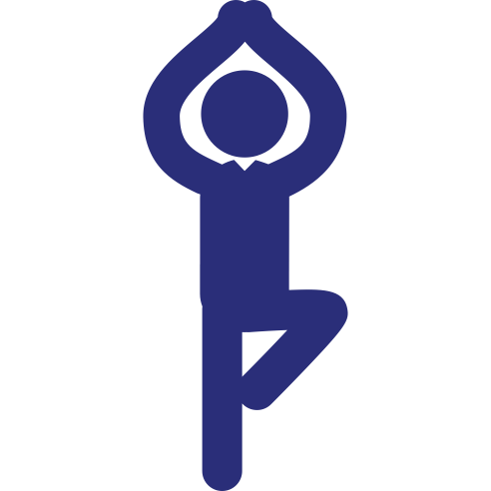
Moving in-the-midst of COVID-19
Physical Activity to Reduce Fall Risk
Strength and balance activities reduce the risk of falls and fall-related injuries.
Multicomponent physical activity, such strength, balance, endurance, and gait activities, can reduce the risk of falling and fall-related injuries in older adults!
https://health.gov/sites/default/files/2019-09/PAG_Advisory_Committee_Report.pdf
At-Home Activities
Take a break from your daily routine to fit in some moderate-to-vigorous physical activity!
Do yoga
Balance on one foot while watching TV
Follow an exercise video, like a Better Bones and Balance® class, to strengthen your muscles
Walk heel-to-toe around the house
Physical Activity Resources
Yoga with Adriene (YouTube)
Better Bones and Balance® class (website)
Older adults should perform balance and strength activities as part of the recommended 150 minutes per week of moderate to vigorous physical activity. If this amount is unattainable, do as much as conditions and ability allow!
To learn more about COVID-19, please visit the Centers for Disease Control and Prevention website at: https://www.cdc.gov/coronavirus/2019-ncov/index.html
Notes:
Older adults

Slide 4

Moving in-the-midst of COVID-19
Physical Activity for Mental Focus
Physical activity improves focus on (home)school tasks.
Acute and habitual moderate-to-vigorous physical activity can improve attention, memory, and academic performance for youth ages 5-13.
https://health.gov/sites/default/files/2019-09/PAG_Advisory_Committee_Report.pdf
Exercise Intensity
At-Home Activities
Take a break from your daily routine to fit in some moderate-to-vigorous physical activity!
Make an indoor obstacle course
Ride a bike, scooter, or skateboard around your neighborhood (Practice social distancing and wear a protective face covering when interacting with others outside your home)
Take a brain-break by watching an activity video from Move to Learn
Low Intensity
Can easily talk and sing without breathing hard
Moderate Intensity
Can comfortably talk, but can’t sing
Vigorous Intensity
Can only say a few words before gasping for breath
Physical Activity Resources
Move to Learn (website)
BE Physically Active 2Day videos (website)
Youth ages 6-17 should strive for > 60 minutes/day of moderate to vigorous physical activity. Do it all at once or break it up throughout the day. Include muscle strengthening activities 2 times per week and bone building activities 3 times per week!
To learn more about COVID-19, please visit the Centers for Disease Control and Prevention website at: https://www.cdc.gov/coronavirus/2019-ncov/index.html
Notes:
Children and adolescents

Slide 5
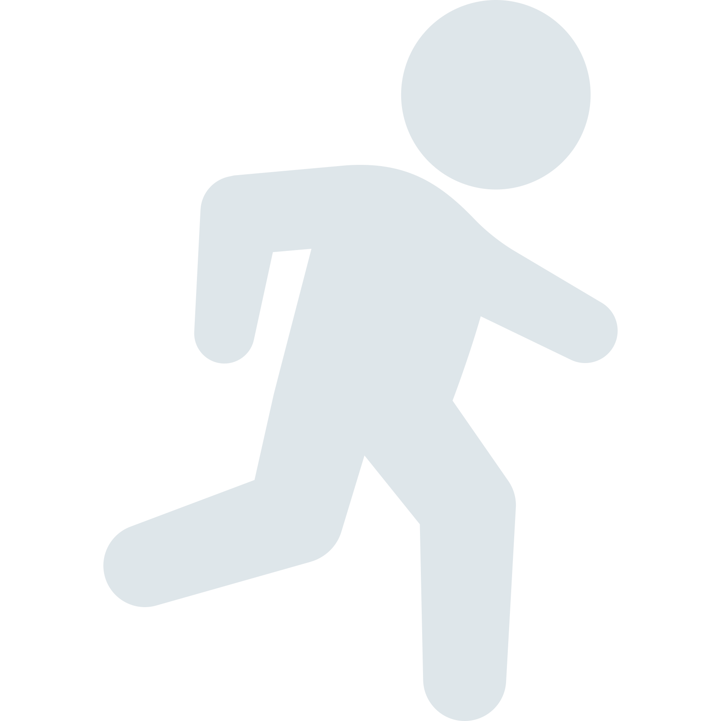
Moving in-the-midst of COVID-19
Physical Activity For Depression
Moderate physical activity
reduces depression.
Adults who participate in steady-state moderate physical activity for 35 minutes on 4 days per week experience significantly reduced symptoms of depression. Improvements in mood also linger after cessation of activity!
https://psycnet.apa.org/doiLanding?doi=10.1037%2Fhea0000836
Exercise Intensity
At-Home Activities
Take a break from your daily routine to fit in some moderate-to-vigorous physical activity!
Dance to your favorite songs
Follow along with one of the videos on the Sweaty Betty website or try an audio-based workout on the Aaptiv app
Take a walk/jog around your neighborhood (Practice social distancing and wear a protective face covering when interacting with others outside your home)
Exercise Intensity
Low Intensity
Can easily talk and sing without breathing hard
Moderate Intensity
Can comfortably talk, but can’t sing
Vigorous Intensity
Can only say a few words before gasping for breath
Physical Activity Resources
Sweaty Betty (website)
Aaptiv: #1 Audio Fitness (app)
Adults should strive for at least 150 minutes of moderate to vigorous physical activity per week for optimal health benefits, including 2 days/week of muscle strengthening activities!
To learn more about COVID-19, please visit the Centers for Disease Control and Prevention website at: https://www.cdc.gov/coronavirus/2019-ncov/index.html
Notes:
Adults

Slide 6
Moving in-the-midst of COVID-19
Physical Activity for Managing Anger
Moderate physical activity
reduces feelings of hostility.
Adults who participate in steady-state moderate physical activity for 35 minutes on 4 days per week experience significantly reduced feelings of hostility. Improvements in mood also linger after cessation of activity!
https://psycnet.apa.org/doiLanding?doi=10.1037%2Fhea0000836
Exercise Intensity
At-Home Activities
Take a break from your daily routine to fit in some moderate-to-vigorous physical activity!
Go for a bike ride in your neighborhood (Practice social distancing and wear a protective face covering when interacting with others outside your home)
Download the Nike Training App and chose a 5 to 60-minute workout to complete
Try the 9-minute strength workout listed below. Don’t worry if you’re new to strength training, they’ll teach you the movements!
Low Intensity
Can easily talk and sing without breathing hard
Moderate Intensity
Can comfortably talk, but can’t sing
Vigorous Intensity
Can only say a few words before gasping for breath
Physical Activity Resources
Nike Training Club (app)
New York Times 9-Minute Strength Workout (article)
Adults should strive for at least 150 minutes of moderate to vigorous physical activity per week for optimal health benefits, including 2 days/week of muscle strengthening activities!
To learn more about COVID-19, please visit the Centers for Disease Control and Prevention website at: https://www.cdc.gov/coronavirus/2019-ncov/index.html

Slide 7
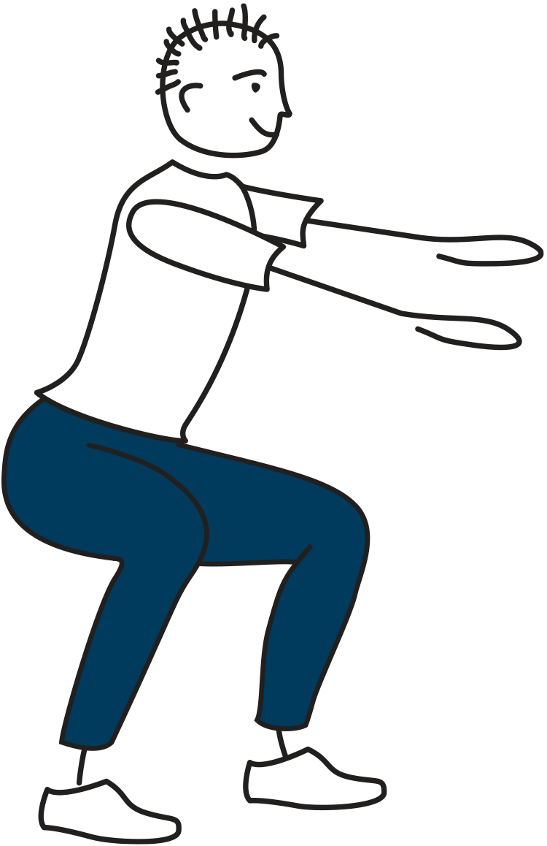
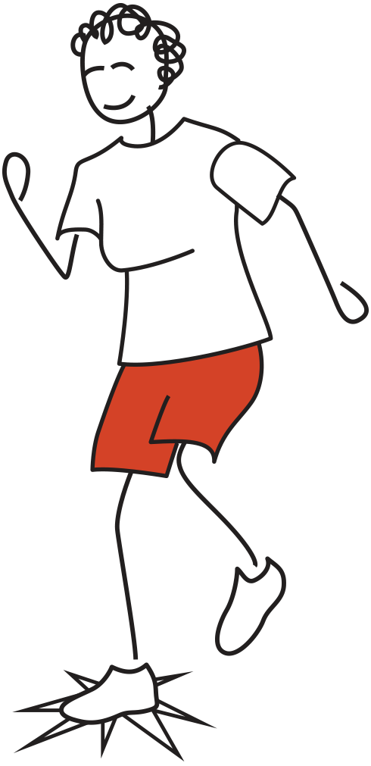
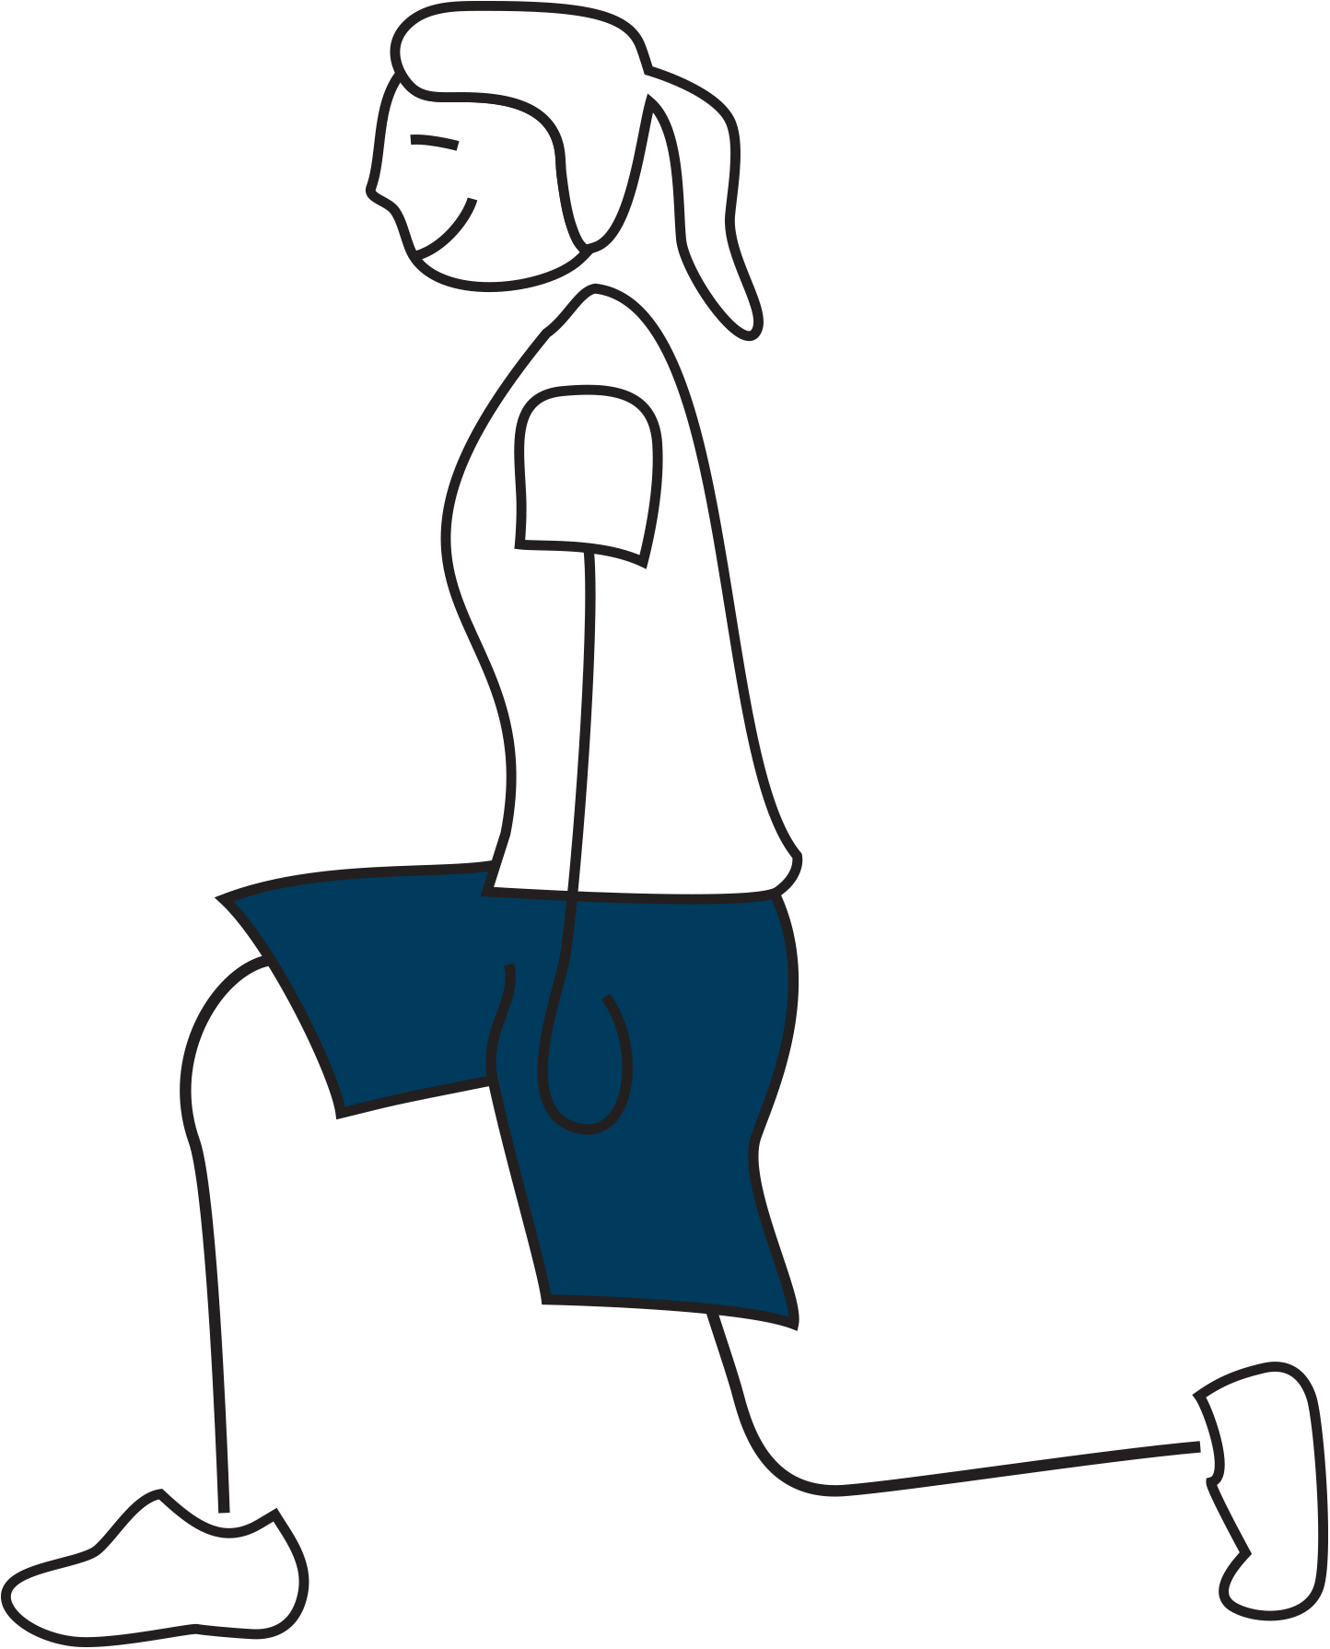
Moving in-the-midst of COVID-19
Physical Activity to Combat Frailty
Muscle strengthening activities combat frailty.
Physical Activity Readiness Questionnaire
Has your doctor ever said that you have a heart condition OR high blood pressure? Do you feel pain in your chest when you do physical activity OR during daily activities of living? Do you lose balance because of dizziness OR have you lost consciousness in the last 12 months? Have you ever been diagnosed with a chronic medical condition? Are you currently taking medications for a chronic medical condition? Do you have a bone or joint problem that can worsen from a change in your physical activity? Do you know of any other reason you shouldn’t do physical activity?
If you answered YES to any of the questions, consult with a physician to get cleared for physical activity.
If you answered NO to all of the questions, you are cleared to gradually begin physical activity!
Strength training is one of the best ways to fight the weakness and frailty that can come with age, according to research at Tufts University.
https://www.cdc.gov/physicalactivity/downloads/growing_stronger.pdf
At-Home Activities
Take a break from your daily routine to fit in some physical activity!
Do some body weight squats
Try marching and stomping to your favorite beat to build or maintain bone mineral density
Do lunges, either forwards, backwards, or side to side
Try a Better Bones and Balance® class
Physical Activity Resources
”Growing Stronger: Strength Training for Older Adults” (pdf)
Better Bones and Balance® class (website)
Adults should perform muscle strengthening activities at least 2 days/week, while children and adolescents should do muscle strengthening activities at least 3 days/week!
To learn more about COVID-19, please visit the Centers for Disease Control and Prevention website at: https://www.cdc.gov/coronavirus/2019-ncov/index.html
Notes:
Adults and children and adolescents

Slide 8

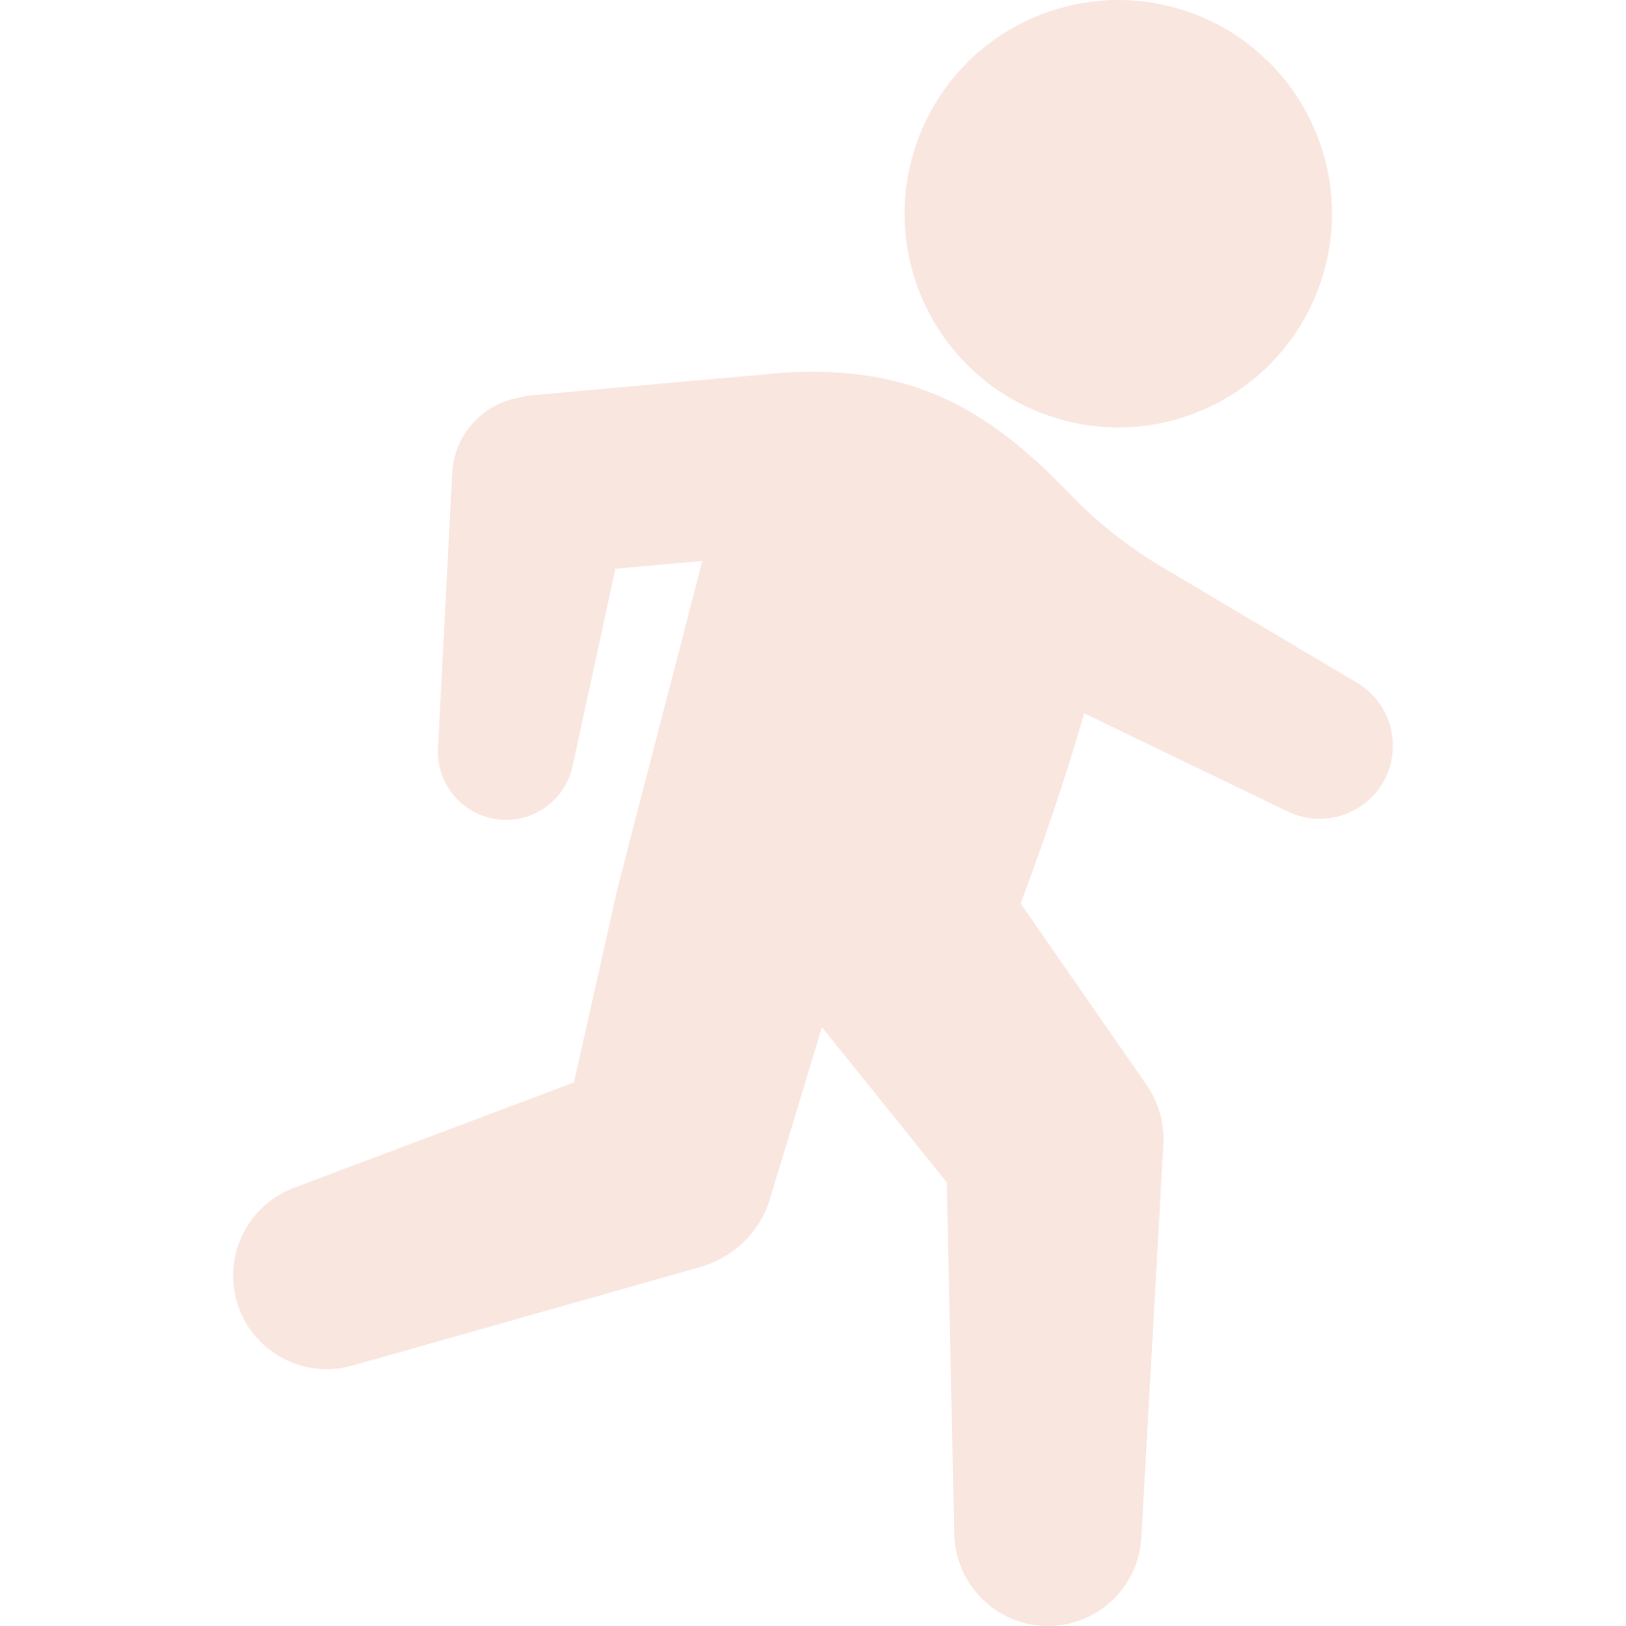
Moving in-the-midst of COVID-19
Physical Activity for Heart Health
Physical activity improves
cardiorespiratory function.
Physical activity is associated with increased cardiorespiratory function in adults! Even small physical activity increases for individuals new to exercising have high potential of reducing risks for chronic disease and mortality.
http://www.sportscardiologybc.org/wp-content/uploads/2016/03/BCMJ_Vol58_No_3_
cardiorespiratory_fitness.pdf
At-Home Activities
Take a break from your daily routine to fit in some moderate-to-vigorous physical activity!
Go for a jog in your neighborhood and track your distance with Map My Run. See if you can beat your distance on your next run!
Make fitness fun! Check out Zombies, Run! for a thrilling take on aerobic activity. (Practice social distancing and wear a protective face covering when interacting with others outside your home)
Exercise Intensity
Low Intensity
Can easily talk and sing without breathing hard
Moderate Intensity
Can comfortably talk, but can’t sing
Vigorous Intensity
Can only say a few words before gasping for breath
Physical Activity Resources
Map My Run (app)
Zombies, Run! (app)
For optimal health benefits, adults should strive for at least 150 minutes per week of moderate to vigorous physical activity, while children and adolescents should get 60 minutes per day!
To learn more about COVID-19, please visit the Centers for Disease Control and Prevention website at: https://www.cdc.gov/coronavirus/2019-ncov/index.html

Slide 9

Moving in-the-midst of COVID-19
Physical Activity for Immune Function
Resistance training improves
immune function.
A single resistance training session temporarily increases the number of circulating immune cells (leukocytes) in the body that help protect against infection.
https://www.researchgate.net/publication/230643818_Immune_Responses_to_Resistance_Exercise
At-Home Activities
Take a break from your daily routine to fit in some strength-focused physical activity!
Perfect your crunch, lunge, or push up form with one of Livestrong’s “How To” videos and then challenge yourself to complete as many as you can in one minute (with good form)!
No weights? No problem! Utilize items around the home or pantry, such as canned food, to use for added resistance!
Exercise Intensity
Low Intensity
Can easily talk and sing without breathing hard
Moderate Intensity
Can comfortably talk, but can’t sing
Vigorous Intensity
Can only say a few words before gasping for breath
Physical Activity Resources
Sworkit (app)
Bodybuilding.com (website)
Livestrong (Youtube)
Adults should perform muscle strengthening activities at least 2 days/week, while children and adolescents should do muscle strengthening activities at least 3 days/week!
To learn more about COVID-19, please visit the Centers for Disease Control and Prevention website at: https://www.cdc.gov/coronavirus/2019-ncov/index.html

