Slide 1
Fig Meeting
Fig Meeting January 17, 2017

Slide 2
Definitions
IRS Accountable Plan:
Must have a business or educational purpose – paid or incurred while performing services as an employee or attending as a student.
Accountable Plan NOT followed:
Reimbursements are treated as a liability to the student or traveler.
Require repayment to the University.

Slide 3
IR-2016-169, Dec.13, 2016
WASHINGTON — The Internal Revenue Service today issued the 2017 optional standard mileage rates used to calculate the deductible costs of operating an automobile for business, charitable, medical or moving purposes.
Beginning on Jan. 1, 2017, the standard mileage rates for the use of a car (also vans, pickups or panel trucks) will be:
53.5 cents per mile for business miles driven, down from 54 cents for 2016
17 cents per mile driven for medical or moving purposes, down from 19 cents for 2016
14 cents per mile driven in service of charitable organizations

Slide 4
Graduate and Upper Division
Students Follow the IRS Accountable Plan the same as Employees – Use the Travel Web Forms and follow the State of Idaho Travel Policies
Under Graduate Students
Normally travel with Advisor or UI Employee
Reviewed on a case by case basis – but will be on a claim voucher unless traveling with an advisor..

Slide 5
Jan 1, 2017 PERDIEM Rate Changes
Perdiem – remained the same.
45.00 instate per day
51.00 out of state per day but would allow higher Federal Rate for travel outside of Idaho and if it is listed on the GSA tables, otherwise use the 51.00 per day.
Partial Day Per Diem Allowances are still the same.

Slide 6
Travel Awards
Funds paid to the students without providing a detailed accounting of the expenditures:
would be considered a Financial Aid Resource
process through the Student Financial Resource Program
Travel Advances – Not recommended for students , but will review on a case by case basis. Will be processed through the Travel Web forms.

Slide 7
PerDiem and Mileage
Perdiem Accounted For:
Mileage Accounted For:
1. Using The state of Idaho Perdiem Schedule and Rates.
OR
2. By presenting receipts for the perdiem, but limiting the reimbursement to be no more than the allowed perdiem schedule.
Mileage Chart
MapQuest, Yahoo or Google Maps
Odometer reading if mileage computations are not easily determined.

Slide 8
Less than 50 miles
Vicinity Miles
Travel Status
Mileage within the official work station area are allowable and may be reported on a daily basis as Vicinity Travel. Normally on a CV, but can be on TC.
50 miles or more or includes an overnight stay.
Mileage – ok
Perdiem – no unless requires overnight stay.

Slide 9
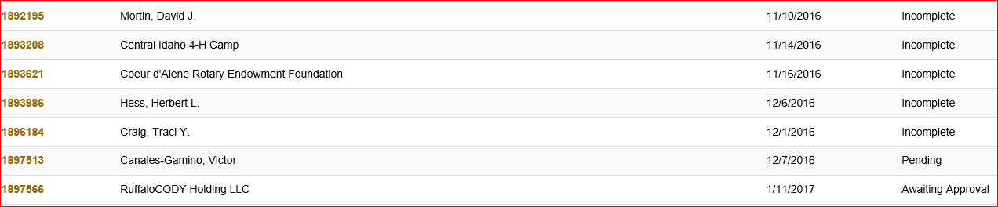
CV Pending Status

Slide 10
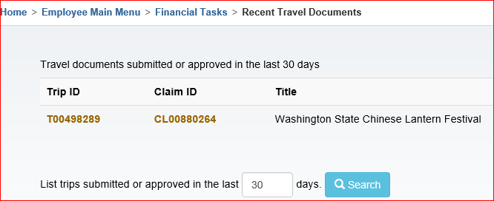
Pending Travel

Slide 11
Purchasing Card Travel
Allowed:
Expense Accounting
Airfare
Lodging
Registration
Etc.
Purchasing Card Claim
Non Travel PCARD
NOT ALLOWED
Perdiem
Fuel for personal vehicles
OR
Personal or indirect routes.

Slide 12
Unclaimed Property
State of Idaho
UI Procedures
State of Idaho requires that any funds that are not claimed are submitted to the State of Idaho Unclaimed Property Division.
Not Claimed, becomes property of the state
After 180 days sends out an affidavit to payee. If the payee completes the form and returns it – can be reissued. Otherwise, we are required to send to the state.

