Slide 1
Fig Meeting
November 15, 2016

Slide 2
Payroll Timing
Cretia Bunney – Payroll Manager
Cretia@uidaho.edu

Slide 3
The University is obligated, by law, to pay employees in a timely manner. EPAF’s need to be put on, timesheets need to be filled out and approved by deadlines for prompt payroll processing.
If a rare situation happens and a payment is unable to be processed through the regular payroll process, please contact payroll and discuss the best method for processing the payment. We would like to be your partner in making this process manageable and timely for paying our employees. Let’s talk about it and decide together how best to accomplish that!
I will be available for questions and discussion at the December meeting.
Thank you! Cretia Bunney

Slide 4
Asset Accounting Reminder
Annual PROPERTY Inventory was Due TO BE COMPLETED by October 31, 2016.
If your department has not returned your property inventory, or you would need to request and extension – Please contact
jgroves@uidaho.edu of ASSET Accounting

Slide 5
Accounts Payable Email Usages
Acctpay@uidaho.edu
APDOCS@uidaho.edu
Use for:
ST101 Requests
W9 Requests
Address Updates & Vendor InFO
General Emails to Accounts PayABLE.
Return Comments from The Pc/Tr forms
Use for:
Uploading of Invoices received from the Departments.
UPLOAD of INVOICES RECEIVED DIRCTLY FROM THE VENDOR

Slide 6
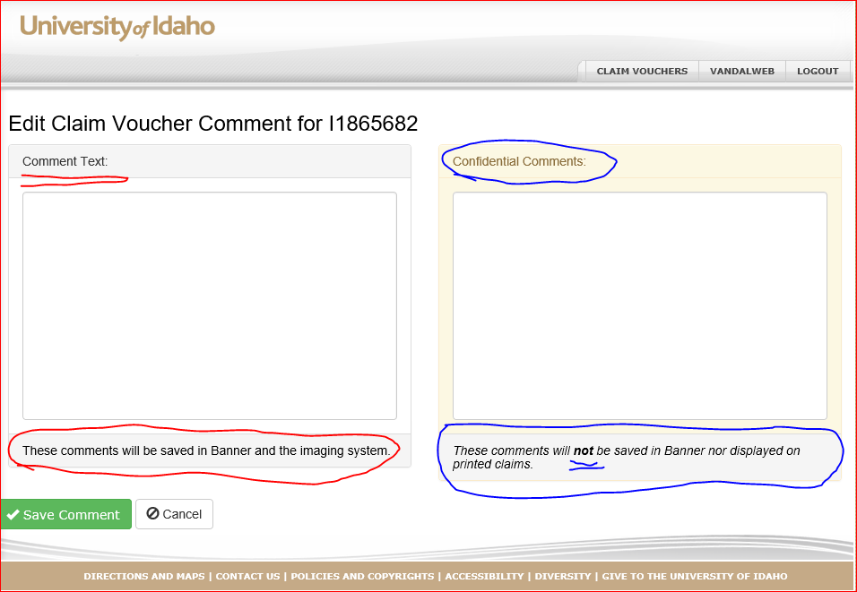
Text Boxes on Claim VouchERs

Slide 7
Enterprise Car Rental Contract
Be sure to use the Enterprise Contract or the UI Purchasing Card.

Slide 8
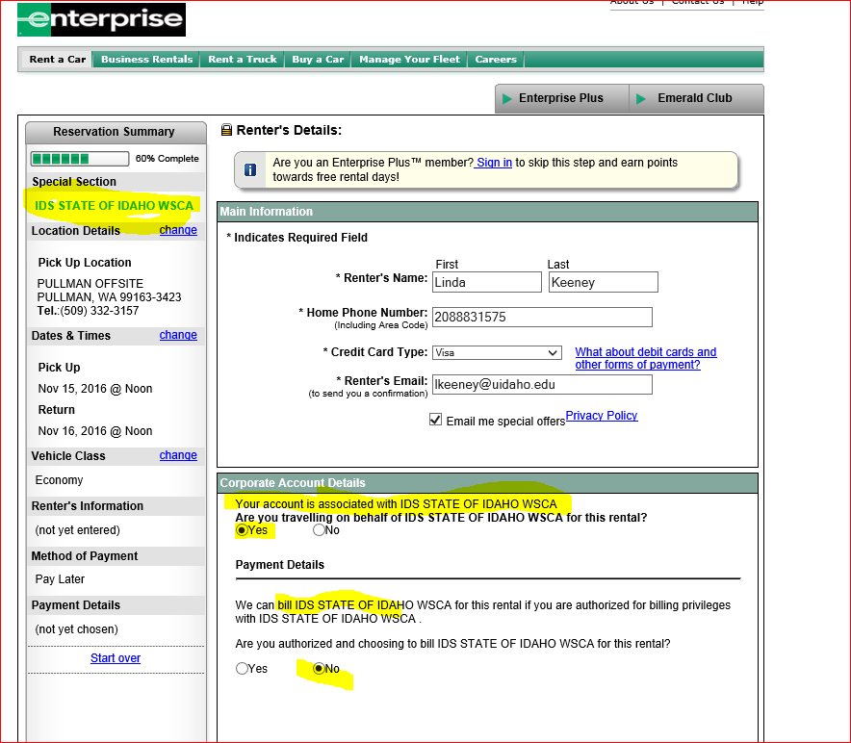

Slide 9
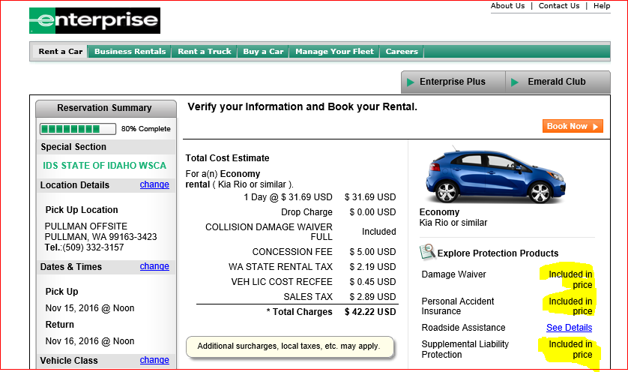

Slide 10
Enterprise Rent A Car
State of Idaho Rental Car Contract
http:www.uidaho.edu/finance/controller/acciybts-payable/travel-services/transportation
Enterprise is the Main supplier and Hertz is the secondary
Included with Contact
Personal Liability Waiver
Supplemental Insurance
Sales Taxes
If Within IDAHO PICKUP,
ST101 when picking up the vehicle
If out of state, they are not tax exempt

Slide 11
All other Rental Cars Require you to use the VISA PCARD for Insurance Coverage
Pcard rental car coverage

Slide 12

Airline Programs
Delta program
Easy Biz

Slide 13
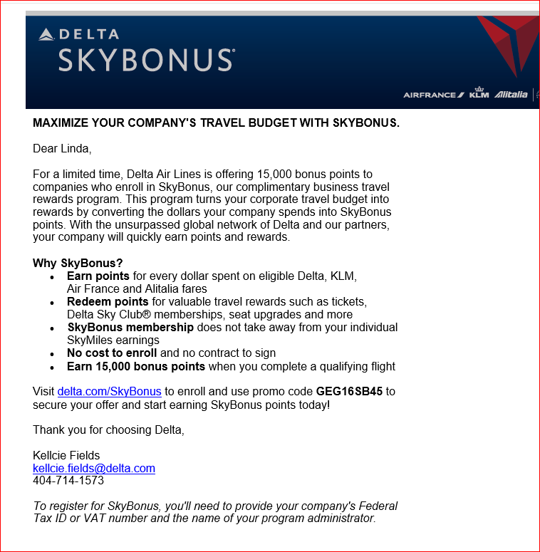

Slide 14
January to May Fig Meetings
Commons – Crest-Horizon Room
10:00 Am
Meeting Dates
January 17, 2017
February 14, 2017
March 21, 2017
April 18, 2017
May 16, 2017

