Slide 1
Fig Meeting
August 23, 2018

Slide 2
Banner Tricks and Tips
Tips and Tricks with Banner - Trina Mahoney

Slide 3
NEW TRAVEL Program………..
Excited to Announce:
Chrome RiveR

Slide 4
Chrome River - Introduction
FEATURES
Simplified Expense Processing
Mobile Interface for Claims & Approval
Image Management for receipts
Trip Preapproval and Exp comparision
Pcard transactions received daily
Email notifications
Expense Rules that outline required information
Purchasing Card Transactions Travel & Z docs reconciliation
Estimated Timelines
Initial meetings before Sept 30,
Programing not to start until After Banner 9 Implementation
Hopefully, Test pilot by January 2019
Shooting for, Campus Roll out March 2019

Slide 5
People Payments
Faainve roll out to the departments is for Vendor Payments only.
Intention is to move the People Payments to the New Travel Program
Mean Time – A temporary process

Slide 6
People Payment Voucher
How It will Work:
Departments: Complete form
Scan Backup Information
Upload to AP GateKeeper
Accounts Payable: enter on Banner
Index images
Approvals: Routed through the Banner Invoice Approval Queues.
Location:
Accounts Payable Website.

Slide 7
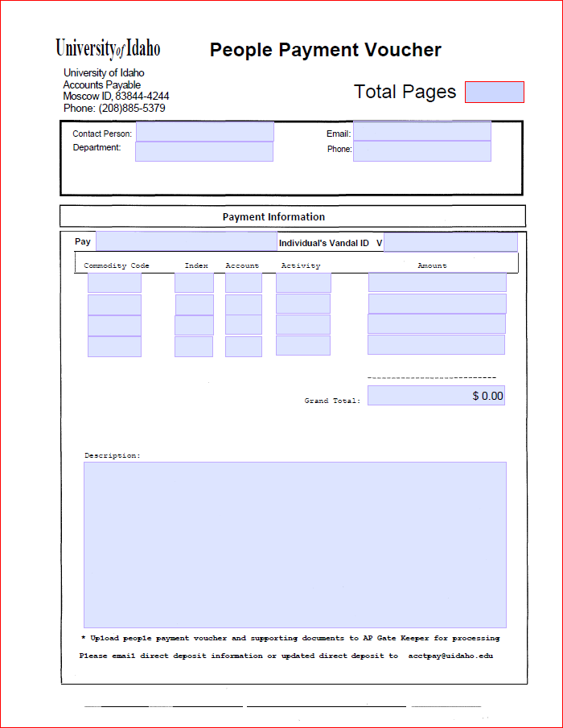

Slide 8
Faainve Training
we have conducted several classes for the Vendor Payments on FAAINVE. The first one was a test training, but since then - things have been going fairly well.
CV still scheduled to be discontinued September 30, with the implementation of Banner 9
FAAINVE is not mandatory for the departments, it is a choice if it works for your areas.
AP is assuming aN increased approval queue workload allowing the FAAINVE to be distributed but hopefully it will allow the departments more flexibility in their business practices.

Slide 9
Any Questions or Related Business Topics
Thank you

