Slide 1
Fig Meeting
October 25, 2018
On Campus Meeting
Off Campus Meeting October 31, 2018

Slide 2
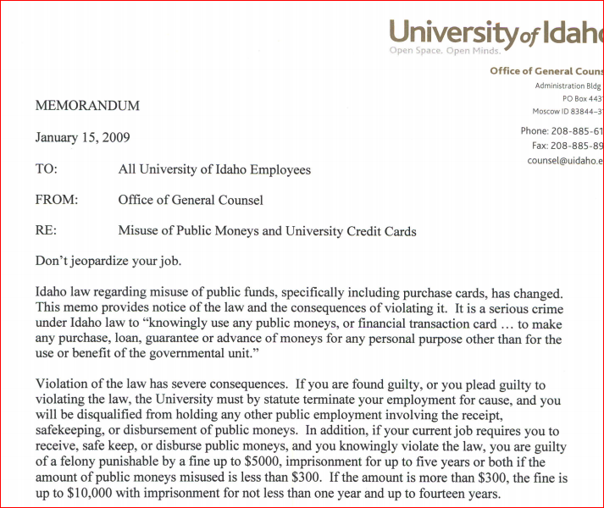

Slide 3
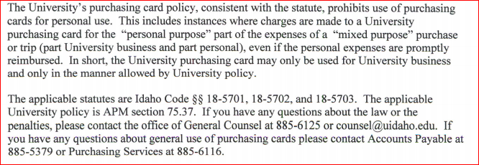

Slide 4
APM Sections on Travel Authorizations
APM 70.05
B-1. Traveler's Authorization/Insurance Coverage. In order for UI employees to be covered by University of Idaho insurance, trip authorization must be received prior to departure. This document may serve as the authorization form. If there is no advance or encumbrance request and once appropriate signatures are obtained, the document may be held in the originating department office. If there is an advance or encumbrance request, the document must be sent to the Travel Office for processing.
APM 70.02
B-1. Appropriate Form for Approval. Approval for travel is requested by the submission of a Travel Authorization Request form [See Travel Management, U of I Travel Website ]

