Slide 1
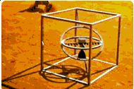


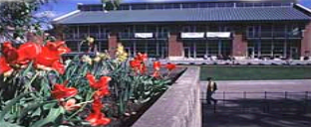

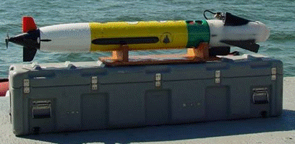
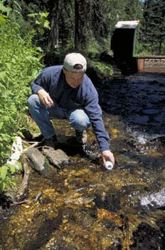
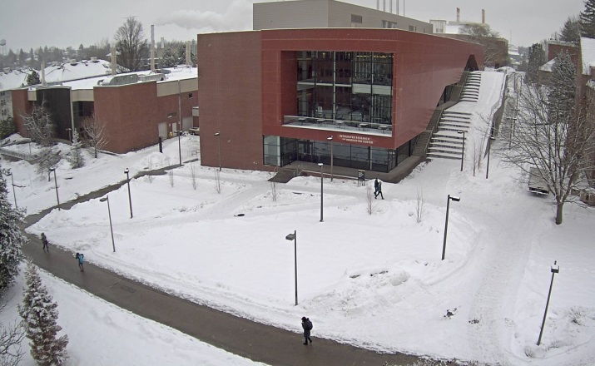



Asset Management
Notes:
Welcome to Asset Management and Accounting.

Slide 2
Asset Management
Unit Responsibilities
  Department Administrators
  Unit Property Administrators
  Security of Equipment
  UI Equipment Usage
  Movement of Property
  Storage of Equipment

Slide 3
Asset Management
Unit Responsibilities
Administrator of each Department (Dept. Head, Dean or equivalent)
  Responsible for safeguarding and maintaining assets assigned under their control
  Develop and implement appropriate operating procedures and internal controls
  Designate a Unit Property Administrator (UPA)
  Ensure end-users and purchasers of property cooperate fully with the UPA

Slide 4
Asset Management
Unit Responsibilities
Change in Administrator
    The new administrator assumes responsibility for all property assigned.
  An inventory of all assets should be conducted at this time
  Promptly verify the accuracy of the assigned inventory

Slide 5
Asset Management
Unit Responsibilities
Unit Property Administrator (UPA) Designation
  Interface with faculty, staff and students in their respective areas
  Direct liaison between the department and the Asset Management Office
  Must be a University employee
  Have current knowledge and understanding of all facets of asset management, including associated policies and procedures
  Or ability to quickly learn the policies and procedures
  Additional UPA criteria recommendations are identified in the APM 10.40.

Slide 6
Asset Management
Unit Responsibilities
Change in Unit Property Administrator
  Departments must notify the Asset Accounting Office when a change in UPA occurs. The UPA is a direct contact between the Unit and the Asset Management Office.

Slide 7
Asset Management
Unit Responsibilities
Custody and Return of Property by Departing Employees
  UPA’s should periodically review inventory assets under the control of University employees (at least annually).
  Each department should establish a procedure to prevent departing employees from removing University property.
  Procedure should include a “checkout” meeting with the UPA. Departing employees are required to return all University property in their possession on or off campus (see 10.40 C-7, iv or asset web page link for exceptions on grant funded assets).

Slide 8
Asset Management
Security of Property
All University Employees have an obligation to safeguard and make appropriate use of property owned or accountable to the University.
This includes individual use or common area property.
Exercise reasonable care in use to prevent damage and maintain good condition, accounting for wear and tear resulting from use.
Exercise reasonable security measures to prevent theft or misuse.
Notify the UPA and/or Asset Management Office of acquisition, movement or disposal of property in a timely manner.
Report lost, stolen, damaged or otherwise impaired property to appropriate parties (supervisor, manager, UPA, Asset Management Office, etc) immediately.

Slide 9
Asset Management
University Property Usage
        May only be used in the performance of University functions.
        May not be rented or loaned to any person or group for private use without the recommendation of the Unit administrator and written authorization from the VP for Finance and Administration.
        Property purchased with funds from grants and contracts may have additional usage restrictions.

Slide 10
Asset Management
University Property Usage
Off-campus use of property
        Examples:
            Employee residences
            Temporary work sites
        Property use must directly benefit University or the sponsored project for which acquired.
        Custodian responsibility remains the same regardless of location.

Slide 11
Asset Management
University Property Usage
Off-campus use of property
          Frequent on-off campus transit
          Includes property normally located off campus
        Document on University Off-Campus Equipment Verification Worksheet (view link in APM or Asset Accounting web page).
        Worksheet must be updated annually and maintained on file by the UPA.
        WILL be used to substantiate asset locations during physical and verification inventories (including internal audit).
        Off campus more than 30 days require an off-campus location in the Banner Fixed Assets Module (PMO can create new locations).

Slide 12
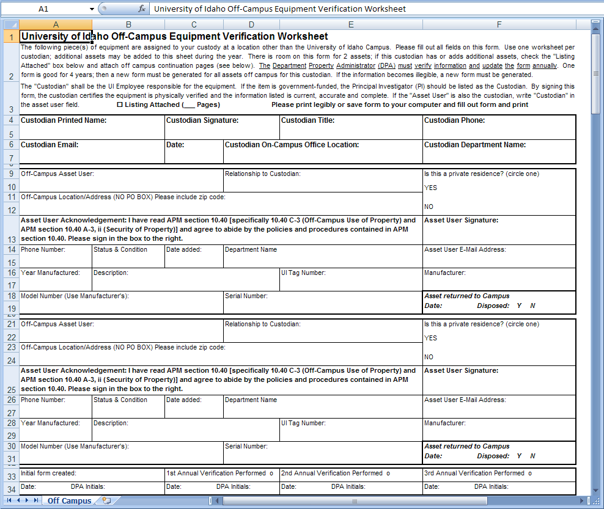
Notes:
Off-Campus Equipment Verification Worksheet is available on the Asset Accounting Web Page

Slide 13
Asset Management
Storage of UI Property
        Property no longer operable; obsolete; idle; beyond economical repair, etc… must be transferred to the Surplus Property Department (see APM 10.41).
        If storage is justifiable the UPA must notify the Asset Management Office to change user status to “Idle” and provide actual property location.
        The UPA is responsible for ensuring the method of storage is adequate to prevent theft, loss, damage, or destruction (ex: art, parts, electronic equipment).

Slide 14
Asset Management
Storage of UI Property
        University buildings or grounds may not be used for permanent or continuous storage of personal property that is not used for official purposes.
        Office decorations, small refrigerators, microwaves, and art are exceptions.
        Property stored in University facilities is presumed to be University property.

Slide 15
Asset Management
Movement of Property
  Promptly enter new location changes in Vandal Web – Asset Change Requests for approval whenever location changes occur.
  Promptly enter equipment transfers to other departments/units in Vandal Web – Asset Change Requests whenever transfer of equipment occurs (including Surplus).
  Temporary moves (less than 30 days), the “Home” location can remain the same in Fixed Assets.

Slide 16
Asset Management
Movement of Property
        Sign-Out Log (view link on asset web page or APM)
        Can be posted on inside door of lab or maintained by UPA
        Readily accessible to equipment custodians/users
        Periodically checked by UPA to ensure proper usage (check-in/out equipment)
        WILL be used to substantiate equipment locations during verification inventories or internal audit

Slide 17
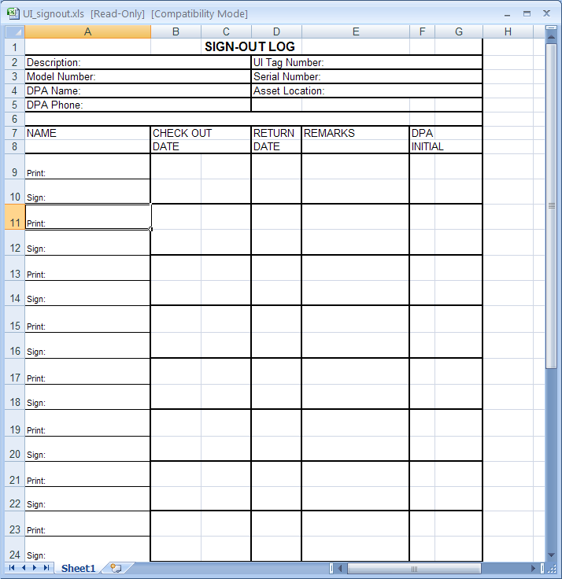
Notes:
Sign-Out Log available on Asset Accounting Web page

Slide 18
Let us Review
The Administrator of each Department (Dept. head, Dean or equivalent) is responsible for?
Safeguarding and maintaining assets assigned under their control.
Developing and implementing appropriate asset operating procedures and internal controls.
Assigning a Unit Property Administrator
All the above
Notes:
Number 4

Slide 19
Let us Review
The Unit Property Administrator?
  Have current knowledge and understanding of all facets of asset management, including associated policies and procedures.
  Possess the ability to quickly learn the asset management policies and procedures.
  Is the direct liaison between the department and Property Management.
  Works part time during the summer months.
  Numbers 1, 2, and 3
Notes:
1 thru 3

Slide 20
Let us Review
Inoperable, obsolete, and/or idle equipment should?
Be transferred to UI Surplus Property (Use Asset Change/Surplus Transfer portal in Vandal Web)
Be thrown in the dumpster
Can be given to an employee for personal ownership
None of the above
Notes:
Number 1

Slide 21
Let us Review
Asset location changes should be recorded where??
Vandal Web – Asset Change Requests
Email to the department head
In a shadow database set up in the department
A sign out log if set up by the department.
Notes:
1 and 4

Slide 22
Let us Review
Off-Campus location changes more than 30 days?
Should be documented on a University Off-Campus Equipment Verification Worksheet
Immediately reported to property management for a location code assignment
Recorded in a shadow database set up in the department
No location changes need to be reported because the change exceeds 30 days.
Notes:
1 and 2

