Slide 1
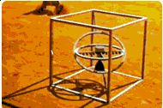


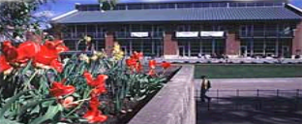
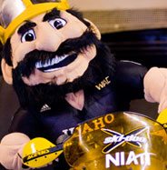
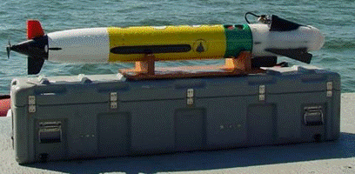
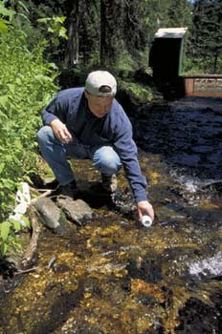
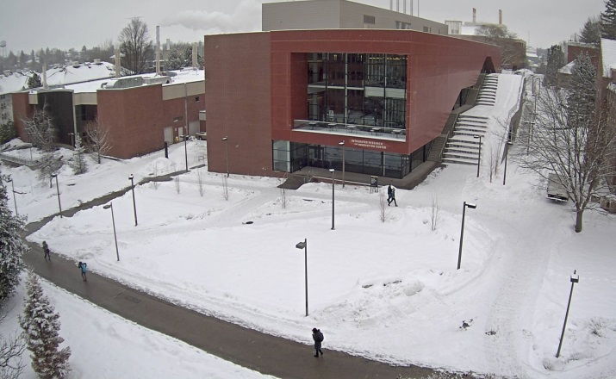



Asset Management
Notes:
Welcome to Asset Management and Accounting.

Slide 2
Asset Management
Point of Contact
Purpose & Mission
Objectives
Criteria
Ownership
Notes:
In this lesson we will provide the point of contact, the purpose and mission, criteria, objectives, definitions, and ownership of university assets.

Slide 3
Joseph Groves
jgroves@uidaho.edu
inventory@uidaho.edu
208-885-4070
875 Perimeter Dr. MS 2281
Surplus Property Building

Slide 4
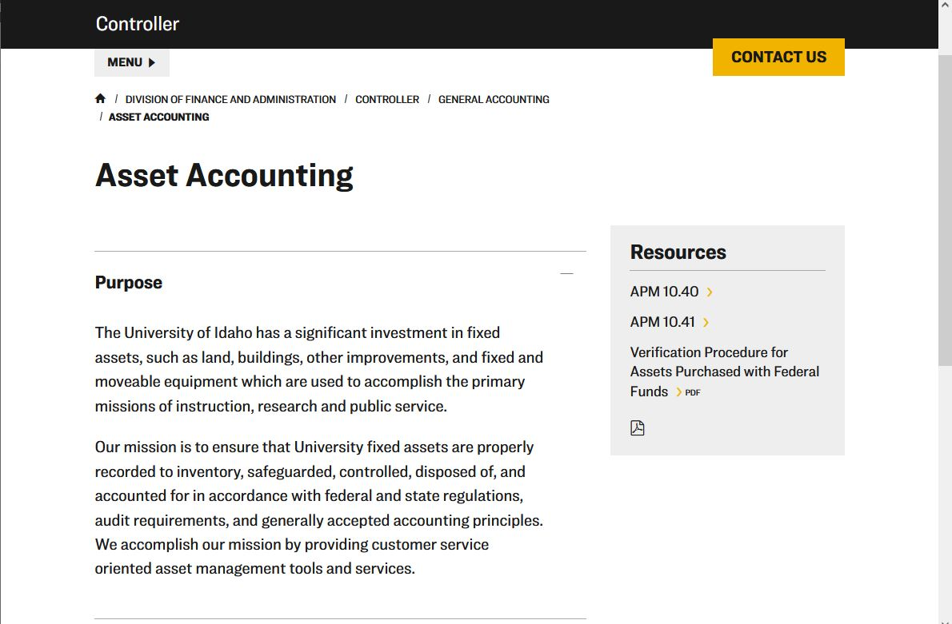

Notes:
Our Mission Statement and Point of Contact Information

Slide 5
Asset Management
Objectives
Increase emphasis on importance of managing University equipment assets
Improve the monitoring of assets
Improve inventory records accuracy
Provide training to department personnel in the proper handling and tracking of University equipment assets
Strengthen existing policies and procedures that have a direct affect on University asset management effectiveness

Slide 6
Asset Management
Asset management is an important function at the University of Idaho. Prudent business practices help protect the University’s multi-million-dollar investment in equipment, meet government and sponsor requirements, and support indirect cost recovery at the University of Idaho.

Slide 7
Asset Management
Criteria
Capital Outlay Expenditures: Purchase of equipment where the account code assigned to purchase the item(s) begins with E6*** (Greater than $5K) or E7*** (Less than $5K).
Account code (E-Code) E5*** should NOT be assigned to equipment purchases.
Artwork & Collections are evaluated on a case by case basis.
Included Costs: The initial price of the item or items (if constructed), including shipping and handling, applicable taxes, installation and ancillary costs (cords, cables, pipes, etc.) necessary for the item to function for the purpose for which it was acquired
Repairs, betterments or improvements: (a) Extend the estimated useful life; (b) increased capacity; (c) substantial improvements in the quality of output; or (d) substantial reduction in operating cost
Inventorial Assets: Stand-Alone equipment items that have a cost of $2,000 or more and a useful life of one year or more

Slide 8
Asset Management
Ownership
University owns all equipment assets purchased with University funds as well as assets received as gifts
University owns all equipment assets purchased with funds from a grant or contract (except when provided by the terms of the grant or contract)
No department, department unit, or University employee may hold proprietary interest in any piece of University property (including assets purchased with grant or contract)

Slide 9
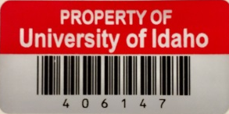
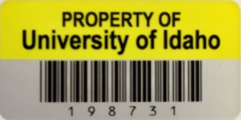
Asset Management
  Asset Accounting provides a unique property number for all items included in the fixed assets inventory system that exceed $2K.
      Red Tags identify Grant & Federally Funded equipment
    Yellow Tags identify all other equipment (excluding vehicles)
  The tag number for licensed vehicles begins with a “V”, and trailers with a “T”. The license plate numbers assigned by Idaho Transportation Dept. is assigned in Banner Fixed Assets and will appear on departmental inventory listings run from ARGOS.
  Virtual tags are assigned for items such as underground pumps, wheel line irrigation systems, small ITS type switches in closets, etc… (begin with an 8)

Slide 10

Asset Management
Capital Outlay less than $2K (Blue Tags)
  Can be provided for equipment such as computers, flat panel monitors, GPS’s, projectors, HD TV’s, etc. Not restricted to these items.
  Blue Tags will be provided upon request ($125.00 for 500 or $25.00 per 100)
  Smaller quantities provided at no cost.
  ITS and Risk Management can also provide.
  Provided as a tool to assist unit tracking & inland marine insurance reporting
  Sample Excel spreadsheet is available upon request or available for download on Asset Accounting’s web page.
  This equipment is not added to Banner Fixed Assets system

Slide 11
Let us Review
University owns all equipment:
Purchased with University funds as well as assets received as gifts.
Purchased with funds from a grant or contract (except when provided by the terms of the grant or contract).
Small refrigerator purchased by an employee with their own money for their office.
Both 1 & 2.
Notes:
Number 4

Slide 12
Let us Review
UI’s inventory $$$ threshold is:
$5,000.00
$2,000.00
$300.00
$2,500.00
Notes:
Number 2

Slide 13
Let us Review
Red inventory tags are provided for:
All capital outlay equipment
University funded equipment exceeding $2K
Grant funded Equipment exceeding $2K
Grant funded Equipment exceeding $5K
Notes:
Number 3

Slide 14
Let us Review
Blue Property tags are provided for:
All capital outlay equipment regardless of costs
Capital Outlay equipment less than $2K
Grant funded Equipment exceeding $2K
Grant funded Equipment exceeding $5K
Notes:
Number 2

