Slide 1
CNR Graduate Studies Office Orientation
Spring 2023

Slide 2
Overview
Introductions
Interactive Ice Breaker
Guest Speakers
UI & CNR Resources
CNR Graduate Handbook

Slide 3
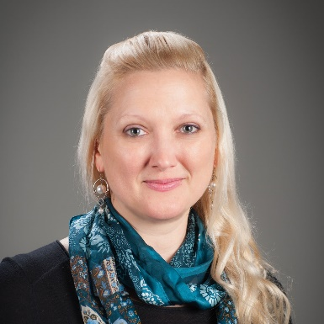
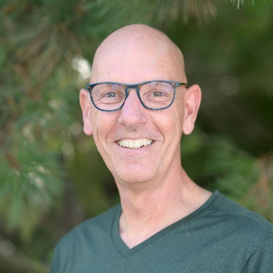
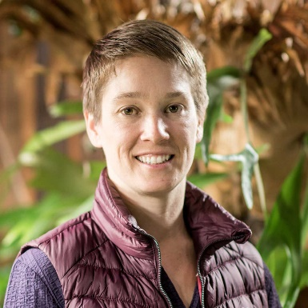
Graduate Studies Office
Leda Kobziar
Interim Director, CNR Graduate Studies Director, MNR Program lkobziar@uidaho.edu 208-292-2512, CNR 17
JayCee Hollingshead Graduate Programs Coordinator College of Natural Resources Administration jayceei@uidaho.edu | 208-885-1505 | CNR 211C
Jaap Vos
Interim Director, Environmental Science Program jvos@uidaho.edu |208-364-4595 Water Resource Center, 242G
Elise Kokenge Asst Director, Grad Student Support College of Natural Resources Administration ekokenge@uidaho.edu | 208-885-0165 | CNR 211B

Slide 4
Graduate Studies Office
Cnr-grad-studies@uidaho.edu
CNR 211 Student Services Suite
Director Roles
Office Roles
Increase quality of graduate experiences and education within the College of Natural Resources
Promote a safe, effective, and supportive working environment for graduate students
Advocate for student needs
Serve as ambassadors and liaisons between students, faculty, and other administrative entities including CoGS.
Promote, evaluate, and assess CNR graduate programs
Chair the CNR Graduate Council
Program requirement questions
Forms questions
Offer letter questions
Non-thesis program course navigation

Slide 5
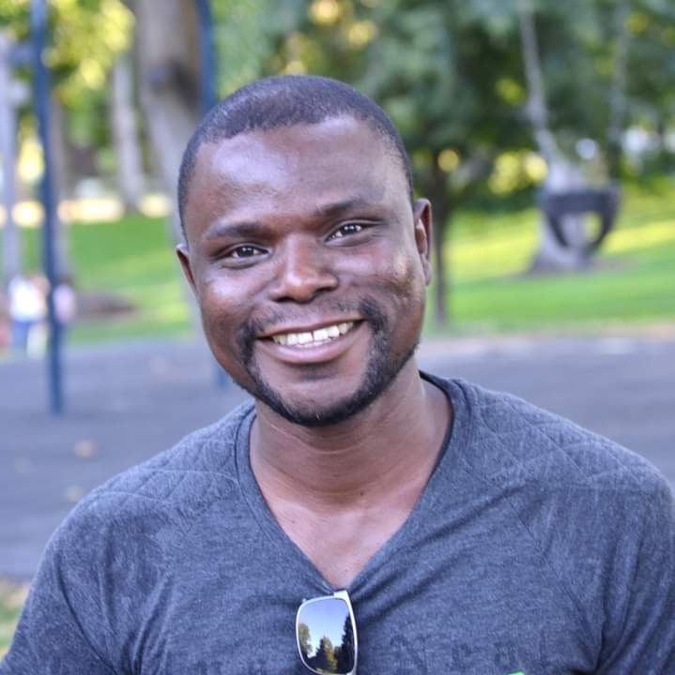
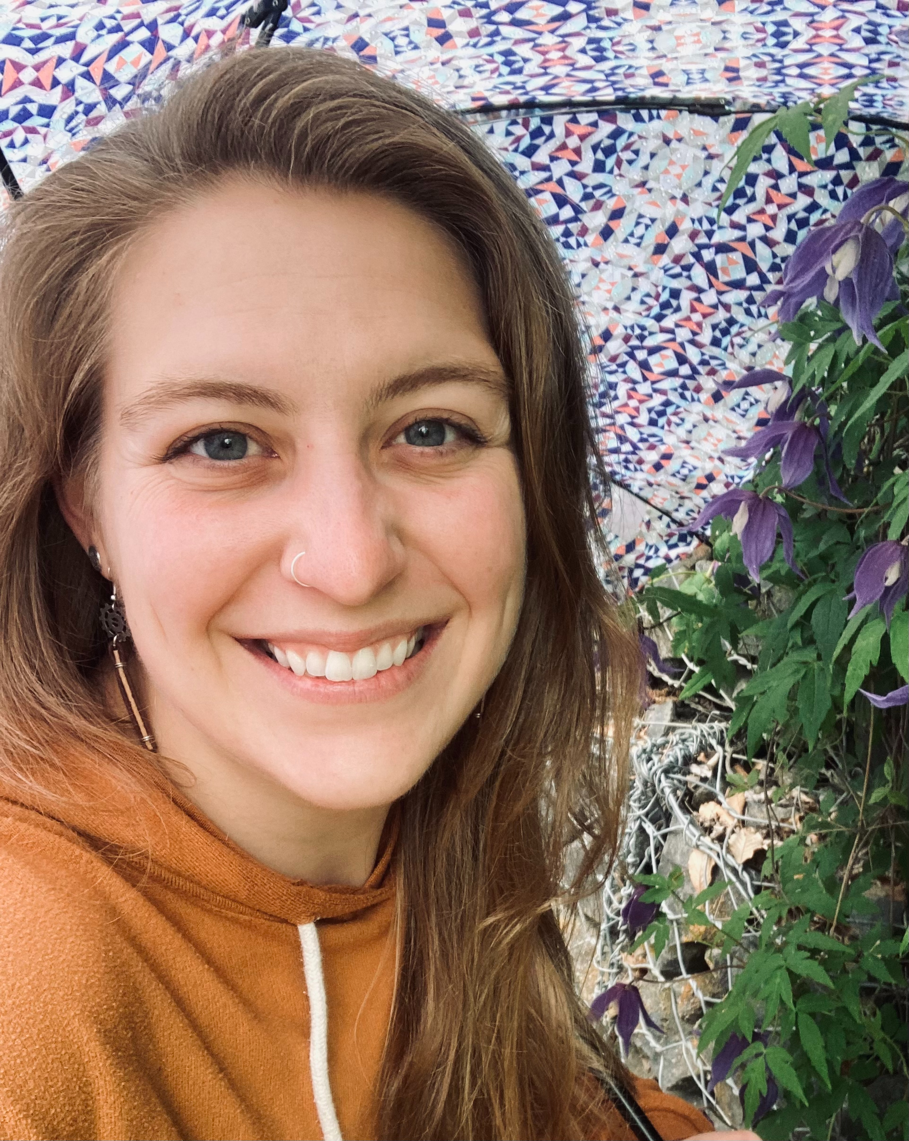
CNR GPSA graduate representatives
David Akowuah
Ph.D. Student FRFS / CNR Grad. Rep akow6305@vandals.uidaho.edu Phinney 306 South
Catherine Hughes
Ph.D. Candidate NRS / CNR Grad. Rep hugh2155@vandals.uidaho.edu CNR 19D

Slide 6
Ice Breaker
Advisor, Degree Program, Department
Where you are from
Favorite Food
Favorite thing to do
Center: one thing everyone at the table has in common

Slide 7
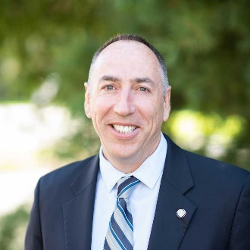
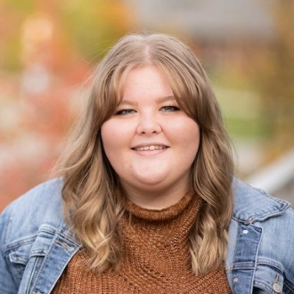
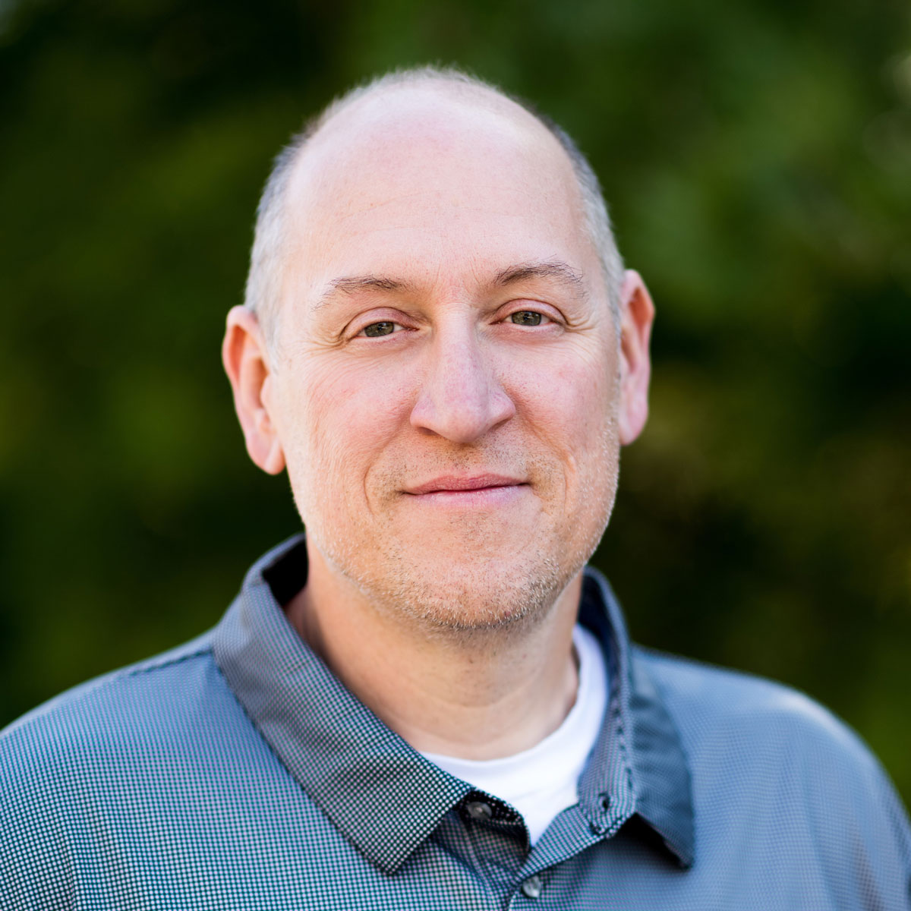
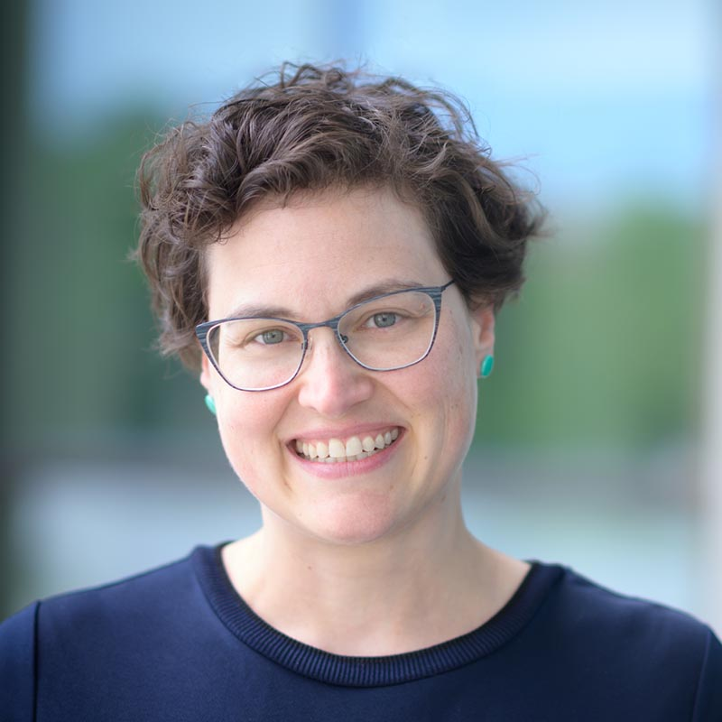
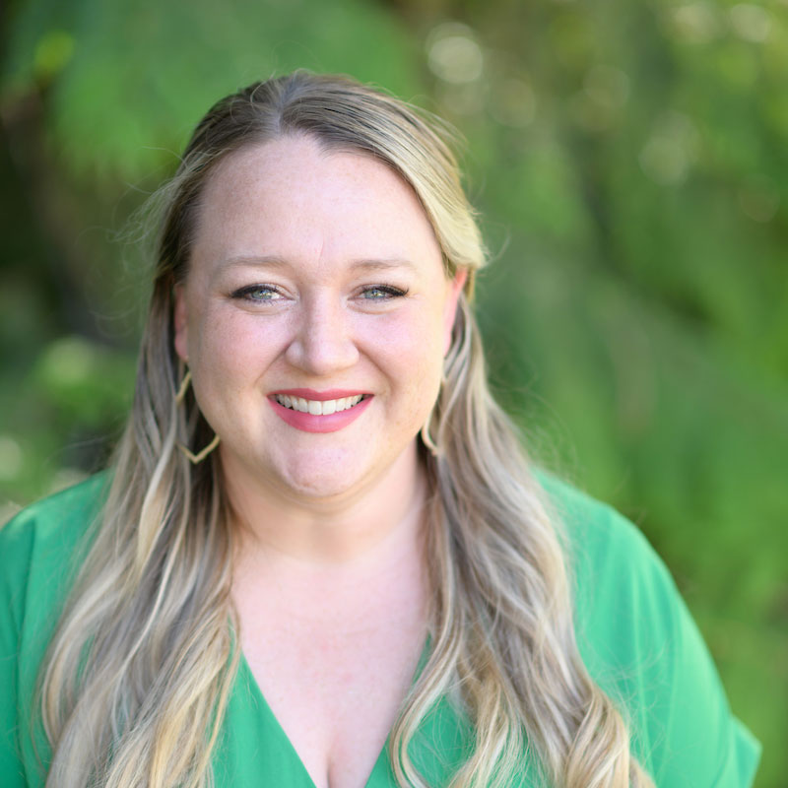
CNR Administration
Dennis Becker Dean and Professor of Natural Resource Policy CNR Administration drbecker@uidaho.edu | 208-885-8981 | CNR 202C
Tricia Maxey Assistant to the Dean Administrative Financial Specialist CNR Administration pmaxey@uidaho.edu | 208-885-8981 | CNR 201
Eva Strand Interim Associate Dean and Associate Professor of Rangeland Ecology & Mgmt CNR Administration evas@uidaho.edu | 208-885-5779 |CNR 202A
Steve Hacker Senior Director - Operations and Outreach CNR Administration shacker@uidaho.edu | 208-885-7400 | CNR 103F
Mary Ellen Brewick Development Director CNR Administration mebrewick@uidaho.edu | 208-885-5145 | CNR 202
Mindy McAllister Director of Recruitment and Stakeholder Engagement CNR Administration mmcallister@uidaho.edu | 208-885-6960 | CNR 202D
Stephanie Perez Assistant Director of Development CNR Administration stephaniep@uidaho.edu | CNR 202G

Slide 8
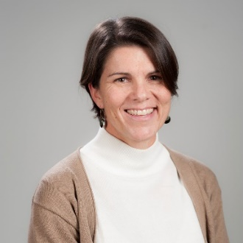
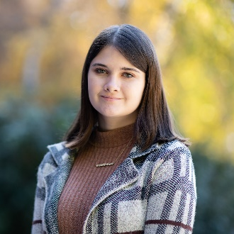
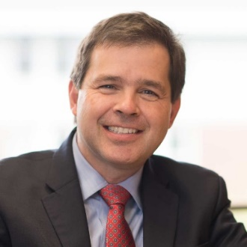
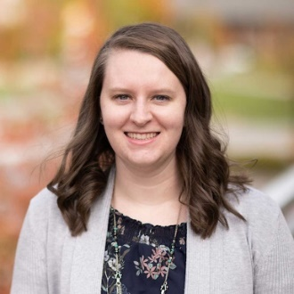
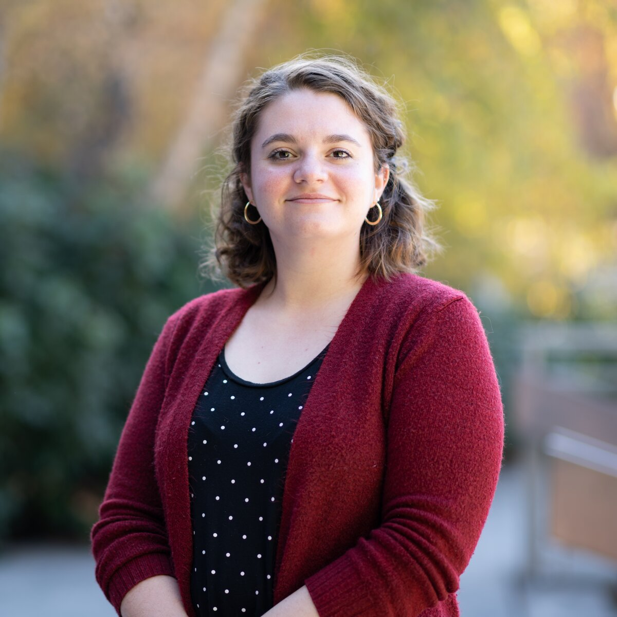
Fish & Wildlife sciences
CNR Department Leadership & administration
Janet Rachlow
Interim Department Head and Professor of Wildlife Ecology
CNR 105B | 208-885-9328 | jrachlow@uidaho.edu
Patience Mateer
Administrative Assistant II
CNR 105 | 208-885-6434 | pmateer@uidaho.edu
Forestry, Rangeland, & Fire sciences
Charles Goebel
Department Head and Professor of Forest Ecosystem Restoration and Ecology
CNR 204A | 208-885-7311 | cgoebel@uidaho.edu
Kaella Dinius
Administrative Assistant II
CNR 204 | 208-885-7952 | kaellad@uidaho.edu
Natural resources & Society / Environmental Science Program
Jaap Vos
Interim Director, Environmental Science Program and Professor of Planning and Natural Resources 208-364-4595 | Water Resource Center 242G | jvos@uidaho.edu
Jamie Jessup Administrative Assistant II Natural Resources and Society, Environmental Science Program CNR 15| 208-885-7911 | jessup@uidaho.edu

Slide 12
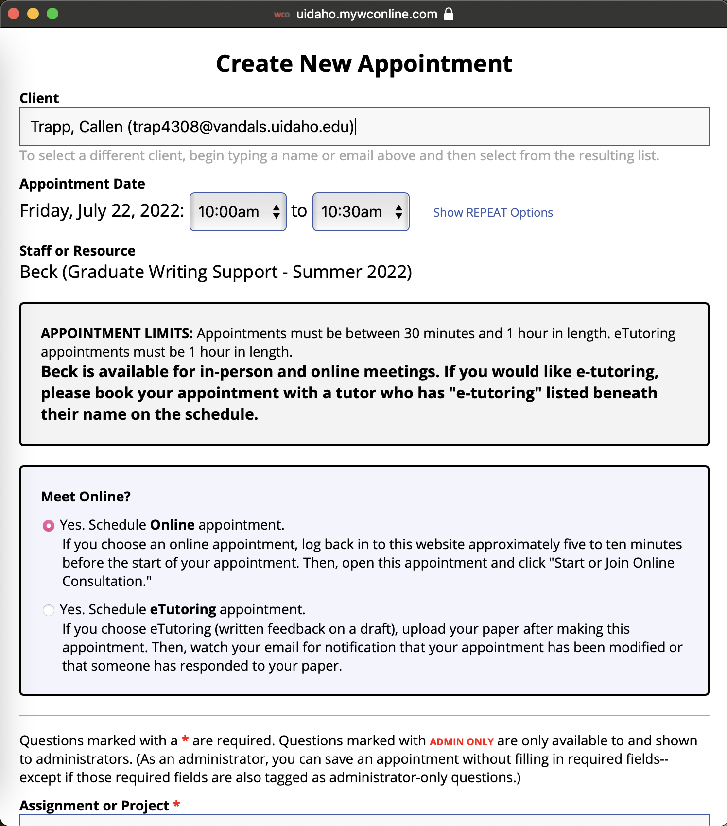

Slide 13
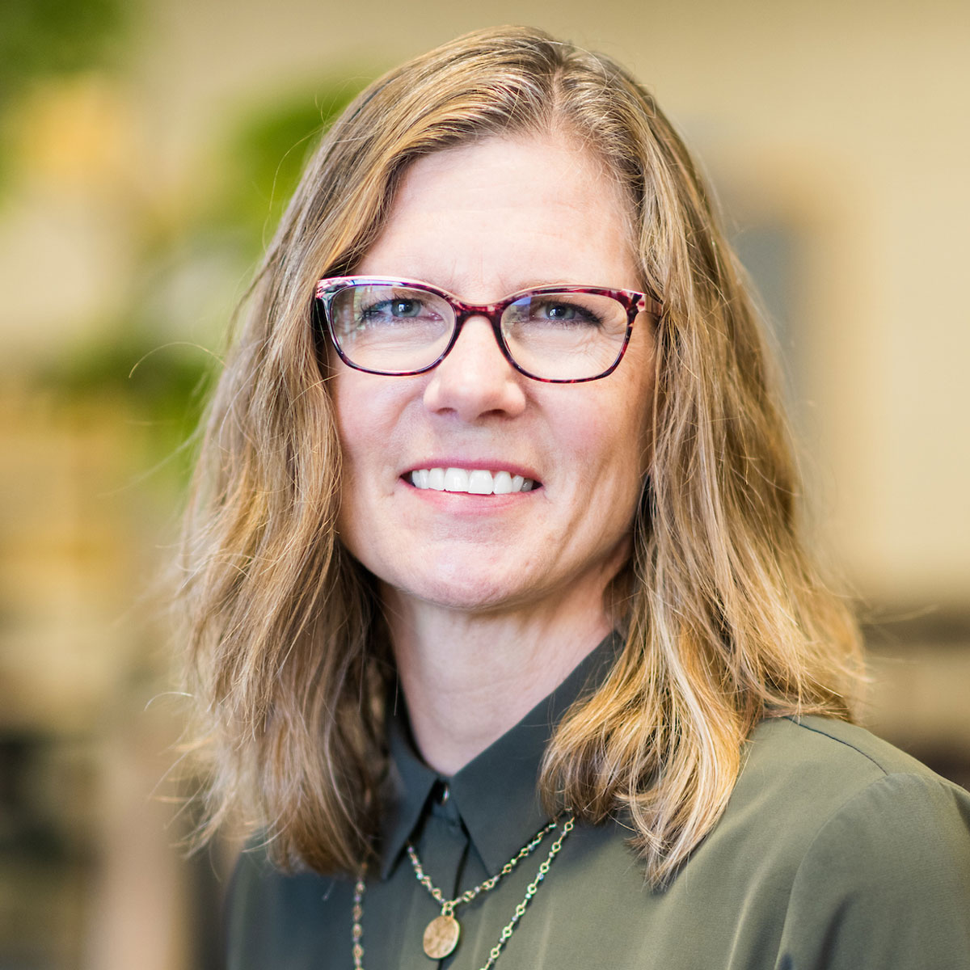
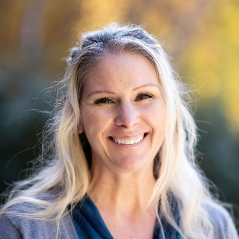
CNR Fiscal
Thomas Zimmer CNR Fiscal Operations Manager CNR Administration zimmer@uidaho.edu | 208-885-2023 | CNR 213F
Jennifer Meekhof Grants and Contracts Manager CNR Administration jmeekhof@uidaho.edu | 208-885-6673 | CNR 213D
Amy Huck Senior Budget Specialist CNR Administration ahuck@uidaho.edu | CNR 213C
Karen L. Johnson Administrative Financial Specialist Forest, Rangeland and Fire Sciences kalj@uidaho.edu | 208-885-1696 | CNR 204
Samiksha Gupta FWS Coop Program Coordinator College of Natural Resources Administration samig@uidaho.edu | 208-885-6336
Andrea Jenkins Financial Administrative Specialist Natural Resources & Society, Environmental Science Program ajenkins@uidaho.edu | 208-885-6023 | CNR 15
Jacob Brewer Administrative Financial Specialist Fish and Wildlife Sciences jbrewer@uidaho.edu | 208-885-1522

Slide 14
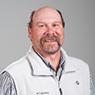
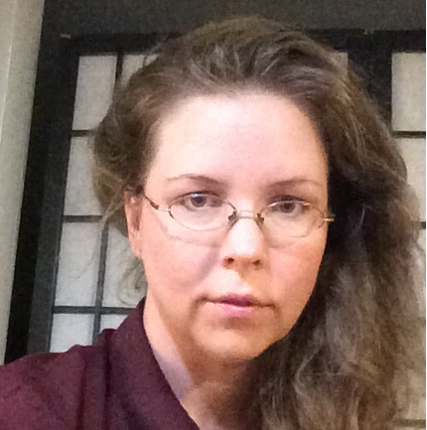
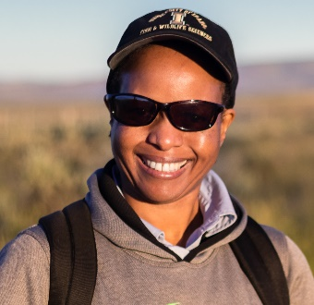
Motorpool
Darrell Stout Business Operations Supervisor Inventory/Safety/Risk Management/Motor Pool, CNR Administration dstout@uidaho.edu | 208-885-6799 | CNR 100
Arwen Bloomsburg
CNR Motorpool Billing
arwenb@uidaho.edu | 208-885-6581 | CNR 213
Motorpool Assistants Fall Semester
Ryle, Colton, Sam
motorpool@uidaho.edu | 208-885-6799 | CNR 100
Laboratories
Dorah Mtui Laboratory Manager Fish and Wildlife Sciences dorahm@uidaho.edu | 208-885-0624 | CNR 217

Slide 15
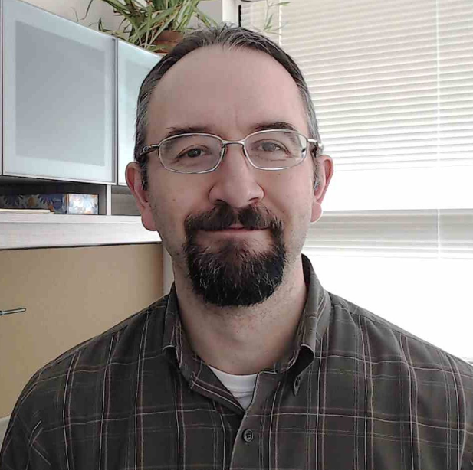
Research Librarian & associate professor:
Jeremy Kenyon Research Librarian
UI Library jkenyon@uidaho.edu | 208-885-7955 | Library, Room 416L

Slide 16
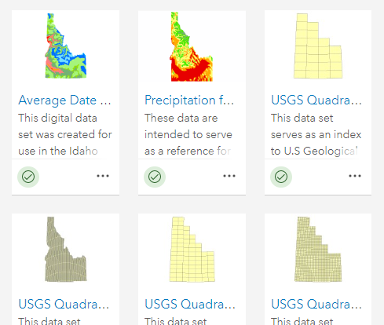
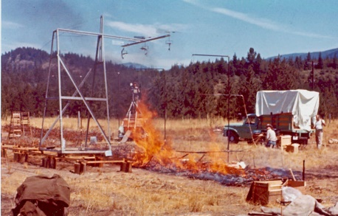
Resources at the U of I Library
Journals and Literature Databases
Journals: nearly all major and society journals, esp. in Natural Resources and Agriculture
Databases: Web of Science, Wildlife and Ecology Studies, Dissertations and Theses Full-text, Sage Research Methods Online, and more.
Access to books and similar items from Northwest universities through Summit, and everywhere else through Interlibrary Loan
Access to ArcGIS, ArcGIS Online, and INSIDE Idaho – Idaho’s GIS clearinghouse of datasets and applications
Historical resources: Idaho’s social, cultural, and ecological history in digitized documents, photographs, and more. Esp. strong in forestry, logging, mining, fire, and conservation.

Slide 17
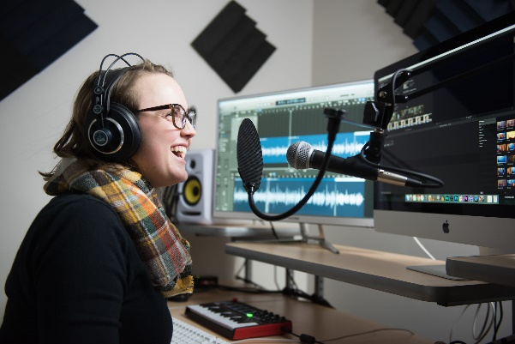
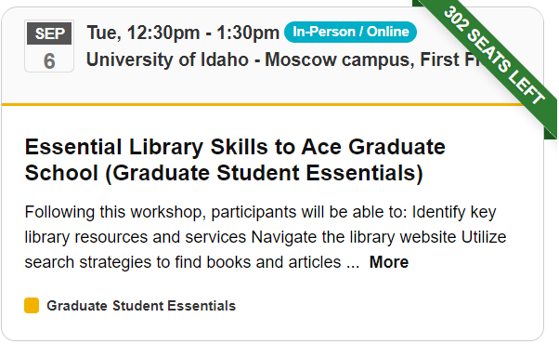
Services at the U of I Library
Library liaison–research assistance focused on CNR and its programs
The Data Hub – geospatial and data services support, staffed 11am-3pm, M-F
The Studio – audio/visual lab, open for use 9am-9pm
Reservable study rooms on the 1st / 3rd floors, as well as reservable graduate study carrels.
Workshops: Graduate Student Essentials, every Tues @ 12:30pm, others on the calendar
Off-campus access: for those at a distance, books can be mailed or some items digitized. For journals/databases, various ways to log in and get access.

Slide 18
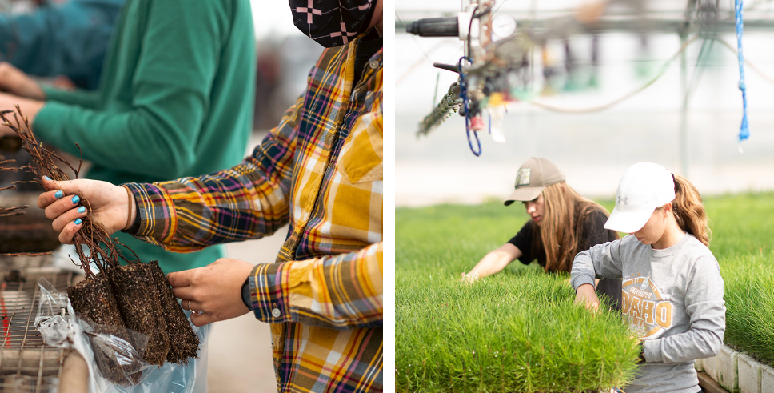
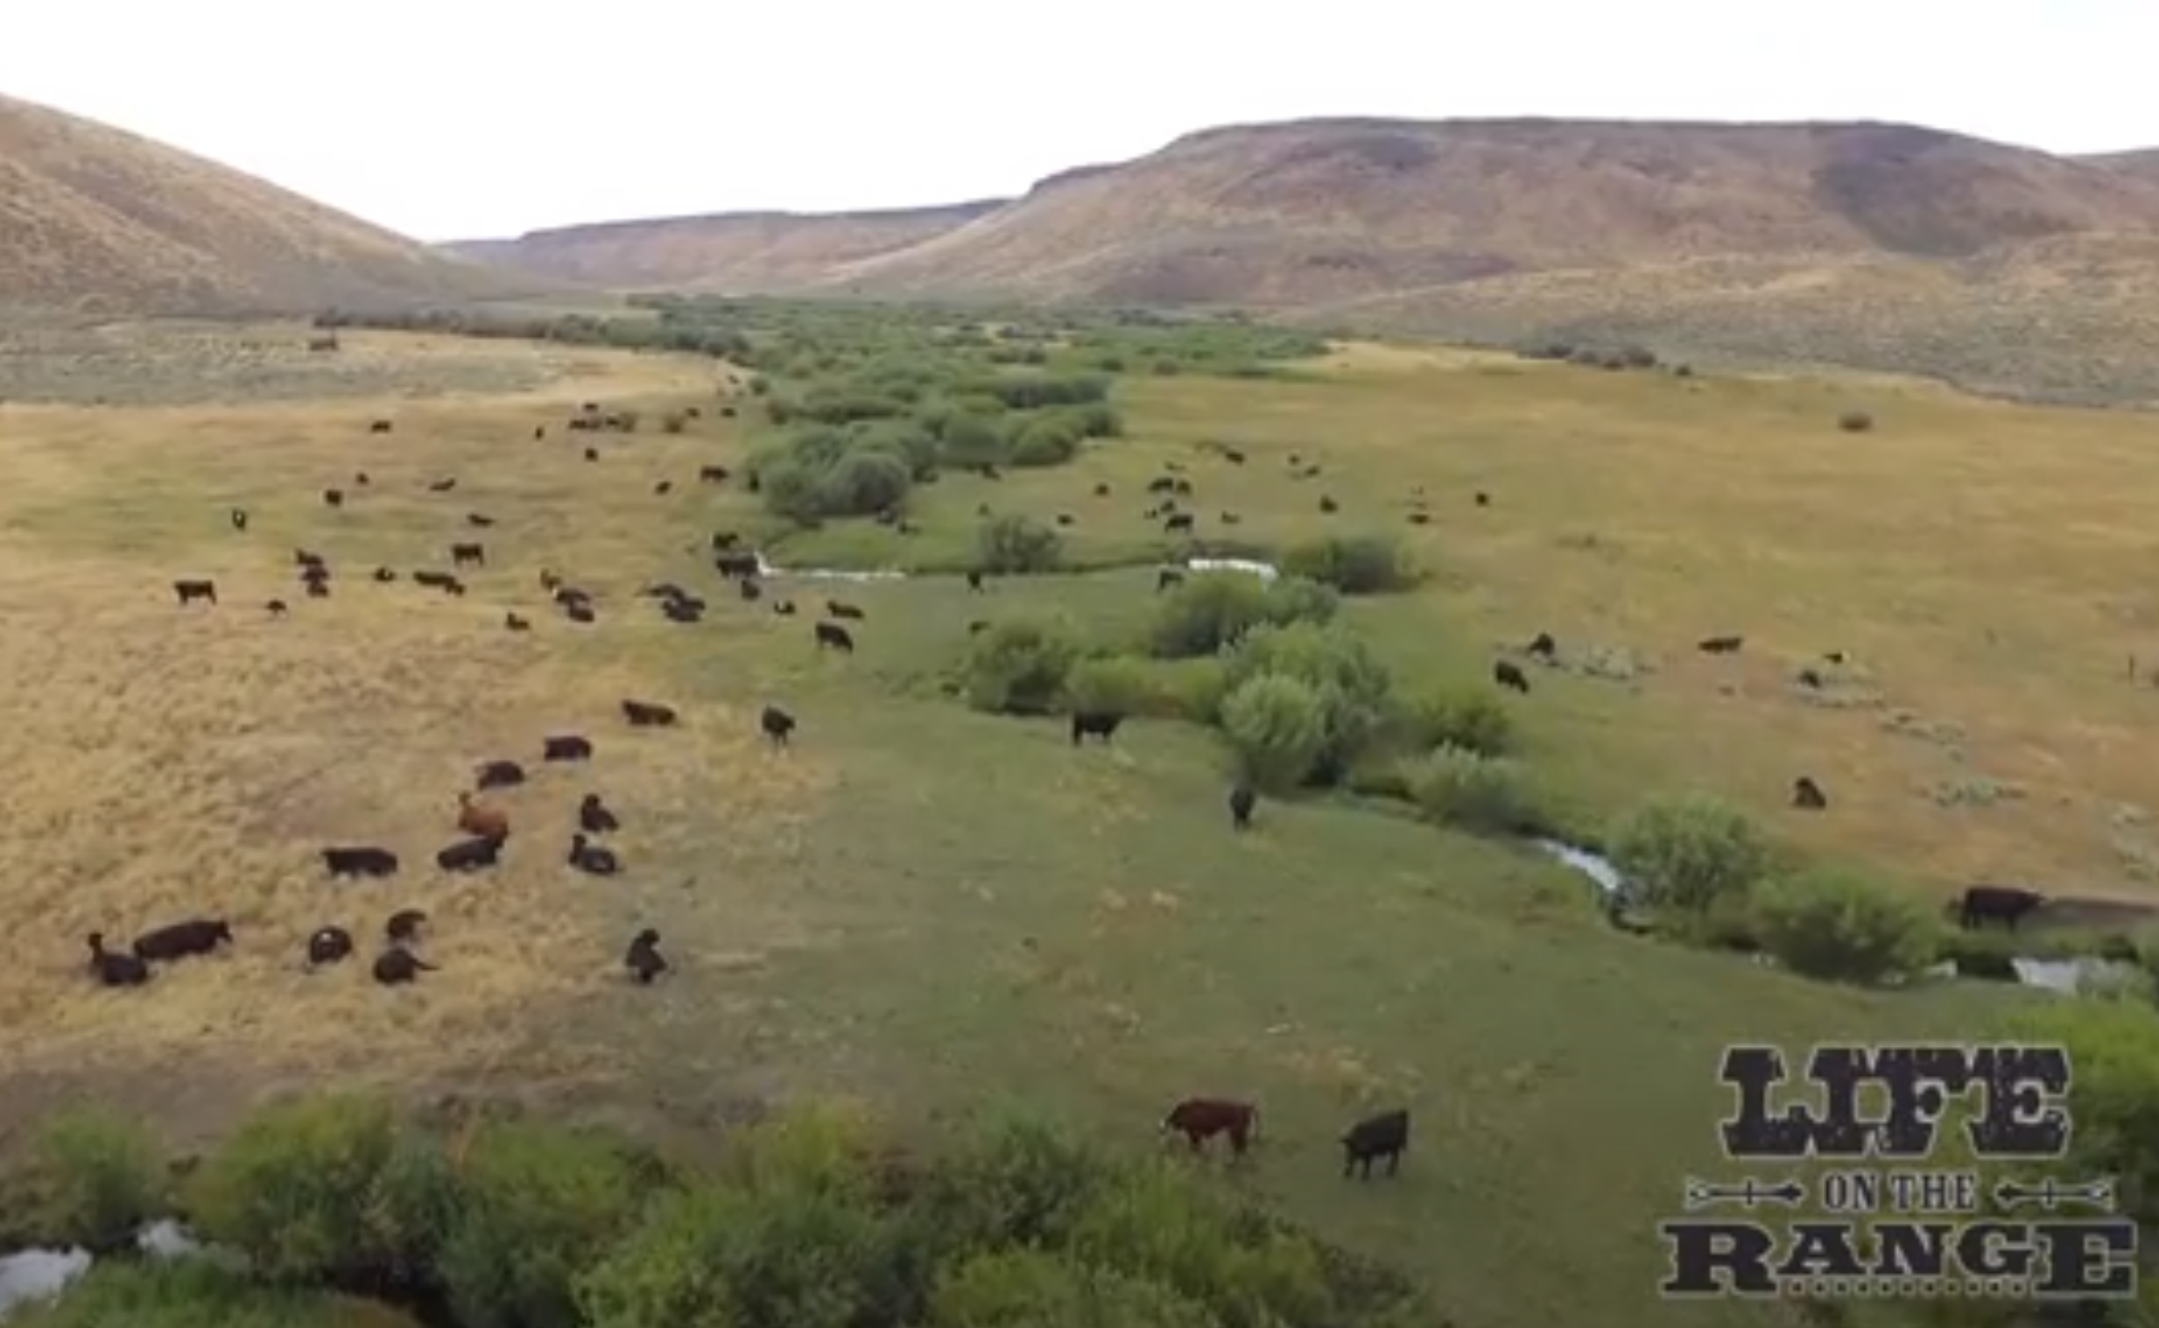
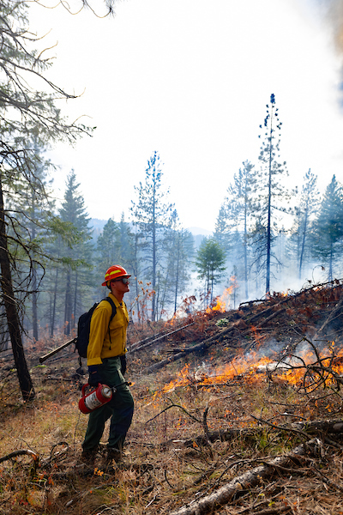
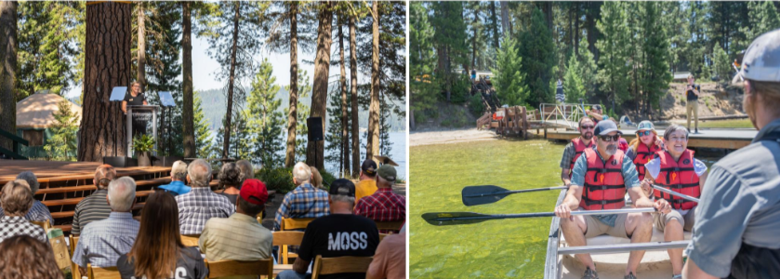
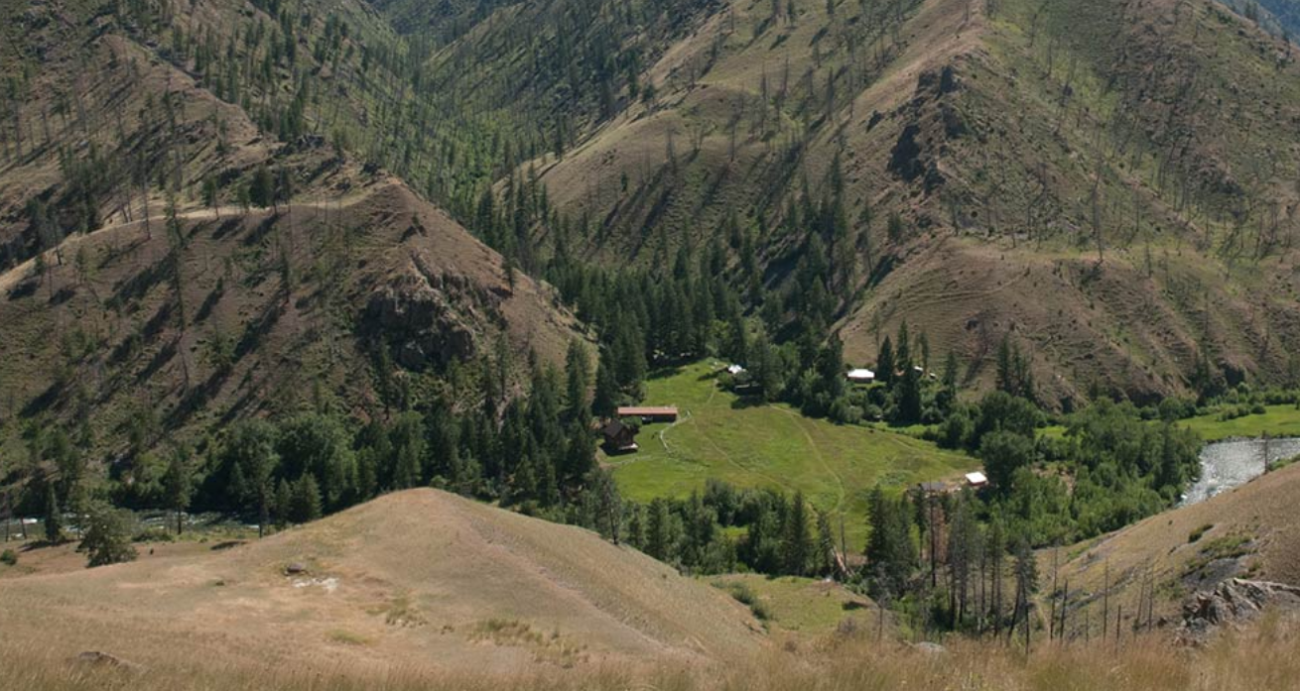
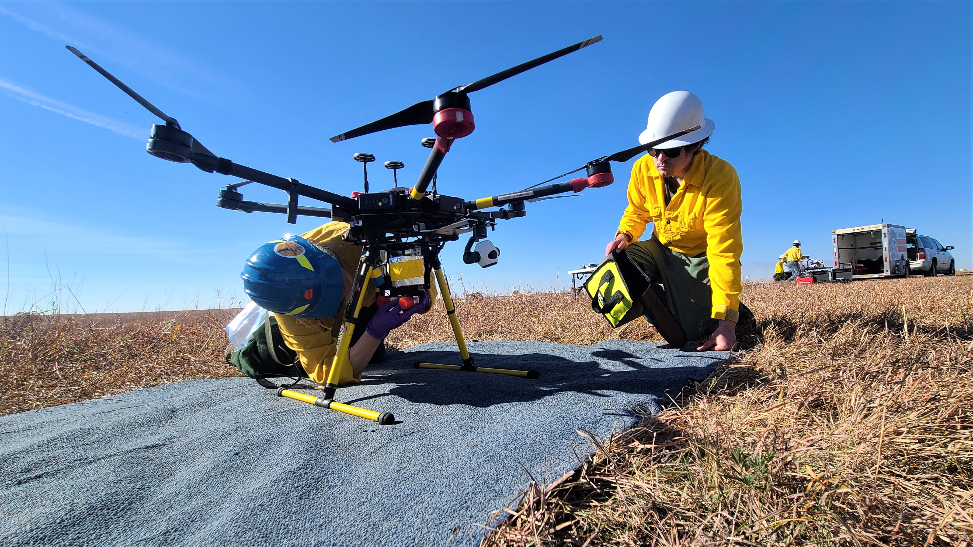
CNR across the state
leda
Rinker Rock Creek Ranch (SW of Hailey, ID)
UIEF
Pitkin Nursery and IFIRE Lab (Moscow)
McCall Outdoor Science School (McCall, ID)
Taylor Wilderness Research Station (Frank Church RNR Wilderness)
Drone Lab (IRIC)

Slide 19
Keys to Communication
Concise
Courteous
Timing
Notes:
Concise, professional, courteous emails with a consideration of timing are several keys for successful communication, not just in academia but in our professional lives.

Slide 20
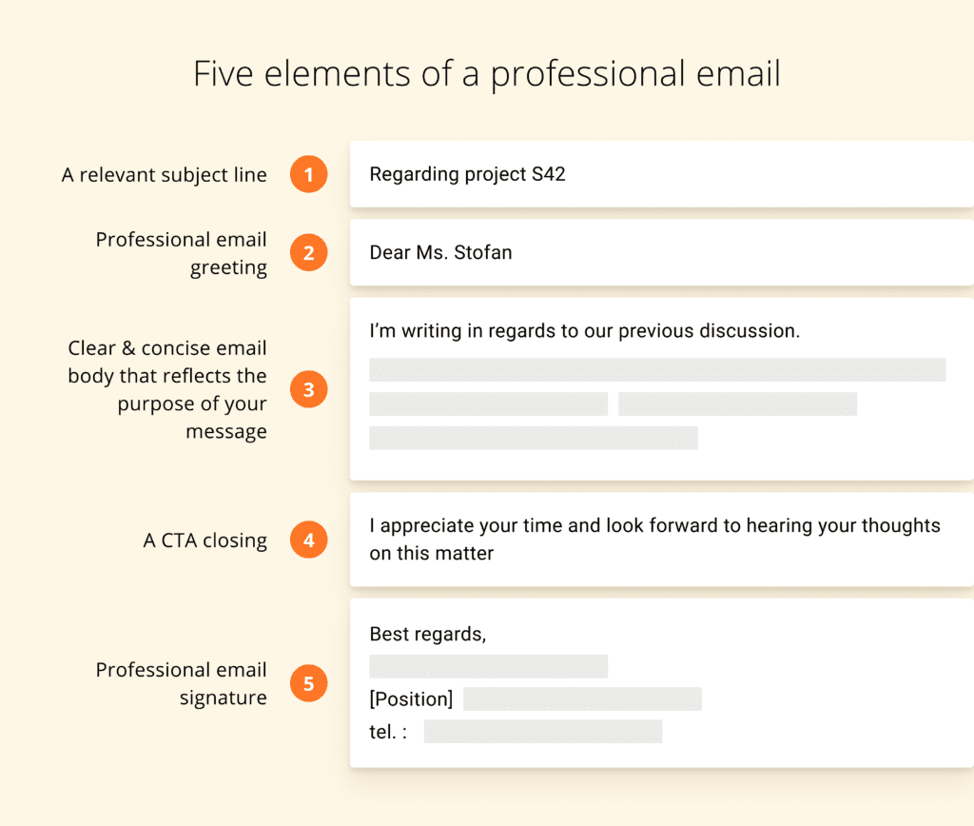
Email Construction
Dear Dr. Vandal
UI Email Signature Generator – Brand Resource Center
- Templates, PP, Flyers, etc.
UI Email Signature Generator – Brand Resource Center
- Templates, PP, Flyers, etc.
Notes:
The university of Idaho provides an email signature generator from the Brand Resource center, You can either click the link in the PowerPoint or you can search Brand Resource Center on uidaho.edu. The brand resource center has many templates with college and program logos. Once you create your email signature, save it into Outlook signatures to close each of your emails.

Slide 21
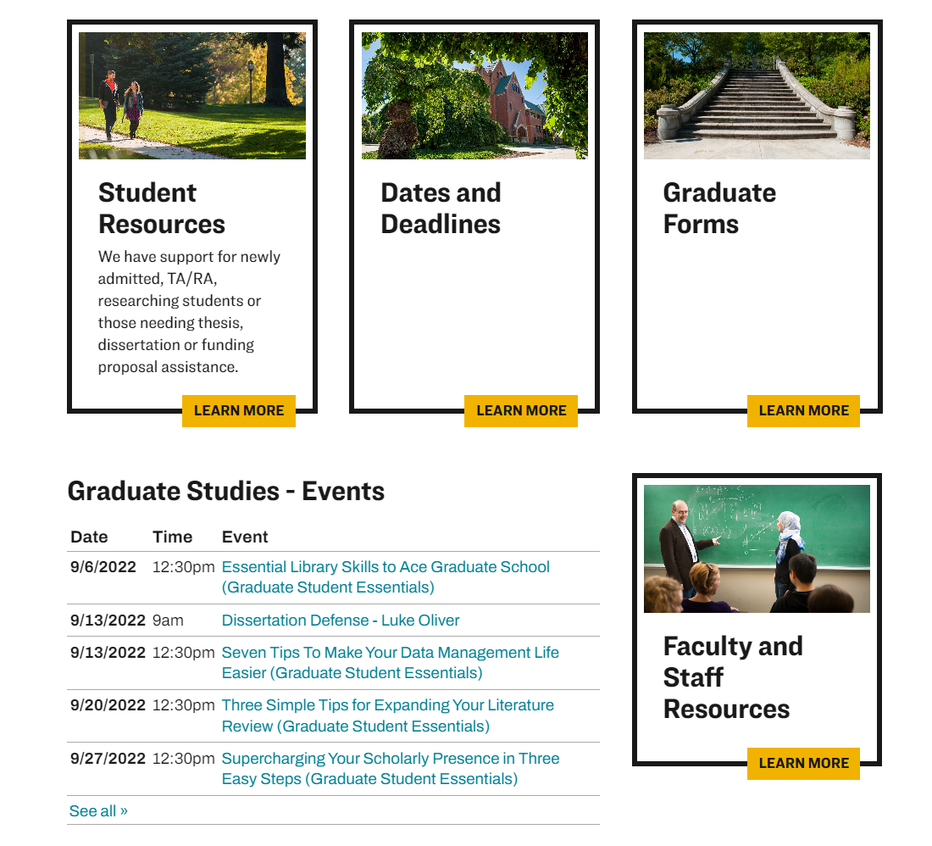
College of graduate studies (COGS)
Graduate degree-granting college and encompasses all graduate programs of the university
Oversee all graduate students
General degree requirements
Maintain 3.0 GPA
# credits to complete degree, transfer credit policy, # of research credits, etc.
Questions about processes (not degree content)
Major professor/committee form, study plan, theses/dissertation
Location: Morrill Hall, Room 104 Email: cogs@uidaho.edu
Website: www.uidaho.edu/cogs Phone: 208-885-6541

Slide 22
COGS: Workshops
Graduate Student Essentials
Workshop Series
Be sure to check the COGS Calendar for events!
https://www.uidaho.edu/cogs/news-events/calendar
Contact COGS directly for further information
Funding Workshops
How to Fund your Graduate Education
Prestigious Fellowship Workshop (2 parts)
Prestigious Fellowship Workshop: Student & Faculty Panel
Prestigious Fellowship Workshop: International Student
Graduate Student Support Workshops
GSSW – Public Speaking Anxiety
GSSW – Imposter Syndrome
Mental Health Webinars
You can also check the Canvas Site Graduate Student Support for previous and upcoming events.

Slide 23
College of Law: Legal clinics
Third-year law students who’ve earned a limited license to practice, represent clients in a variety of different courts under the supervision of clinical faculty.
Free services available to University of Idaho students and the general public
MOSCOW
BOISE
Main Street Law Clinic
Misdemeanor defense
Family law
Consumer protection
Landlord-tenant disputes
Immigration Litigation & Appellate Clinic
Asylum
Permanent resident status
Citizenship
Status under the Violence Against Women Act (VAWA)
Relief from removal
Educational programs in immigrant communities
Clinical Labs
Bankruptcy
Family Justice Clinic
Victims of domestic and sexual abuse
Entrepreneurship Law Clinic
Small and start-up business
For profit and nonprofit
Housing Clinic
Residential tenant eviction defense
Habitability
Security deposits
Email: legalaidclinic@uidaho.edu
Phone: 208-885-6541

Slide 24
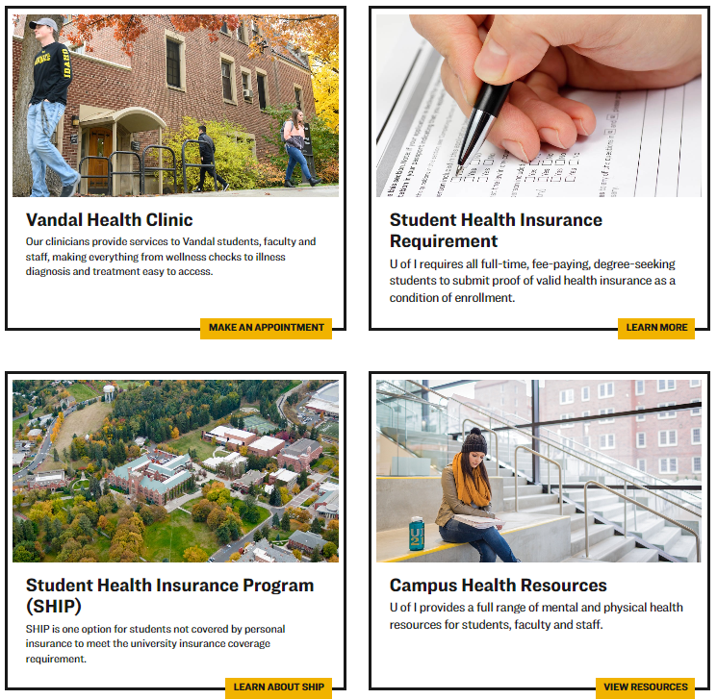
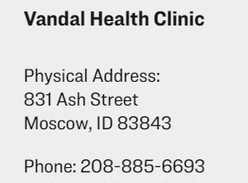
Student Health
Our health as a vandal family is a priority...
The Student Health Services (SHS) supports the university community's overall health and wellness.
SHS oversees all health-related matters:
Vandal Health Clinic
UI Health Insurance Requirement
Student Health Insurance Program (SHIP)
Location:
www.uidaho.edu/vandal-health-clinic

Slide 25
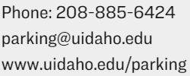
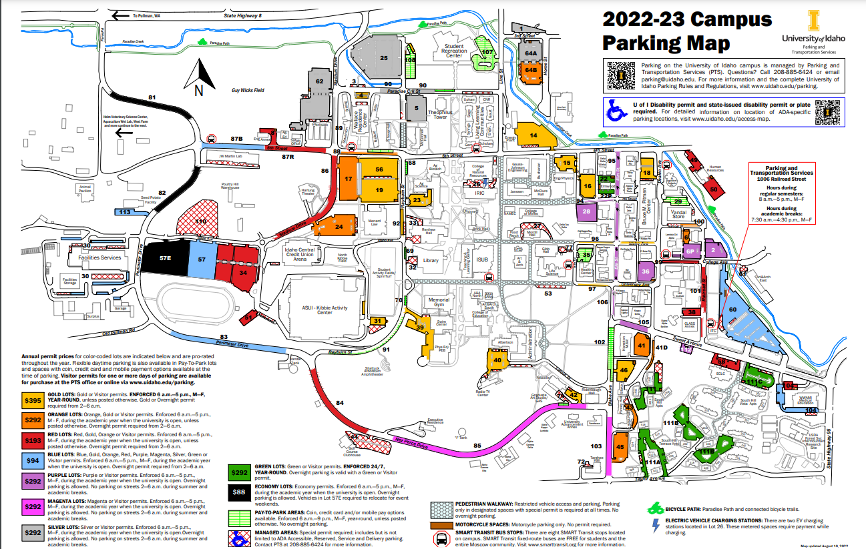
Parking and vehicles
Parking and Transportation Services:

Slide 26
Local Transportation
SMART Transit (FREE fixed-route shuttle & other low-cost options)
www.smarttransit.org/ Download the FREE fixed-route schedule HERE
Moscow VanPool (Commute for a small fee)
www.ci.moscow.id.us/177/VanPool
Vandal Access (On-campus ADA mobility assistance)
www.uidaho.edu/infrastructure/parking/shuttle
Taxis
College Cabs LLC: 855-829-4487 | College Cabs LLC on Facebook
Moscow Taxi: 208-892-4544 | Moscow Taxi
For more info visit: https://www.uidaho.edu/infrastructure/parking/alternative-transportation/local-transit

Slide 27
Free food for students!
Grocery store style food pantry
Multiple free food cabinets across campus
Mobile Food Pantry once a month
Swipe Out Hunger short-term food insecurity relief
For more information visit: www.uidaho.edu/current-students/student-involvement/food-pantry
Contact the Food Pantry at foodpantry@uidaho.edu or call 208-885-6078

Slide 28
Center for Disability Access and Resources (CDAR)
“The University of Idaho is committed to providing equal and integrated access for individuals with disabilities to all the academic, social, cultural and recreational programs it offers.”
Classroom accessibility
Testing accommodations
Notetaking services
Assistive technology
Scholarships
…and more!
Contact CDAR
Bruce M. Pitman Center
Suite 127
Phone: 208-885-6307
Fax: 208-885-4257
Email: cdar@uidaho.edu
Website: www.uidaho.edu/current-students/cdar

Slide 29
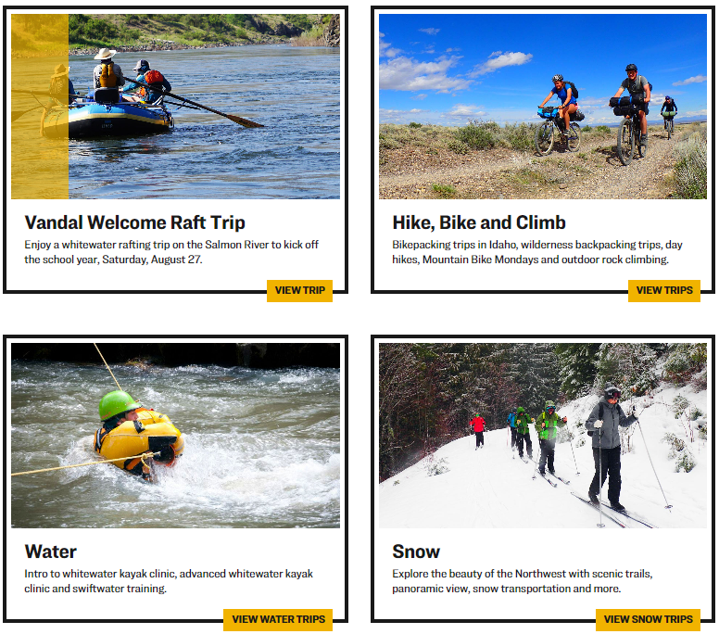
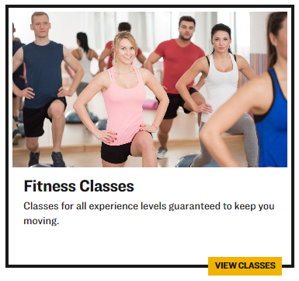
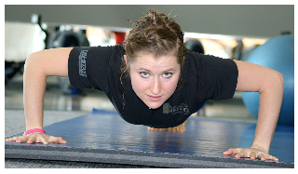
Recreation & Wellbeing Outdoor program
Location: Student Rec Center
Website: https://www.uidaho.edu/current-students/recwell
Email: recwell@uidaho.edu /
Phone: 208-885-6381

Slide 30
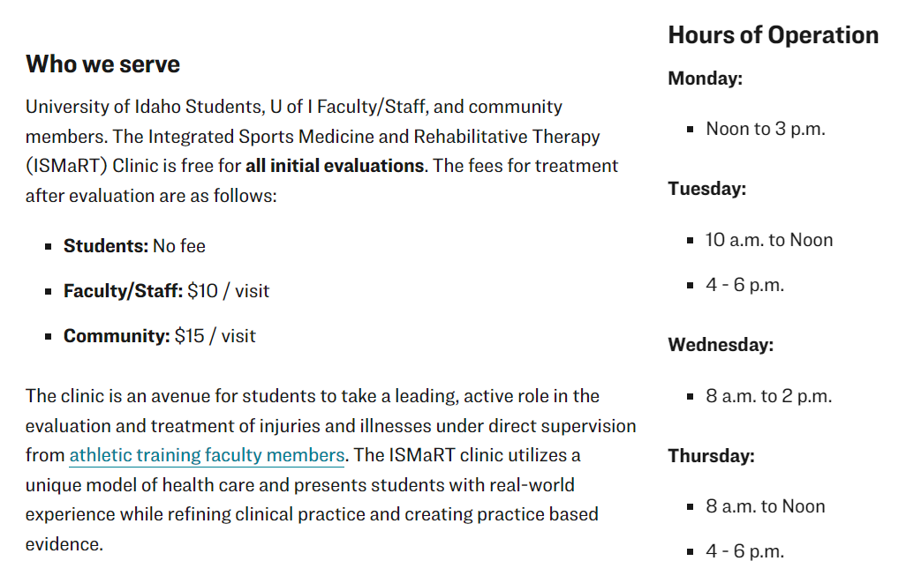
Integrated Sports Medicine & Rehabilitative Therapy clinic - ISMArt
Location: First Floor Education Building
atclinic@uidaho.edu
208-885-1673

Slide 31
Women’s Center
Website: https://www.uidaho.edu/diversity/edu/womens-center
Email: wcenter@uidaho.edu
Phone 208-885-2777
Office: Memorial Gym Room 109
Notes:
Founded in 1972, the Women’s Center is one of the longest-running, continuously operated campus-based women’s centers in the United States!
For almost 50 years, we’ve been advocating for gender justice by providing innovative ways for students, staff, faculty, and local community members to learn more about social justice and enjoy a safe, comfortable place to gather, interact, and study. They facilitate exceptional opportunities for deep learning and engaged activism, in order to support and empower all individuals in building an inclusive and compassionate society.

Slide 32
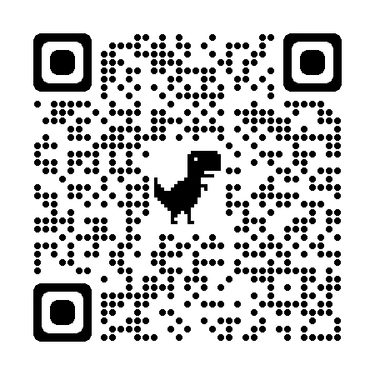
Please provide us feedback

Slide 33
Group activity: Hunt for the answers in the CNR Graduate Handbook
Directions

Slide 34
1. What is the difference between the number of credits required to complete a MS degree and a PhD degree in the College, times the number of departments in the College (answer is one number)?
Notes:
Page 5

Slide 35
2. Which degree program from which department requires the highest number of semesters of Seminar?
Notes:
Page 13

Slide 36
3. You are a student with a 20 hr/week RA or TA assistantship. How many credits must you take each semester?
Notes:
Page 28 to COGS website for answer

Slide 37
4. During the annual review process, what are the four things graduate students who receive a warning should expect to know?
Notes:
Page 22

Slide 38
5. As a UI graduate student acquiring data while your RA/TA is funded by an either and internal or external fund, who owns the data you produce or discoveries you make (intellectual property)?
Notes:
Page 27-28

Slide 39
6. What does "EESC" stand for and to which UI property would you go to attend the program?
Notes:
Page 7

Slide 40
7. What is considered good academic standing for graduate students?
Notes:
Page 22

Slide 41
8. What is the CNR Graduate Studies Office always willing to help with?
Notes:
Page 24

