Slide 1

Chrome River Travel for the
Traveler
Training
Notes:
Hello! And welcome to the College of Natural Resources Chrome River Travel training. This video is created with the new C N R traveler in mind.
The course will give an overview of the procedures and paperwork needed to travel on business for the University of Idaho and the College of Natural Resources.
Additional information is available at the C N R Fiscal page on the University of Idaho website or by contacting the C N R fiscal team.
Please feel free to reach out at any time by emailing cnrfiscal@uidaho.edu with questions or for assistance.

Slide 2
Course overview
Overview
  CNR Fiscal
    Fiscal Processors/delegates
    GL Approvers
  Chrome River
    For UI employee p-card, travel, OOP reimbursement
TRPA/travel claim creation & submission
Pre-Travel
During Travel
After Travel
Claim Submission
This is a presentation designed for the CNR Traveler for domestic and international travel.
Notes:
C N R Fiscal is the group of staff in the College of Natural Resources that processes all financial transactions including travel claims and purchase card transactions. They are referred to throughout this presentation as either "C N R Fiscal Processors" or "Delegates".
C N R Fiscal also includes the General Ledger (or G L) Approvers for the College of Natural Resources. G L Approvers are the highest-level fiscal approvers in a college.
Chrome River is the University of Idaho's platform for clearing all purchase card transactions, travel claims, and out-of-pocket reimbursements for employees.
The T R P A and travel claim creation and submission is the list of things that a traveler needs to do before, during, and after travel, in order to clear travel expenses and receive reimbursement.

Slide 3
Travel Pre-approval pathway
Research plan w/social distancing
Department Head Approval
CR Traveler Pre-Approval
Supervisor
APPROVED for Travel
GL Approver Steve Hacker*
Traveler Pre-Approval
GL Approvers: Grant- A Huck, NonGrant- J Christensen
APPROVED for Travel
Supervisor
Normal process
Covid (OR SImilar EVENT) process*
No Pre-Approval submission means that no travel claim can be processed. Must create a Pre-Approval for any reimbursements or clearing charges.
*Subject to change
Notes:
Before you travel you must complete and submit a Travel Pre- Approval, also known as a "T R P A", in Chrome River.
The T R P A must be completed, submitted, and approved before you leave on your trip.
In case of COVID or other similar indiscriminate travel restrictions, the Primary Investigator (or P I) on a project must submit a research plan to the P I's department head, which the department head must approve, before the traveler can complete the T R P A.
If you do not complete a T R P A, your travel claim cannot be processed, and you will not receive any reimbursement for per diem, mileage, or out-of-pocket expenses incurred on the trip.
Contact C N R Fiscal if you have questions or concerns about this.

Slide 4
CNR Traveler overview
BEFORE TRAVEL
DURING TRAVEL
AFTER TRAVEL
Create a
Travel Pre-Approval Request with Expense Estimates
Domestic: two weeks prior, minimum
International: 30 days prior, minimum
Collect your receipts:
Physical or digital (email or photo)
Complete Travel Claim Expense form
Provide receipts
Save as pdf, jpeg, or png
OR
Upload directly to Chrome River (Drag-and-drop or CR SNAP app)
Submit to CNRfiscal@uidaho.edu
Notes:
Before you travel: Create a T R P A and get it approved before you leave for your trip.
Anyone who is traveling on university business must submit a T R P A even if that person decides to not request any reimbursement.
You must also submit a T R P A if you are paying for someone else's travel, but are not traveling yourself.
If you are travelling domestically, you must submit your T R P A a minimum of two weeks before your departure date.
If you are travelling internationally, you must submit your T R P A a minimum of 30 days before your departure date.
During Travel: You must keep the receipts for all your travel expenses and submit them with your travel claim.
C N R Fiscal strongly recommends taking a picture of each receipt, so that you can submit it even if you lose or accidentally destroy the physical copy.
Receipts may also be uploaded directly to Chrome River, either by logging in and dragging-and-dropping them into your receipt gallery, or by uploading via the Chrome River SNAP application.
After your trip ends: To begin the processing on your travel claim, you need to complete a Travel Claim Expense Form and submit it with your receipts for the trip.
The Travel Claim Expense Form and receipts may be submitted electronically in P D F, J PEG or P N G format.
An important side note: If you used a Motor Pool Vehicle with a fleet card, the fleet card receipts should be sent directly to Motor Pool. Fleet card receipts do not go on your Travel Claim Expense Form.

Slide 5
Travel report approval
Traveler
Inspect for errors
Inpect for errors
Inspect for errors
Processor
Create report
Final check
Supervisor
GL Approver
Accounts Payable
After travel, a report is created and submitted
Traveler can return for corrections.
Processor makes all
Corrections
Report can be returned at any point in the process
  **IF you see an error, return the report for corrections!
Traveler and delegates ALL get an email notification.
Notes:
When you return from travel, you will complete the Travel Claim Expense form and submit it to C N R Fiscal via email.
The C N R fiscal processor will enter the information from the Travel Claim Expense Form into a Travel Report in Chrome River.
Travelers should not submit or create their own travel reports.
The C N R Fiscal Processors complete and submit the travel report.
This will route to you, the traveler for review and approval.
Please review the report.
If there are errors or omissions, you will need to return the report to the C N R Fiscal Processor to correct it.
You should put the details of the corrections in the comments section on the front page of the report.
If the report is correct, you may approve it.
Once you have approved a Travel Report, this report then moves to the G L Approver, followed by your supervisor, and then to Accounts Payable for final approval.
Anyone can return the report for corrections; however, all corrections will be made by the C N R Fiscal Processors.
The traveler and their delegates (the C N R fiscal processors) receive email notifications for all returned reports.
You are not expected to make corrections but C N R Fiscal may ask you for clarification or additional information.

Slide 6
BEFORE TRAVEL
Traveler Responsibilities
Notes:
Let's move into what you need to do to before you travel.

Slide 7
Travel PRE-APPROVAL instructions
Chrome River TRPA instructions
After-the-fact TRPA
International Travel
Personal Travel
Notes:
The link in the first bullet will take you to the instructions for completing your T R P A.
Please follow the link if you need to refresh your memory.
We will go through the instructions in the next few slides.
We will also go over After-the fact T R P A s, special instructions for international travel, and personal travel.

Slide 8
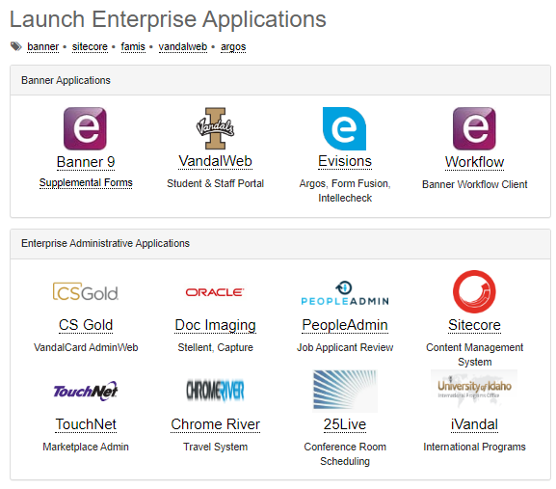
8-18-2022 A Bloomsburg
Chrome River Travel Pre-Approval (TRPA) Instructions
Access Chrome River by going to https://support.uidaho.edu/TDClient/Requests/ServiceDet?ID=707
Log in with your University of Idaho NetID and password.
Click on the Chrome River icon to enter the application
Notes:
Access Chrome River by clicking on the link in the slide, or typing the web address into your browser.
You will have to log in with your University of Idaho NetID and password. If you do not have those credentials, please contact I T S.
Once you are in, click the Chrome River icon to open the application. You should not have to enter your credentials again.

Slide 9
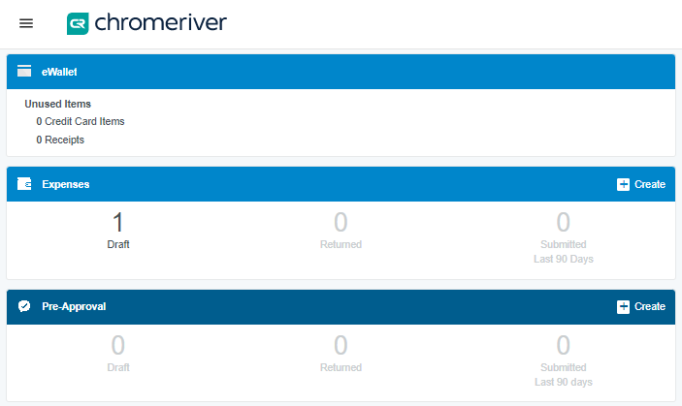
8-18-2022 A Bloomsburg
Chrome River Travel Pre-Approval (TRPA) Instructions
4. Once in Chrome River, on the left side of the screen, you will
see three headers "eWallet", "Expenses", and Pre-approval".
5. Click the "+ Create" link on the "Pre-Approval" Header.
This will bring up a "Pre-Approvals for [Your Name]" screen
on the right side of the browser window.
Notes:
In Chrome River, there will be at least three headers on the left side of the screen.
Look for the "Pre-Approval" header, and click on "Create".

Slide 10
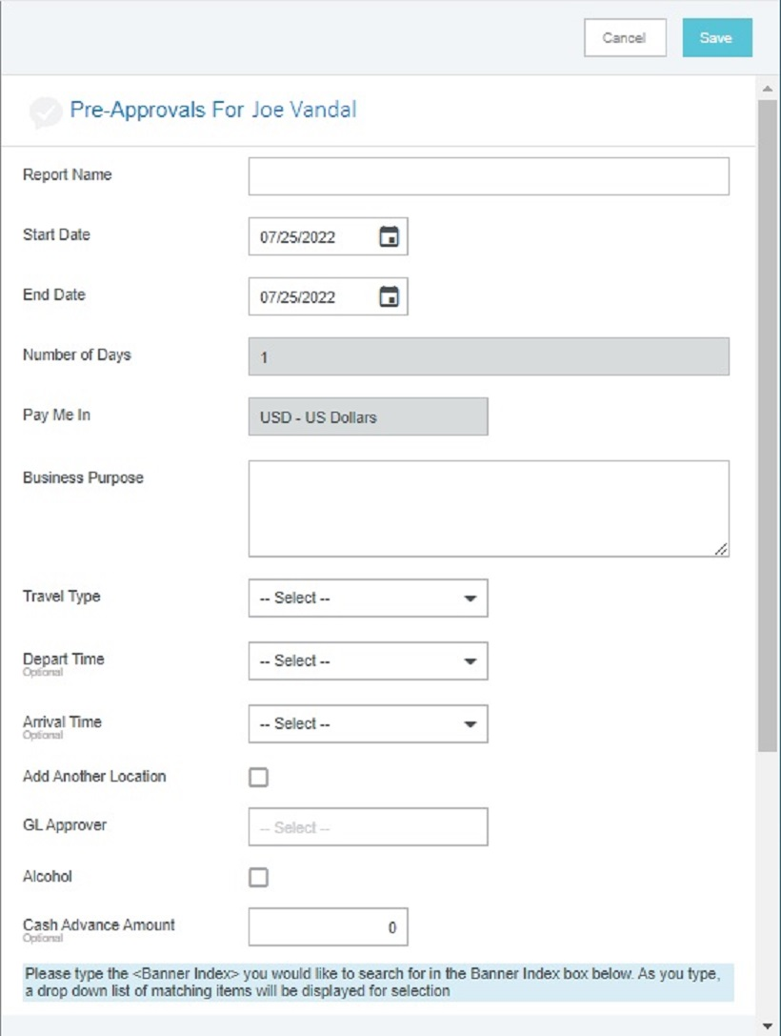
8-18-2022 A Bloomsburg
Chrome River Travel Pre-Approval (TRPA) Instructions
Filling out the form
Report name.
  Report names must start with "TRPA" and include:
    your last name
    your first initial
    your destination
    your purpose (if it will fit)
    the departure date or date range for the trip
    e.g. "TRPA J Vandal Boise,ID NRI 7.1-15.2022" or "TRPA_Vandal_J_Bend,OR_research_8-11-22"
  NB: there is a 45-character limit to the title.
  Blanket TRPAs are permissible but can only be made for a 90-day period, in a single state.
    e.g. "TRPA J Vandal IFC WA 7.1-9.30.22"
Start/end dates
  Start date is the date you leave on your trip; end date is the date you return.
  Add a day or two on either end of the trip in case of delays
Business purpose
  Enter where you are going and the business-related reason why. If you are traveling with others, list the names of the other travelers.
Notes:
Here's how you fill out the form.
The "report name" of the Travel Pre-Approval must always start with the letters T R P A.
The name must also include your last name and first initial, the trip destination – that is, the city and state - and either the departure date or the date range of the trip.
It is frequently helpful to include information about the purpose – one word, like "Research" or "Training" or the abbreviation of a conference, like "S A F" or "E I T I C" - but since there is a character limit in the name field, this might not fit.
When you enter the start and end dates of your trip, C N R Fiscal recommends that you add a couple days on either end, just in case your original travel dates change, or an unexpected event delays your return.
If your trip exceeds the listed travel dates by more than one day on either end, Accounts Payable will require a new T R P A for the trip.
If you are taking multiple small trips in the same area, you may create a blanket T R P A. By C N R policy, blanket T R P As can only cover a period of 90 days and travel in a single state. There is no special process to create a blanket T R P A. Simply enter the first date of the blanket travel period under start date, and the last date of the blanket travel period under end date.
The business purpose should include the who, what, where, and why of the trip.
Be concise but be specific.
Please include the names of all other travelers accompanying you on the trip.
For larger groups such as classes, contact C N R Fiscal for process details.

Slide 11
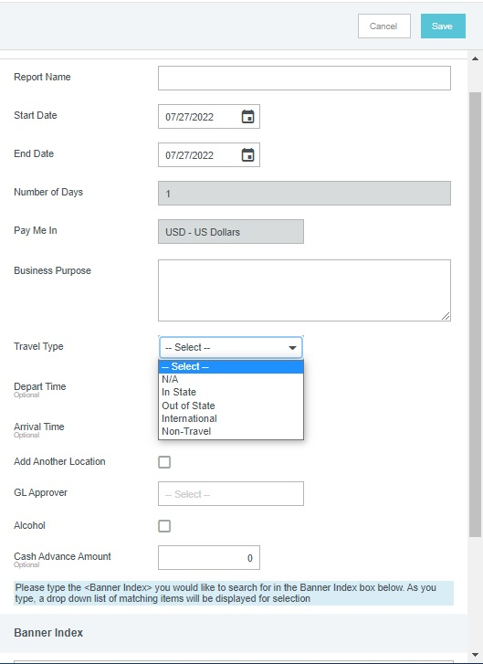
8-18-2022 A Bloomsburg
Chrome River Travel Pre-Approval (TRPA) Instructions
Filling out the form
4. Travel Type
  Choose "In state", "Out of State", or "International" from the drop-down menu.
  DO NOT select Non-Travel
  In-State travel must be on a different TRPA than Out-of-State travel.
  For blanket travel, create a separate TRPA for each state.
5. Departure/Arrival Time
  Ignore these
6. Add another location
  Click this to bring up a text box where you can enter an extra destination, if you are traveling to multiple locations on the trip.
7. GL Approver
  For CNR Travel on a grant index: Amy Huck
  For CNR Travel on non-grant index: Joseph Gordon Christensen
  For travel on a non-CNR index: Contact the college that controls the index.
Notes:
Your travel type will depend on where you go. Your options are in state, out of state, and international. Do not select "non-travel". Select "n/a" only if you yourself are not traveling, but you are paying for the lodging or airfare of another traveler.
It is not necessary to choose a departure or arrival time.
If you are traveling to multiple locations within a state, please list them, by clicking the "Add Another Location" box, and typing the name of the next destination in the field provided. Click the "Add Another Location" box again to list additional destinations.
For blanket travel, if you are traveling out of state, you must create a separate T R P A for travel in each other state.
The G L (General Ledger) approver is the highest college-level fiscal approver for travel.
This person will never be your supervisor or a faculty member.
The G L approver will always be fiscal staff.
If you are traveling on a non-C N R index, the G L approver will be fiscal staff from another college.
Contact that college to find out who the proper approver is.
If the G L Approvers listed in the instructions do not come up in the list, contact C N R Fiscal for the current names.

Slide 12
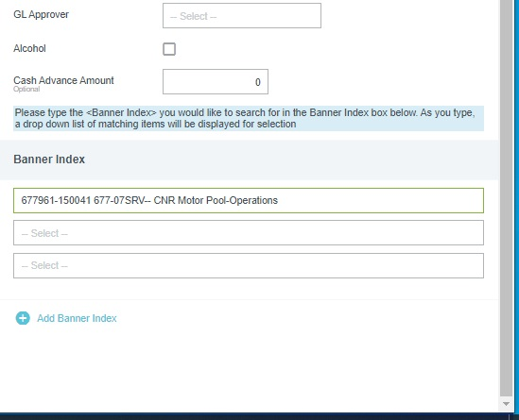
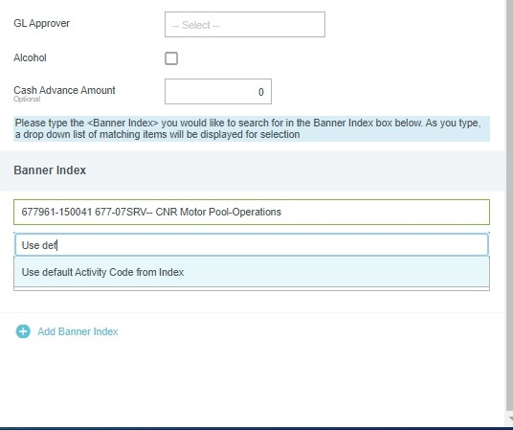
8-18-2022 A Bloomsburg
Chrome River Travel Pre-Approval (TRPA) Instructions
Filling out the form
8. Alcohol
  Talk to CNR Fiscal before clicking this
9. Cash advance
  Talk to CNR Fiscal before typing in this box
  Only for use by employees who don't have a p-card.
  Requires more advance notice than a regular TRPA
10. Banner index, Activity code, Location code
  Enter the six-digit index on which your travel will be paid.
  If you do not know your index, contact your supervisor.
  After you enter the index, two more fields will pop up: Activity Code and Location Code
  Enter "Use default" for both. Sometimes the default Activity Code will flood in automatically. If the Location Code floods in, delete and enter “leave location code blank”
  If you need to split the travel between two or more indexes, click the "+ Add Banner index" link
11. Click the "Save" button at the top of the
window.
111111-120000 677-00XXX-- Sample Index – do not use
111111-120000 677-00XXX-- Sample Index – do not use
Notes:
Your travel should not involve alcohol. If you think it should, contact C N R Fiscal before you click this.
If you are interested in a cash advance, be sure to contact C N R Fiscal to discuss the process BEFORE you submit. Travel with a cash advance requires significantly more advance notice than travel without a cash advance.
Remember that you must have the specific index number for the project to which your trip will be charged in order to complete the T R P A. Contact your supervisor if you do not know this number.
To fill in the "Activity Code" and "Location" boxes, you may either type in the specific activity code, if you know it, or you may type in "Use Default" and then select the "Use default Activity Code" option from the dropdown. "Use default" is the preferred option.
Always choose "Use Default" for the Location. If a location code floods in, delete it and type in "Leave Location code blank"
You may split your travel costs between two or more indexes by clicking on the "Add Banner Index" button.
Once you are done, click the "save" button at the top of the window.

Slide 13
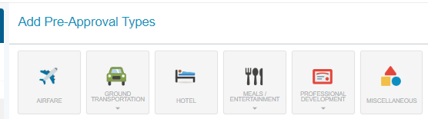
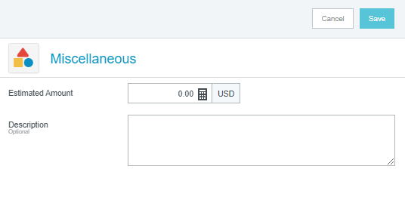
8-18-2022 A Bloomsburg
Chrome River Travel Pre-Approval (TRPA) Instructions
Add Preapproval Type
After you save, this screen will come up.
Select the "Miscellaneous" tile.
Enter an amount in the "Estimated Amount" field.
Choose an amount that you think will cover all your trip expenses, then add 30%.
Type what that will cover in the Description box, e.g. airfare, lodging, perdiem.
Click the "Save" button to add the amount to the TRPA
DO NOT ITEMIZE YOUR ESTIMATED EXPENSES.
Notes:
All T R P As must have an estimated amount for the trip, even if you do not plan to request reimbursement.
Travel expense estimations are to be added by clicking the "Miscellaneous" tile.
One dollar is the minimum amount that can be entered for the estimated cost.
Please use one dollar if you are not intending to request reimbursement.
Your estimate can be as high as all of your possible expenses plus thirty percent. Overestimating the cost is better than underestimating the cost.
Do not itemize the estimated cost for any reason.
Itemizing the estimate causes unnecessary work for the C N R Fiscal processors.

Slide 14
AFTER-THE-FACT TRPA
You did not create a TRPA before your trip
Your TRPA was not approved before your trip's start date
Your trip exceeded the dates listed on your TRPA, even for reasons out of your control
A TRPA is still required before you will be reimbursed and before your travel claim can be processed.
Fill out a Travel Pre-Approval Exception form, found on Accounts Payable's Travel website: https://www.uidaho.edu/dfa/finance/controller/accounts-payable/travel-services/travel-forms-and-policies
Have your supervisor sign the form
Attach the form to your new TRPA before submitting the TRPA
Notes:
T R P As are required before C N R can process any expenses for your trip.
In the event that there is no T R P A in place before your departure date, or your trip took longer than you estimated and you returned outside of the dates listed on the T R P A, you will be required to create and submit a new T R P A, as there is no way to change a T R P A after it has been submitted.
An after-the-fact T R P A requires additional paperwork, namely, the Travel Pre-Approval Exception Form, found on the Travel Forms and Policies page on Accounts Payable's website. If you are trying to submit a T R P A after your listed departure date, you will be unable to submit the T R P A unless this form is uploaded to Chrome River and attached to the T R P A.
To avoid this extra paperwork, please make sure to have your T R P A submitted well before your departure date.

Slide 15
International travel
To be completed in tandem with TRPA process
Timeline –
    Contact Dean of CNR to get approval memo or email (if under disease mitigation travel restrictions)
    Contact IPO for travel registration
    submit TRPA a minimum of 30 days before departure date.
Needed materials
    IPO travel registration confirmation email added to the TRPA
    Dean's approval email/memo added to TRPA (if travel restrictions are active)
    "Fly America" waiver for federal-grant travel if a foreign air-carrier is used
IPO contact instructions
  https://www.uidaho.edu/academics/ipo/ui-faculty-staff-opportunities/international-travel/international-travel-registration
  Email ipo@uidaho.edu
Notes:
If you are planning to travel internationally, you must follow all the instructions for a T R P A for domestic travel, with the addition of requirements unique to international travel.
International travel requires documentation of approval for the trip from the International Programs Office, and, if travel restrictions are in place to mitigate the spread of disease, an approval memo or email from the Dean of your college.
Those documents should be attached to the T R P A when you submit it, 30 days or more prior to your departure date.
If a trip is funded by a federal grant, you must use a U S airline, regardless of cost, if one is available.
In order to use a foreign carrier, you must complete a "Fly America Act" waiver and attach it to your T R P A as well.
If your trip does not meet the requirements for a "Fly America waiver", and you use a foreign carrier anyway, the airfare charges will be moved to your non-grant index.
If you do not have a non-grant index, you will be required to pay out-of-pocket for the airline charges.

Slide 16
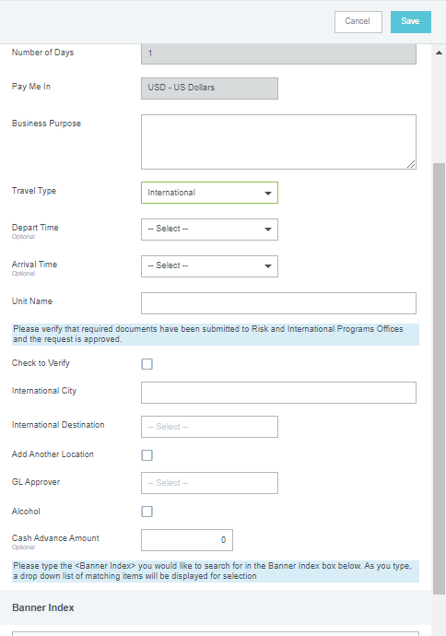
International travel
Travel Pre-Approval (TRPA)
Travel type: International
Unit: Your department.
  Enter the full name or abbreviation
Risk and IPO verification
  Attach IPO travel registration confirmation email
  Click the checkbox
International city
  Type in the city name
International destination
  Choose the country from the menu
Complete the rest of the form as usual
Notes:
When you select "International" as your travel type in the T R P A, several new fields will appear.
Unit refers to the department for which you are traveling.
Click the "Risk and International Programs Office verification" checkbox if you have attached the travel registration confirmation email from the International Programs Office
You will have to type in the name of the city to which you are traveling, but the name of the country can be chosen from the menu. If you are traveling to multiple foreign destinations click the "Add another location" box to add them. You will, however, only be able to choose the country.

Slide 17
Personal travel
If you include any personal travel days in your trip
All costs for the trip must be paid out-of-pocket first
Your p-card may not be used for airline or lodging costs
Reimbursement may be claimed only for the business-related expenses
Cost comparisons are required for any expenses (e.g.: airfare or ground transport) that may be affected by personal time on the trip
  "Cost comparisons" show what your trip would have looked like without the personal time.
  Get cost comparisons ahead of time - difficult to get afterwards
Notes:
The university will not pay for or reimburse you for any personal travel done before, after, or in the course of your business trip.
If you wish to include personal travel in your trip, you will not be allowed to use your p-card for airline or lodging costs.
You must pay out-of-pocket for all trip expenses, personal or business-related, and then seek reimbursement for the business-related expenses afterwards.
In order to make this possible, you must get cost comparisons for airfare, lodging, and other expenses, which show how the trip would have looked if your personal travel were not included.
Get these cost comparisons ahead of time, preferably as far in advance as when you submit your T R P A – airline and hotel websites are not set up to give you information about the past.

Slide 18
AFTER TRAVEL
Notes:
Next is what you need to do when you come back from your trip .

Slide 19

Post–Travel tasks
Collect all materials
Travel Claim Expense Form
  Index(es)
  Itemized Location and Per Diem amounts
  List of other travelers
Receipts
  Itemized receipts showing a zero balance
  Hotel guest folios
Cost comparisons
  For personal travel on business trip
SUBMIT all materials
Within two weeks of the end of travel
Or every month if out in the field for multiple months at a time.
Submissions after 60 days may count as taxable income
**It is optimal to go through the report and include all information prior to submission. Incomplete travel claims take longer to process and involve more work for both processor and traveler.
Notes:
When you return from your travel, collect all receipts and cost comparisons if needed, and fill out a Travel Claim Expense Form which can be found on the CNR Fiscal website and is hyperlinked in this slide.
Travel claims should be submitted as soon as possible after you return from your trip.
Within two weeks of the end of your trip is best.
This minimizes the likelihood that the project index on which you traveled will end before your travel can be charged to it.
If your trip lasts for multiple months, it is a good idea to submit a travel claim form at the end of each month, just to keep things current.
According to Accounts Payable, travel claims made more than 60 days after your trip may count as taxable income for you, which involves more paperwork. C N R Fiscal strongly advises that you get them get them done quickly.
Once you have the materials collected, please submit them to CNRFiscal@uidaho.edu as one email.

Slide 20
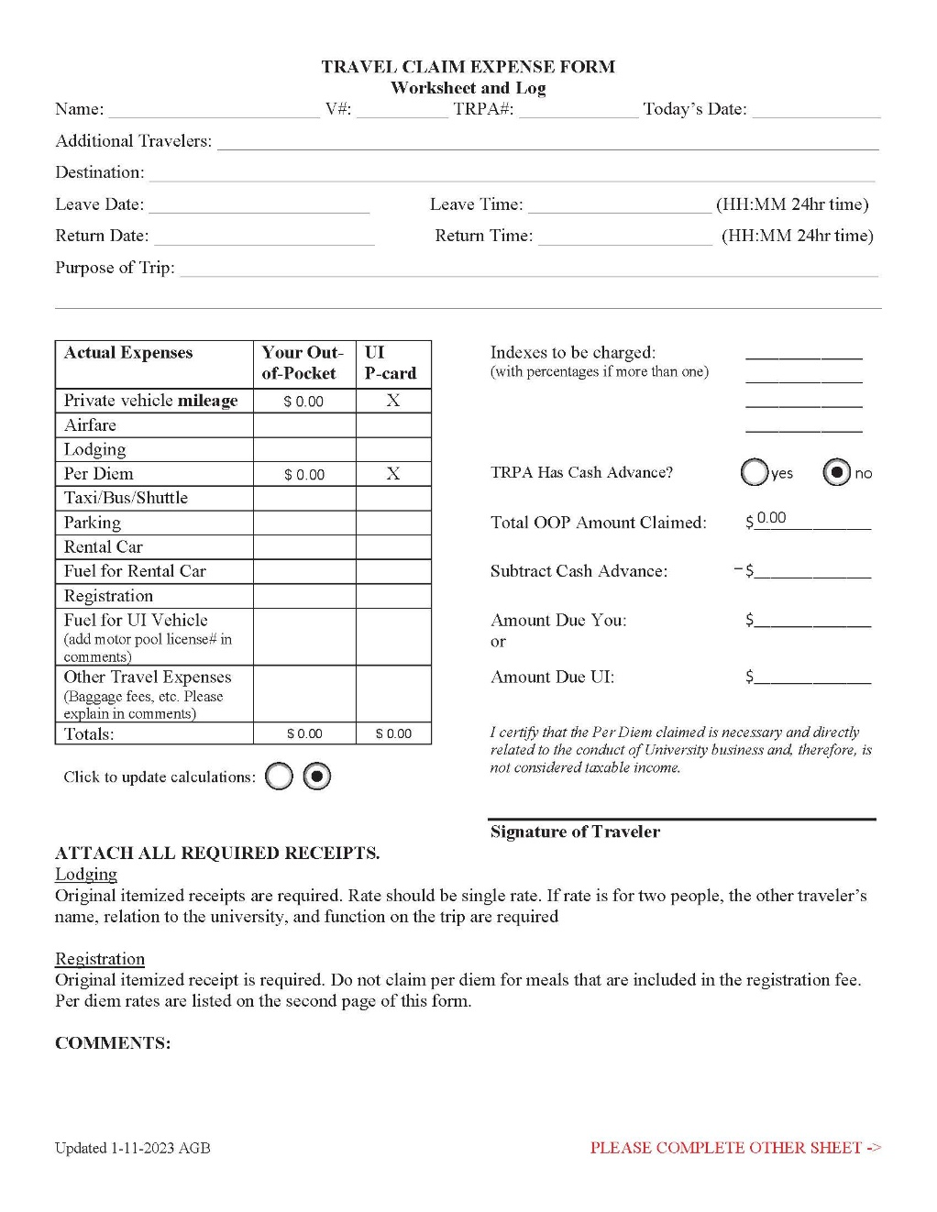
TRAVEL CLAIM EXPENSE FORM
Find the fillable "Travel Claim Form" PDF at
https://www.uidaho.edu/cnr/forms-resources/fiscal-hr-services
Required fields:
Name
V#
TRPA#: found in Chrome River under the Pre-Approval header
Today's date: the claim's submission date – within 15 days of end of travel
Destination: all locations traveled to
Leave Date/Time
Return Date/Time
Purpose of trip – same as what's on the TRPA
Index to be charged: if splitting charges, list all indexes and the amount or percentage to go on each
Optional fields:
Additional travelers – ignore if traveling alone. List all if traveling in company.
Notes:
The Travel Claim Expense Form has two sides.
Please fill out both sides before submitting the form.
The header portion requires your name and V number, the T R P A number, and the date you submit the claim.
If anyone else traveled with you, you should list them and their relation to the university.
The header also requires your destination or destinations, if you went several places, and the date and time you departed on your trip, as well as the date and time you returned.
If you are taking multiple trips on a blanket T R P A, please fill out a separate Travel Claim Expense Form for each trip.
The purpose of the trip should be the same as what you put in the T R P A, or should provide additional information if the purpose of the trip changed between the T R P A submission and the trip itself.

Slide 21
TRAVEL CLAIM EXPENSE FORM
Actual expenses table:
Columns for Out of Pocket (purchased with your money), and UI P-card (purchased with University money)
Private vehicle milage: auto calculates from mileage total on back page
Per Diem: auto fills from amounts on back page.
Gasoline for rental cars: fuel purchase for vehicles rented from a rental company (Enterprise, Hertz, etc)
Gasoline for UI Vehicles: fuel purchased for UI Motor Pool vehicles, out-of-pocket or on your own UI-issued pcard
  Never includes fuel purchased on a Motor Pool fleet card for MP vehicles
  MP Fleet receipts go to Motor Pool directly – never listed on travel claim.
Notes:
The "actual expenses" table has two columns, one for out of pocket expenses - that is, travel expenses purchased with your personal money – and U I P-Card – that is, expenses for which you used your university-issued purchasing card.
The "private vehicle mileage" and "Per diem" rows in these columns flood in amounts automatically, based on the itemized worksheet on the back page of the travel claim expense form. For this reason, please make sure that you are using the most current version of the Travel Claim Expense Form.
Amounts in the other rows must be typed in. This is a summary table, so enter the total amounts for each expense category for the trip, in the appropriate column.
If you use your personal vehicle on the trip, you will be reimbursed for mileage. You may not purchase fuel for your personal vehicle on your university purchase card. The university will not reimburse you for fuel for your personal vehicle.
If you use a vehicle rented from a rental agency, you may buy fuel for those either out of pocket or on your university p-card.
The "Gasoline for UI Vehicles" boxes are for fuel expenses for a CNR Motor Pool vehicle which you paid out of pocket, or which you paid with your personal UI Purchase card.
Fuel expenses paid with a Motor Pool Fleet Card should not be listed on this form.
Motor Pool Fleet Card receipts must be submitted to Motor Pool directly.

Slide 22
TRAVEL CLAIM EXPENSE FORM
Index to be charged:
List index(es) to which travel expenses will be charged
  For multiple indexes, list percentage or dollar amounts to go on each one.
Cash Advance and Out Of Pocket Amount:
Cash advance: if you requested one on your TRPA, click "yes", if not, click "no"
Total amount claimed: the total of all expenses incurred for the trip – auto-fills
Subtract cash advance: the amount you already received for the trip.
Amount due you: "your out-of-pocket" total from the table, less the amount of the cash advance, if the difference is positive. The university will pay you this money.
Amount due UI: "your out-of-pocket" total from the table, less the amount of the cash advance, if the difference is negative. You will pay the university this money.
Comments:
Enter exceptions to lodging or per diem amounts.
Enter extra information that will help explain odd claim charges
Notes:
The "indexes to be charged" section is where you will list the index or indexes from which the trip expenses will be paid.
List the six digit index number and either the percentage of the expense that should go on that index, or the dollar amount.
Percentages should add up to 100 percent. Dollar amounts should add up to the total of the trip expenses.
Choose the true option for whether you requested and received a cash advance.
The total Out-Of-Pocket amount claimed will automatically flood in from the "Your out of pocket" column total.
If you received a cash advance for the trip, subtract the amount of the cash advance from the total out of pocket amount. (If you did not get a cash advance, the amount subtracted will naturally be zero.)
If the difference between the total expenses and the cash advance is positive – that is, the trip expenses were greater than the cash advance amount – this will be the "amount due you" - that is, the amount you will be reimbursed for the trip.
If the difference between the total expenses and the cash advance is negative – that is, the trip expenses were less than the cash advance amount – this will be the "amount due U I" - that is, the amount you will have to repay the university for the trip.
Use the Comments box at the bottom to note any exceptions to the per diem or lodging amounts, such as "Lunch was provided on this day" or "I am not claiming per diem for this trip" or "I did not have any lodging costs for this night."
The comments box can also be used to note any other pertinent information that would help C N R Fiscal process your claim.

Slide 23
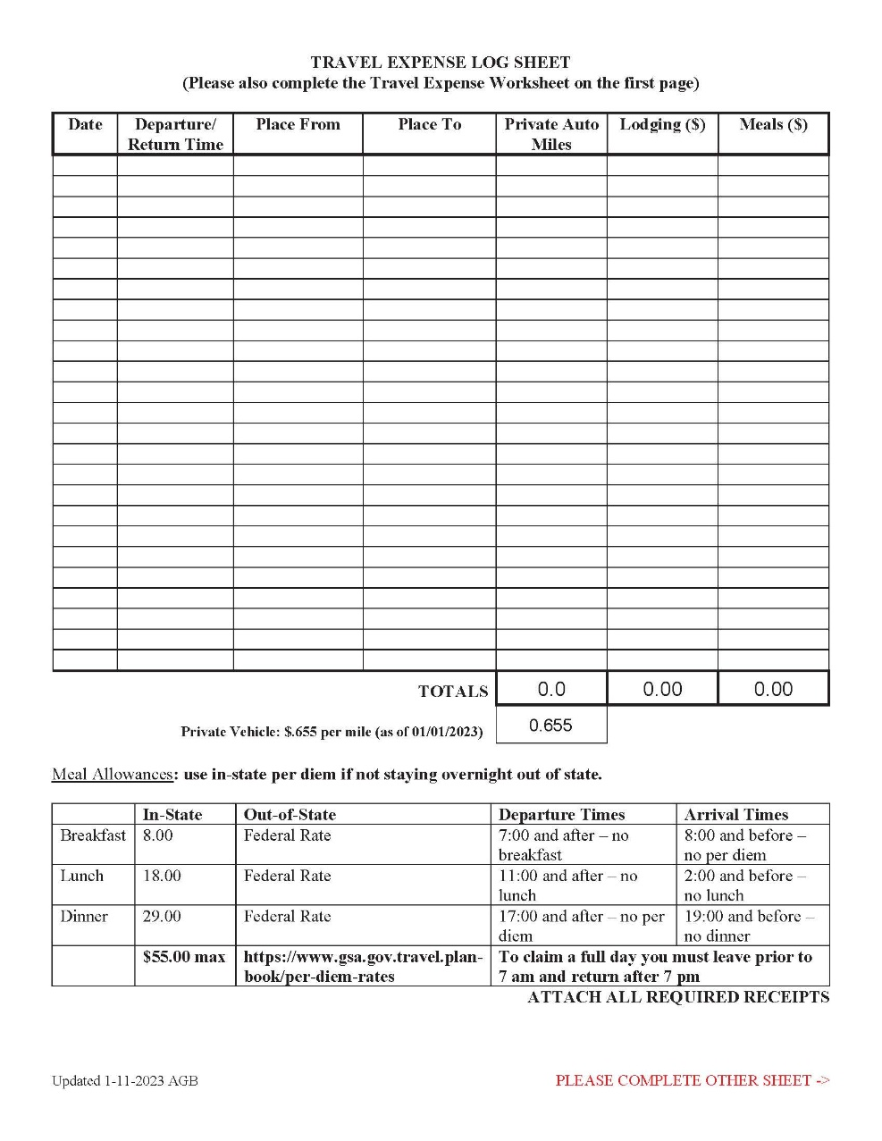
TRAVEL CLAIM EXPENSE FORM
Log Sheet:
Date: each leg of your trip, itemized
Departure/return time: the time of day you left or returned to each location
  Determines whether you are eligible for meals.
Place from: where you left at a given time
Place to: where you arrived at a given time
Private Auto miles: distance driven in personal vehicle during trip leg
  Column auto-sums miles for the trip
  Auto-calculates total reimbursement from miles recorded and milage rate
  Count mileage from duty station, not home
Lodging: cost for that night
  Split lodging total between OOP and UI on front page, if applicable
Meals ($):
  In-state per meal amounts listed in table.
  Must travel >50 miles from duty station to claim.
  Out-of-state meal amounts, per federal reimbursement
  Column auto-sums total for trip
  Make notes of differences in comments
Notes:
The travel expense log sheet is for a day-by-day account of your mileage (for personal vehicles), lodging and per diem.
List each day of your trip separately.
If you traveled to multiple destinations in one day, list the cities or field locations in the order in which you visited them. It is helpful but not required for you to list the time at which you departed from or arrived at each.
If your destination had no address or is out in the woods, include a map so that CNR Fiscal processors can ensure accurate mileage.
Enter mileage in the "private auto miles" column only if you used a private vehicle to travel. Motor Pool and rental vehicles are not eligible for mileage reimbursement.
Mileage is counted from your duty station, which is your official work location according to the University's employment system. Use your physical work address when calculating mileage.
Enter the cost of lodging for each night of your stay. Make sure that it matches the cost from your camping receipt or hotel guest folio.
If you paid for all your lodging out of pocket, put the total in the out of pocket column on the front of the claim form.
If you paid for all of your lodging by p-card, list that amount in the U I P-card column on the front.
If you paid for your lodging with a mix of out-of-pocket and U I pcard, split the totals into the appropriate categories, and put them in the matching columns on the front of the claim form.
Enter the total amount of per diem you wish to claim for a day in the "meals" column. Your departure and return time will determine which meals can be claimed. Specific times are listed in the per-diem rate table at the bottom of the page.
The in-state Per diem rates paid by the University of Idaho are also listed in the table.
University of Idaho pays out-of-state per diem according to the federal rates listed on the Government Services Administration website.
Chrome River will automatically calculate the proper per diem based on the locations entered in the worksheet.
If you are not claiming the full amount of allowable per diem, please make sure to subtract the appropriate amount from your daily total. Add a note in the comments section on the first page, so that C N R Fiscal does not contact you to ask if you really meant to claim the amount you listed.

Slide 24
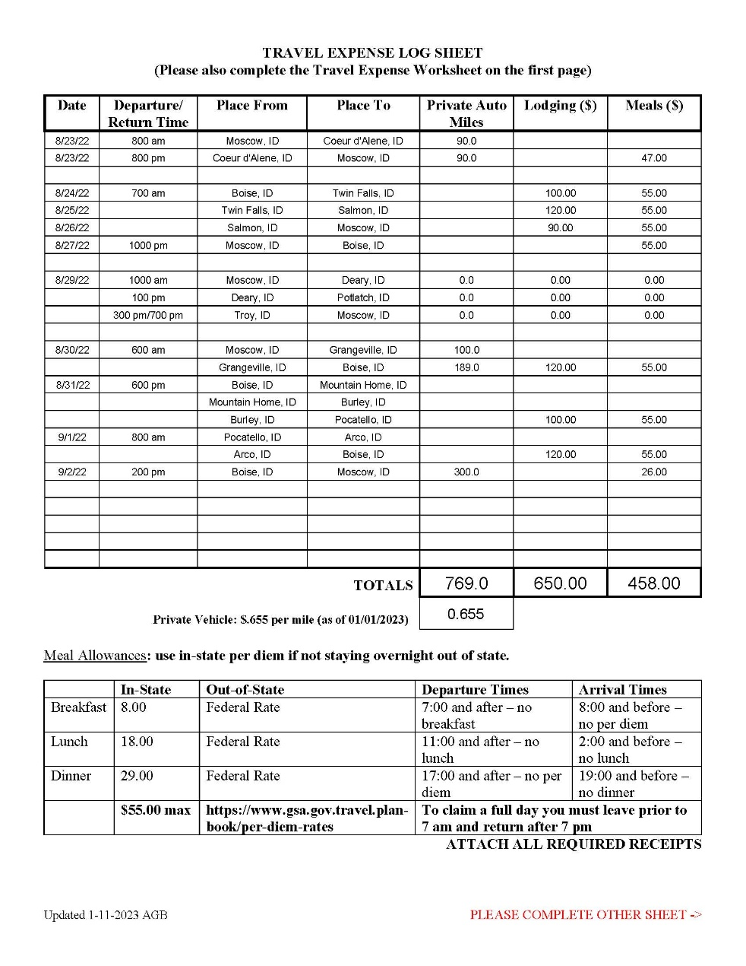
TRAVEL CLAIM EXPENSE FORM
Log Sheet, examples:
Example 1:
  One-day trip from Moscow to Cd'A.
  Private vehicle: each leg of tip itemized
  Not overnight, so no lodging
  Left after 7 am, so claims only lunch and dinner
  Lists arrival time in Moscow, not departure time from Cd'A
Example 2:
  Four-day trip, stays in a different city each night
  Uses either motor pool or rental vehicle, so no mileage
  No lodging amount for final day, because traveler is home
  Full per diem for all four days, departure from duty station was 7 am or earlier, return to duty station was 8 pm or later.
Example 3:
  One-day trip, multiple destinations
  Departure time from each location listed
  Departure and arrival time for final locations noted at end of day.
  Didn't use private vehicle, so no milage
  Didn't stay over-night, so no lodging
  Didn't travel >50 miles from duty station, so no per diem
1
2
3
Notes:
Here are some examples of how to complete the travel expense log sheet. All of the examples given are acceptable ways to complete the log sheet.
Example 1 is a one day trip from Moscow to Coeur d'Alene, ID. Each leg of the trip – outbound and return – is listed on a separate row. The traveler used a private vehicle to travel, so the mileage for each leg of the trip is also listed separately. If these were the only items listed on the log sheet, the mileage would be automatically added up for a total of 180 miles. Since the trip is only a day trip, there is no lodging cost. Since the traveler departed after 7 am, the traveler cannot claim per diem for breakfast. The traveler returned after 7 pm, however, so is eligible to claim both lunch and dinner per diem.
Example 2 is a four day trip. Each night of the trip has a different destination. The traveler has only listed the departure time from the duty station, as well as the return time to the duty station. A motor pool or rental vehicle was used for travel, so there is no mileage listed. Lodging costs for the three nights are listed in the appropriate row. There is no lodging cost for the fourth night, as the traveler is home. Since the traveler departed at or before 7 am on the first day, and returned after 7 pm on the last day, the traveler may claim full per diem for all four days.
Example 3 is a one day trip with multiple destinations. The traveler has listed departure times from all locations as well as a return time in the last row. Mileage is not listed, meaning the trip was in a motor pool or rental vehicle. The one day trip means that there are no lodging expenses. The traveler cannot claim per diem for this trip, as all of the destinations are less than 50 miles away from the traveler's duty station.

Slide 25
TRAVEL CLAIM EXPENSE FORM
Log Sheet, examples:
Example 4
  Multiple day trip, multiple destinations, multiple modes of travel
  Day 1:
    Duty station departure time listed
    Departure time from duty station listed
    Private vehicle miles listed for each leg of day's travel
    Lodging listed at end of day's travel
    Per diem amount listed at end of day's travel
  Day 2, day 3:
    Multiple destinations with only first departure time for each day listed
    Traveler used rental or Motor Pool vehicle, so no mileage
    Lodging and per diem cost listed at end of each day
    Full per diem claimed, because traveler has not returned to duty station, regardless of morning start time.
  Day 4:
    Only arrival time at duty station listed
    Traveler used private vehicle again, so mileage is listed, and had no intermediate destinations
    Per diem, based on arrival time, is breakfast and lunch – not eligible to claim dinner for that day.
4
Notes:
Example 4 is a multiple-day, multiple-destination trip during which both private and non-private vehicles are used.
On day one, the trip is split into two legs – one from Moscow to Grangeville, and one from Grangeville to Boise. This indicates that the traveler spent time doing business in Grangeville. Mileage for this leg is listed separately from the mileage in the second leg. Mileage for the second leg from Grangeville to Boise is listed in the next row, and since this is the final segment of travel for the day, the lodging and per diem amounts are also listed in this row.
Days two and three are both days with multiple destinations, and the departure times for the beginning of each day are listed. Day two ends in a different city from day one, and day three sees the traveler back in Boise. Arrival and departure times are not listed for any of the destinations on those days. The traveler did not use a private vehicle to travel on those days, so no miles are entered in the "private auto miles" column. Lodging and per diem amounts are listed on the last row for each date.
Day four is travel from Boise back to Moscow with no work stops in between. Only the arrival time is listed. The traveler is back in the private vehicle, so the mileage for the day is listed in the "private auto miles” column. Since the traveler is home at the end of the day, there is no lodging cost, and since the traveler arrived before 7 pm, dinner per diem cannot be claimed.

Slide 26
submitting materials
Travel Claim Submission
Travel Expense Claim form is fillable PDF – can be done on the computer
    If done on paper, scan Travel Expense form to PDF OR take a really good picture of each page, once completed
Scan or digitally photograph all receipts and supporting documents
    Put one receipt for each photo or page of scan - Do not put multiple receipts in one image
    Photos must be clear and legible, showing the entirety of the receipt.
    Name receipt file with transaction date, merchant name, payment amount
    Position credit card slips on the matching invoice so that all the printing on the invoice is visible.
Collate all documents
    in one multi-page PDF (print to PDF to reduce file size if needed) OR
    in one email, OR
    Upload directly to Chrome River
Email document to cnrfiscal@uidaho.edu
If uploaded directly to Chrome River, email CNRfiscal@uidaho.edu to notify fiscal processors of pending travel claim
CNR Fiscal prioritizes travel claims in processing but expect delays if claim form or receipts are inadequate, absent, or incomplete.
Notes:
The Travel Claim Expense Form is a fillable PDF that can be completed in the computer. C N R Fiscal recommends that travelers fill it out that way.
If you choose to print it and complete it on paper, you will have to calculate milage reimbursement and per diem totals manually.
To submit receipts, you will need to scan or digitally photograph the receipts. Please make sure that there is only one receipt per image.
If you have an invoice and a credit card slip for a single transaction, make sure the credit card slip does not hide any portion of the print on the invoice.
Once the form is completed, sign it, add the receipts and other supporting documents to it, and email it to cnrfiscal@uidaho.edu.
C N R Fiscal prefers to receive travel claims as one, multipage P D F document. If the single PDF document is greater than 10 Megabytes in size, you can reduce the file size by opening the document's print settings, selecting "Print to PDF“, and printing it.
The file name should contain the same information as the T R P A title for the trip.
You may also send the claim form and all receipts, attached to the same email, if it will not work to send them as one document. Receipt file names should include the transaction date, the merchant name, and the amount of the transaction.
Or you may upload all documents directly to Chrome River. If you upload your documents directly to Chrome River, you must email C N R Fiscal to notify them that your documents are there and need attention.
C N R Fiscal does not receive notification from Chrome River that documents have been uploaded, so failure to notify C N R Fiscal will result in extensive delay in processing your claim.

Slide 27
Miscellaneous information
Forms and instructions for College of Natural Resources HR, Travel, and P-cards are on the CNR Fiscal website:
        https://www.uidaho.edu/cnr/forms-resources/fiscal-hr-services Bookmark it, refer to it often
Conference Registrations, Field and Research Supplies, and Shipping are NOT travel expenses:
    Submit information for these separately
      UI P-card Log: https://www.uidaho.edu/-/media/UIdaho-Responsive/Files/cnr/downloads/fac-staff-forms/Purch-Card-Trans-Log-form.pdf
      Out of Pocket purchase log: https://www.uidaho.edu/-/media/UIdaho-Responsive/Files/cnr/downloads/fac-staff-forms/Personal-Purchases-Log-form.pdf
      If membership is not included in the conference registration, you must fill out and submit an individual Membership Approval Request https://www.uidaho.edu/-/media/UIdaho-Responsive/Files/division-of-finance-and-administration/finance/Controller/accounts-payable/forms/membership-approval-request-form-oct.pdf
Car Rentals: UI contract with Hertz and Enterprise (includes Alamo and National)
    https://www.uidaho.edu/dfa/finance/controller/accounts-payable/travel-services/transportation
    Don’t purchase extra insurance, UI account carries these
Personal Account Receivable (personal AR): Unallowable expenses that have been put on a UI purchasing card will be moved to your personal account and will need to be paid in person at the UI Bursar.
Other information including links to University policies are available at the Accounts Payable Form and Documents website: https://www.uidaho.edu/dfa/finance/controller/accounts-payable/ap-forms
Notes:
This slide contains links to additional information and forms that may be helpful to you.
All CNR Fiscal travel and p-card forms, as well as Human Resources information, can be found on the CNR Fiscal website.
Please note that conference registrations, field and research supplies, and shipping costs are not travel expenses, and should not be included on your travel claim form.
Non-travel receipts and transactions should be submitted separately. A U I pcard transaction log and an out-of-pocket/personal purchases log are available on the C N R Fiscal website.
Membership fees cannot be purchased on a U I Pcard unless they are part of the registration fees for a conference. If you must purchase a membership separately in order to join a conference, you must fill out and submit an Individual Membership Approval Request form. The form must be signed by you and your dean or department chair.
When you rent a car, if possible use the companies with which the University has a contract. The rate will be less than what you would pay at another company. Make sure to specify that you are renting for the University of Idaho. You will have to pay for rental amounts in excess of the University's rental contract.
If you use your U I P-card to purchase something that is not allowed, the expense will be transferred to your personal AR – your account with the University – and you will be required to reimburse the university for the purchase.
The Accounts Payable Forms and Documents website also has other information about Chrome River, links to University travel and p-card policy, and a list of standards that receipts must meet in order to be accepted.

Slide 28

Wiser now are you
Notes:
This concludes the C N R Chrome River Travel Training.
If you have any questions about any of the information on this presentation, please contact C N R Fiscal.

